Slide 1
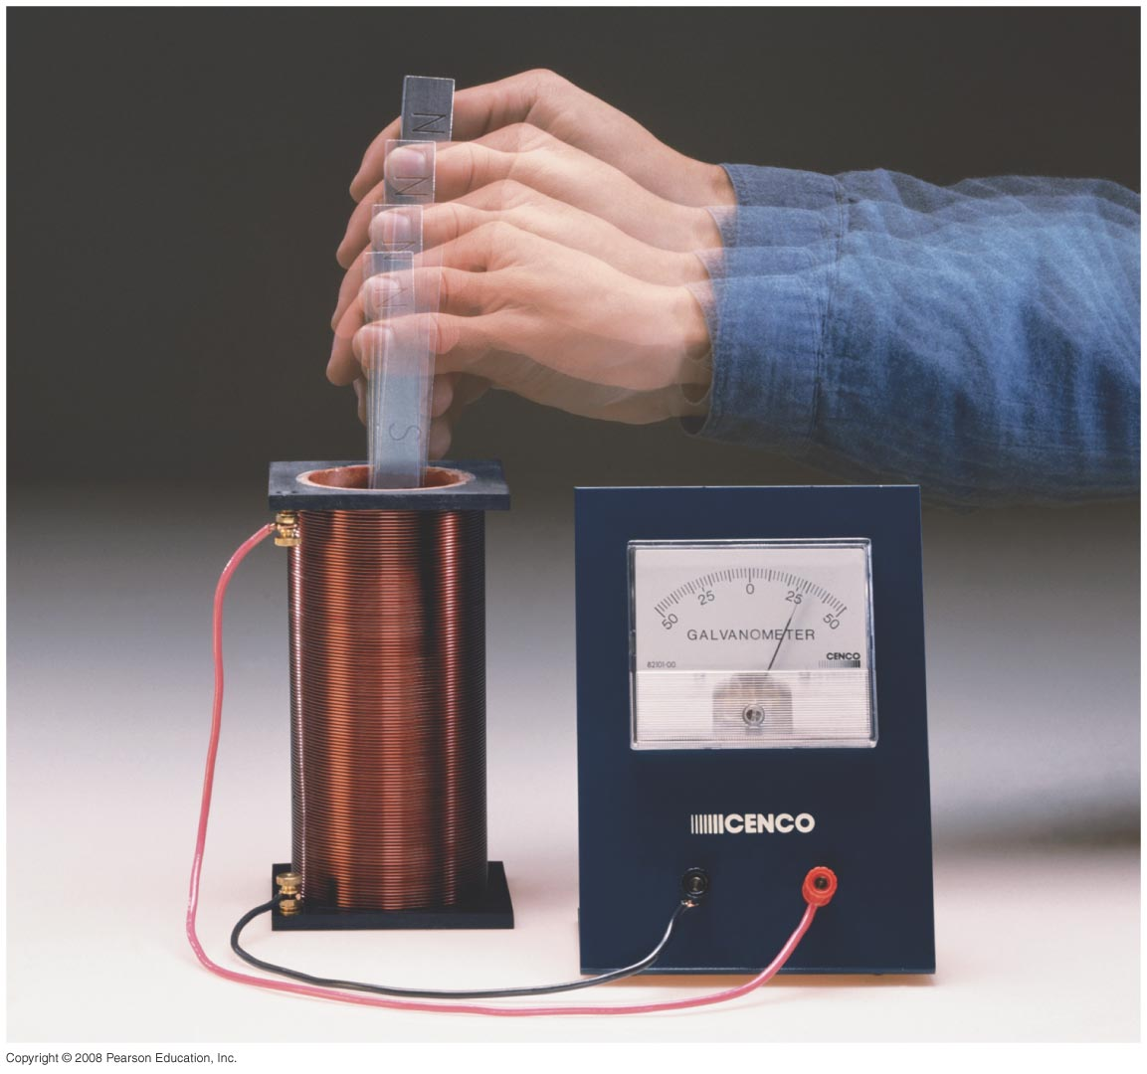
Chapter 29:Electromagnetic Induction and Faraday’s Law
Study Guide posted, exam on Friday April 5th
Quiz on Friday
Notes:
Chapter 29 opener. One of the great laws of physics is Faraday’s law of induction, which says that a changing magnetic flux produces an induced emf. This photo shows a bar magnet moving inside a coil of wire, and the galvanometer registers an induced current. This phenomenon of electromagnetic induction is the basis for many practical devices, including generators, alternators, transformers, tape recording, and computer memory.

Slide 2
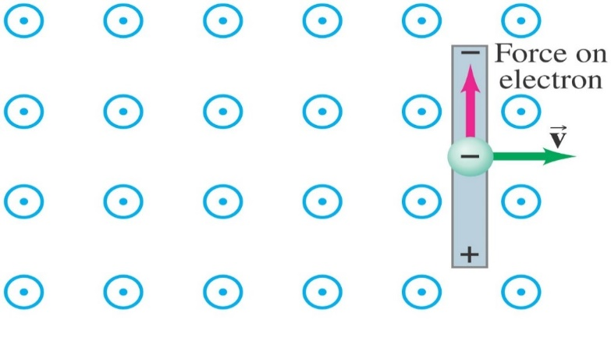
29-3 EMF Induced in a Moving Conductor
The induced current is in a direction that tends to slow the moving bar – it will take an external force to keep it moving.
(q is negative (electron)
F_{B1} =qV$×$B
F_{B2} =I$ℓ×$B
I
E
F_{e} =qE
Force slowing down the motion of the bar
Notes:
Figure 29-12b. Magnetic Upward force on an electron in the metal rod (moving to the right) due to B pointing out of the page.

Slide 3
29.3 Motional EMF
Moving rod in B-Field --> Electrons experience F_{B}
2. electrons move in the direction of F_{B} creating a charge separation in the metallic bar and E-field is created
3. Electric Force F_{E} balances F_{B}
F_{E}
+
L
B
equilibrium
E
-
v
F_{B}
-
Notes:
3

Slide 4
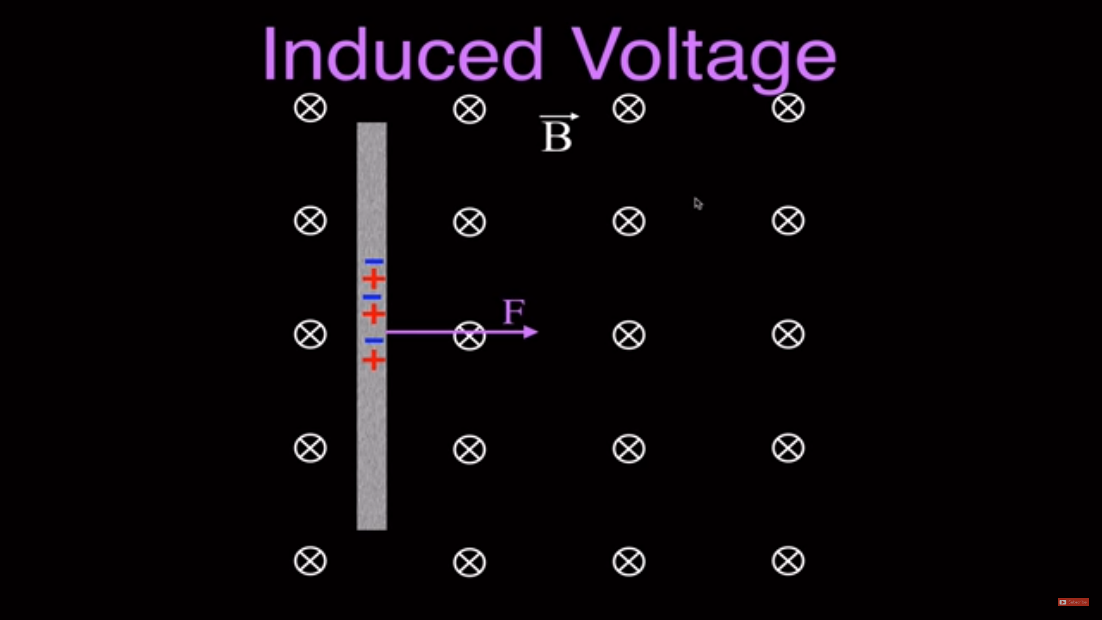
29.3 Motional EMF
Please watch the following video on the Motional EMF, this example uses positive charges q,
in the next examples electrons are used.
When talking about the Lorentz force in the video, he means the magnetic force $\vec{F}$=q $\vec{v}×\vec{B}$.
https://www.youtube.com/watch?v=PqfxMWBe4PI&list=PLcJ1NYursFxhX2lZLeJP-IcwiQlrwz3Sw

Slide 5
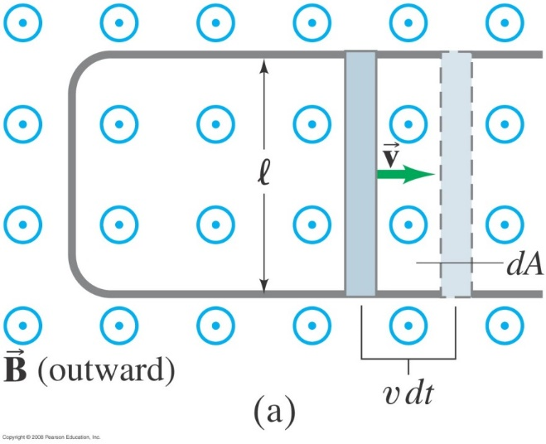
29-3 EMF Induced in a Moving Conductor
Example 29-8: Force on the rod.
To make the rod move to the right at speed v, you need to apply an external force on the rod to the right. (a) Explain and determine the magnitude of the required force. (b) What external power is needed to move the rod?
Notes:
Solution: a. The external force needs to be equal and opposite to the magnetic force (IlB) if the rod is to move at a constant speed. I = Blv/R, so F = B²l²v/R.
b. The external power is Fv = B²l²v²/R, which is equal to the power dissipated in the resistance of the rod (I²R).

