Slide 1
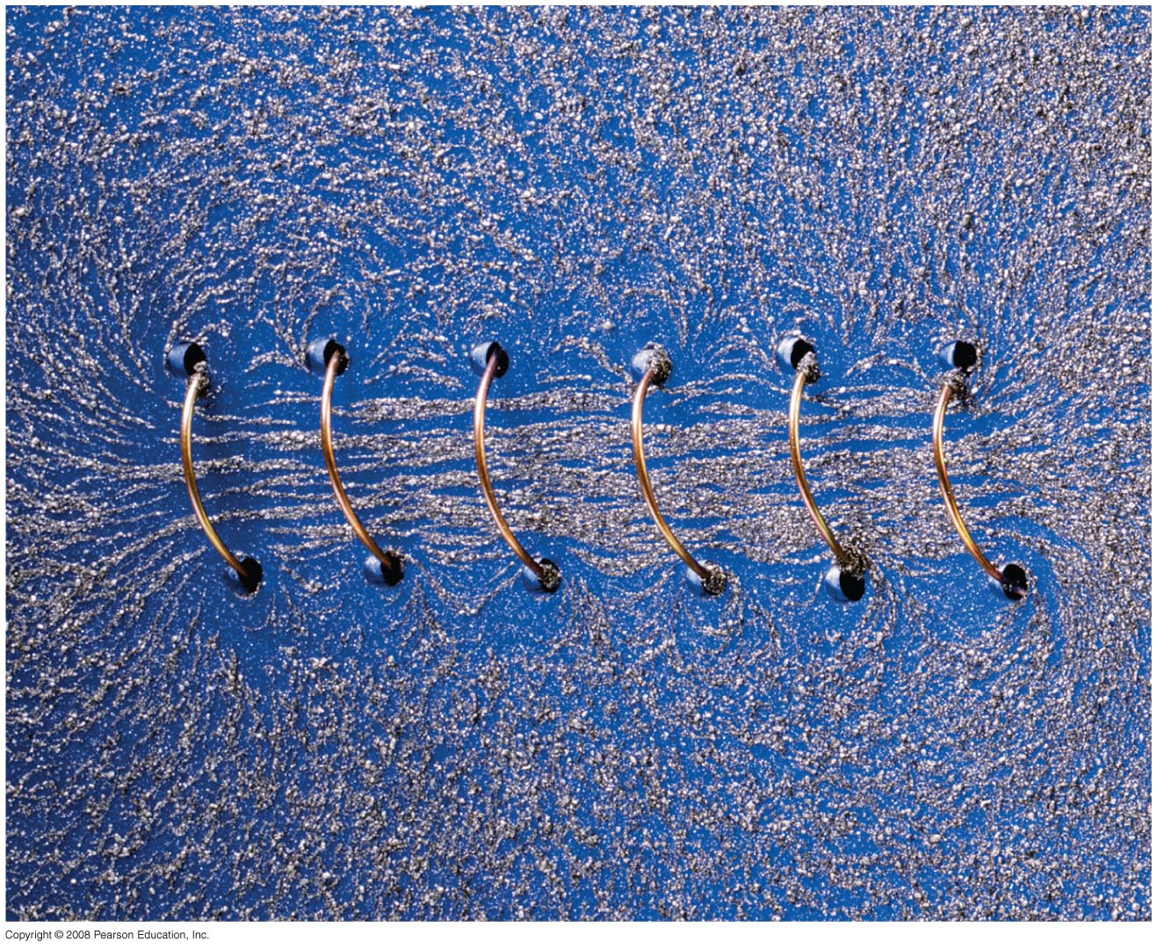
Chapter 28 Sources of Magnetic Field
HW 4: Chapter 26, Pb.11,Pb.18, Pb.28, Pb.32, Pb.50, Pb.51 due on Wednesday, March 20
Study Guide posted, exam on Friday April 5th
Notes:
Chapter 28 opener. A long coil of wire with many closely spaced loops is called a solenoid. When a long solenoid carries an electric current, a nearly uniform magnetic field is produced within the loops as suggested by the alignment of the iron filings in this photo. The magnitude of the field inside a solenoid is readily found using Ampère’s law, one of the great general laws of electromagnetism, relating magnetic fields and electric currents. We examine these connections in detail in this Chapter, as well as other means for producing magnetic fields.

Slide 2
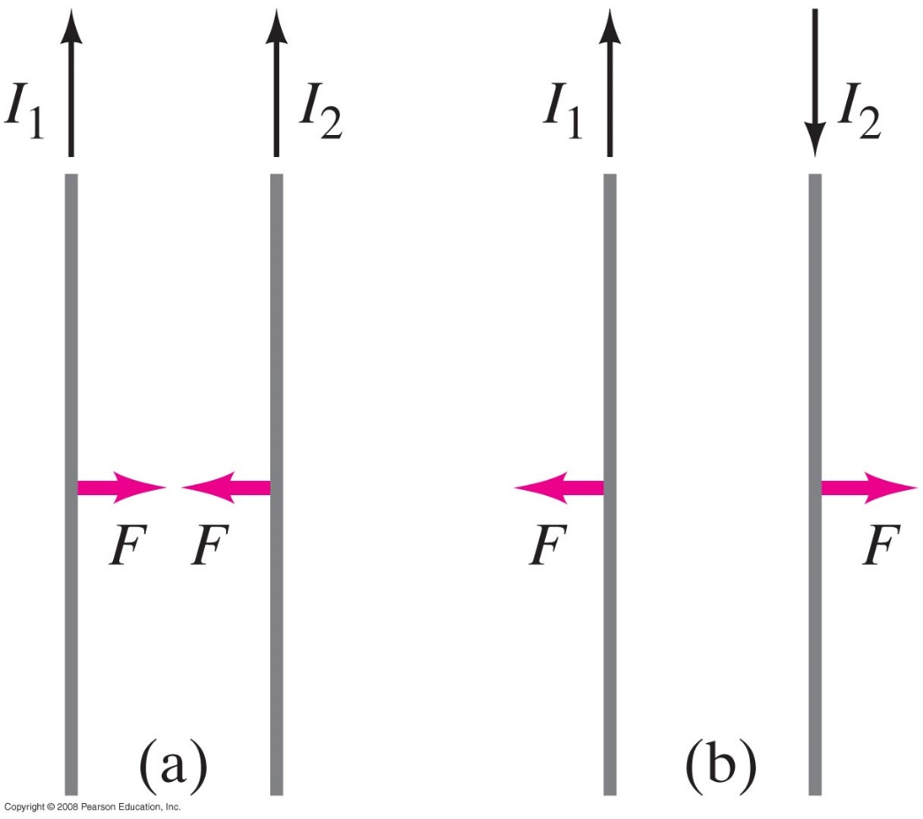
28-2 Force between Two Parallel Wires
Parallel currents attract; antiparallel currents repel.
Notes:
Figure 28-6. (a) Parallel currents in the same direction exert an attractive force on each other. (b) Antiparallel currents (in opposite directions) exert a repulsive force on each other.

Slide 3
28-2 Force between Two Parallel Wires
Example 28-4. Force between two current-carrying wires.
The two wires of a 2.0-m-long appliance cord are 3.0 mm apart and carry a current of 8.0 A dc. Calculate the force one wire exerts on the other.
Notes:
Solution: F = 8.5 x 10⁻³ N, and is repulsive. Appliances powered by 12V dc current are marketed to truckers, campers, people running on solar power (especially off-grid), among others.

Slide 4
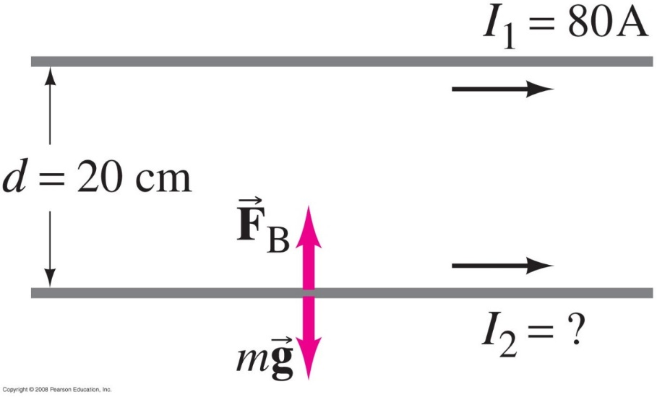
28-2 Force between Two Parallel Wires
Example 28-5: Suspending a wire with a current.
A horizontal wire carries a current I₁ = 80 A dc. A second parallel wire 20 cm below it must carry how much current I₂ so that it doesn’t fall due to gravity? The lower wire has a mass of 0.12 g per meter of length.
Notes:
Solution: The magnetic force due to the current in the wire must be equal and opposite to the gravitational force on the second wire. We need a definite length of wire, as the forces on an infinitely long wire will be infinite; choose 1 meter for simplicity. Substitution gives I₂ = 15 A.

Slide 5
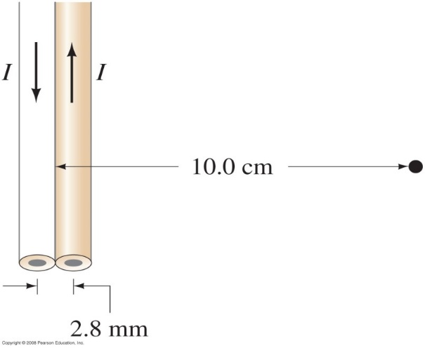
Problem 14
14. (II) A long pair of insulated wires serves to conduct 28.0 A of dc current to and from an instrument. If the wires are of negligible diameter but are 2.8 mm apart, what is the magnetic field 10.0 cm from their midpoint, in their plane (Fig. 28–36)? Compare to the magnetic field of the Earth (5$×{10}^{−5}$T).

Slide 6
28-3 Definitions of the Ampere and the Coulomb
The ampere is officially defined in terms of the force between two current-carrying wires:
One ampere is defined as that current flowing in each of two long parallel wires 1 m apart, which results in a force of exactly 2 x 10⁻⁷ N per meter of length of each wire.
The coulomb is then defined as exactly one ampere-second.

Slide 7
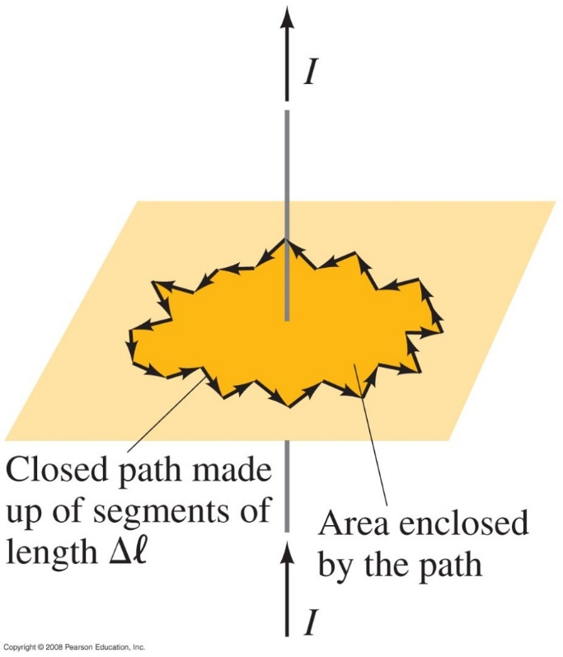
28-4 Ampère’s Law
Ampère’s law relates the magnetic field around a closed loop to the total current flowing through the loop:
This integral is taken around the edge of the closed loop.
Notes:
Figure 28-8. Arbitrary path enclosing a current, for Ampère’s law. The path is broken down into segments of equal length Δl.

Slide 8
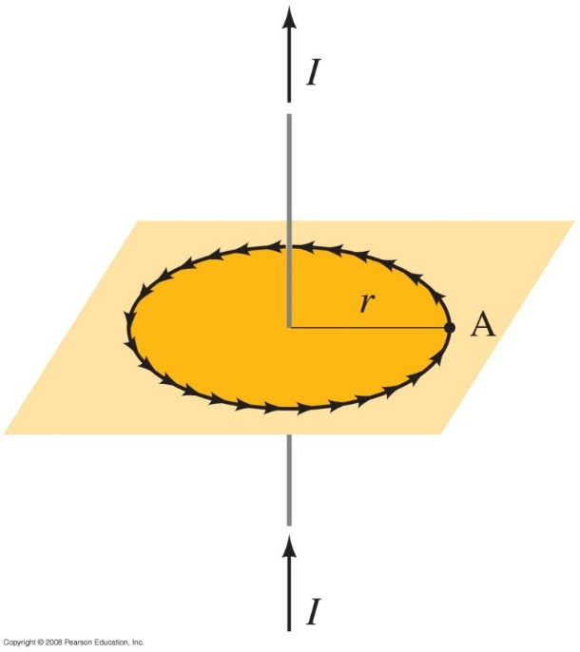
28-4 Ampère’s Law
Using Ampère’s law to find the field around a long straight wire:
Use a circular path with the wire at the center; then B is tangent to at every point.
The integral then gives
Notes:
Figure 28-9. Circular path of radius r.

Slide 9
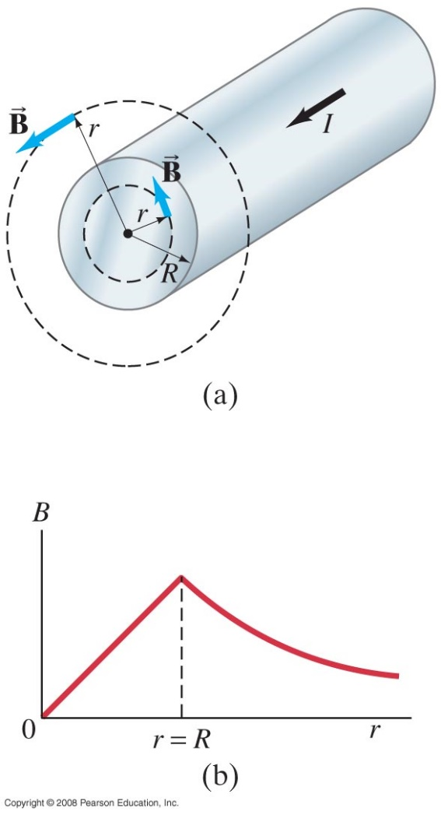
28-4 Ampère’s Law
Example 28-6: Field inside and outside a wire.
A long straight cylindrical wire conductor of radius R carries a current I of uniform current density in the conductor. Determine the magnetic field due to this current at (a) points outside the conductor (r > R) and (b) points inside the conductor (r < R). Assume that r, the radial distance from the axis, is much less than the length of the wire. (c) If R = 2.0 mm and I = 60 A, what is B at r = 1.0 mm, r = 2.0 mm, and r = 3.0 mm?
Notes:
Solution: We choose a circular path around the wire; if the wire is very long the field will be tangent to the path.
a. The enclosed current is the total current; this is the same as a thin wire. B = μ₀I/2πr.
b. Now only a fraction of the current is enclosed within the path; if the current density is uniform the fraction of the current enclosed is the fraction of area enclosed: I_{encl} = Ir²/R². Substituting and integrating gives B = μ₀Ir/2πR².
c. 1 mm is inside the wire and 3 mm is outside; 2 mm is at the surface (so the two results should be the same). Substitution gives B = 3.0 x 10⁻³ T at 1.0 mm, 6.0 x 10⁻³ T at 2.0 mm, and 4.0 x 10⁻³ T at 3.0 mm.

Slide 10
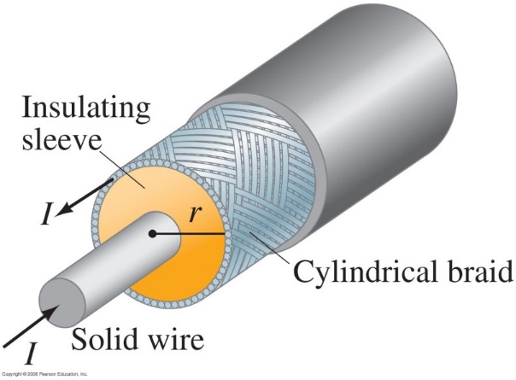
28-4 Ampère’s Law
Conceptual Example 28-7: Coaxial cable.
A coaxial cable is a single wire surrounded by a cylindrical metallic braid. The two conductors are separated by an insulator. The central wire carries current to the other end of the cable, and the outer braid carries the return current and is usually considered ground. Describe the magnetic field (a) in the space between the conductors, and (b) outside the cable.
Notes:
Solution: a. Between the conductors, the field is solely due to the inner conductor, and is that of a long straight wire.
b. Outside the cable the field is zero.

Slide 11
28-4 Ampère’s Law
Solving problems using Ampère’s law:
Ampère’s law is only useful for solving problems when there is a great deal of symmetry. Identify the symmetry.
Choose an integration path that reflects the symmetry (typically, the path is along lines where the field is constant and perpendicular to the field where it is changing).
Use the symmetry to determine the direction of the field.
Determine the enclosed current.

Slide 12
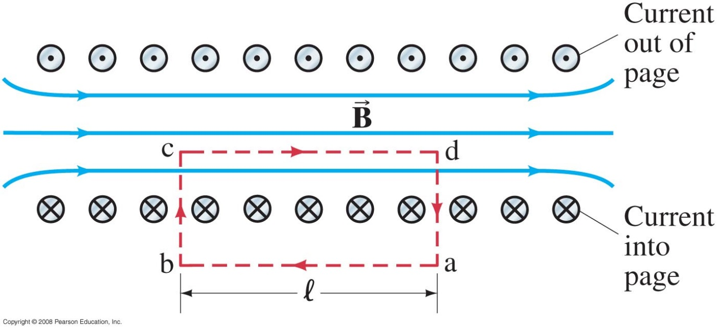
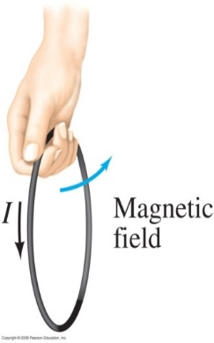
28-5 Magnetic Field of a Solenoid and a Toroid
A solenoid is a coil of wire containing many loops. To find the field inside, we use Ampère’s law along the path indicated in the figure.
Notes:
Figure 28-16: Cross-sectional view into a solenoid. The magnetic field inside is straight except at the ends. Red dashed lines indicate the path chosen for use in Ampère’s law.

Slide 13
28-5 Magnetic Field of a Solenoid and a Toroid
The magnetic field is zero outside the solenoid, and the path integral is zero along the vertical lines, so the field is
(n is the number of loops per unit length)
N: number of Turns
l: length

Slide 14
28-5 Magnetic Field of a Solenoid and a Toroid
Example 28-9: Field inside a solenoid.
A thin 10-cm-long solenoid used for fast electromechanical switching has a total of 400 turns of wire and carries a current of 2.0 A. Calculate the field inside near the center.
Notes:
Solution: Substitution gives B = 1.0 x 10⁻² T.

Slide 15
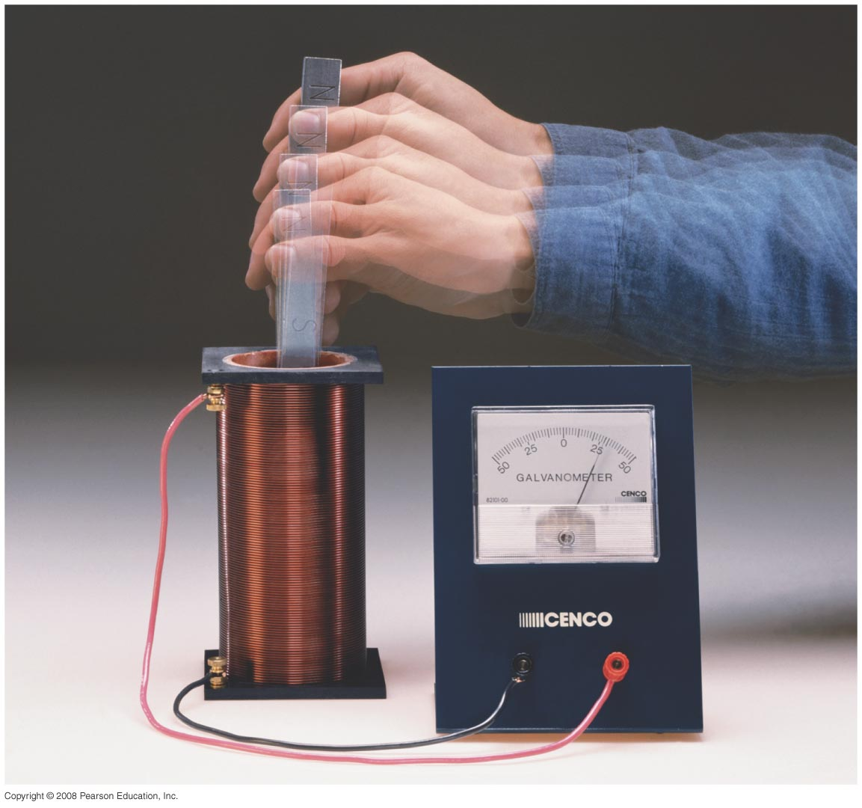
Chapter 29:Electromagnetic Induction and Faraday’s Law
Notes:
Chapter 29 opener. One of the great laws of physics is Faraday’s law of induction, which says that a changing magnetic flux produces an induced emf. This photo shows a bar magnet moving inside a coil of wire, and the galvanometer registers an induced current. This phenomenon of electromagnetic induction is the basis for many practical devices, including generators, alternators, transformers, tape recording, and computer memory.

Slide 16
29-1 Induced EMF
https://www.youtube.com/watch?v=gfJG4M4wi1o

