Slide 1
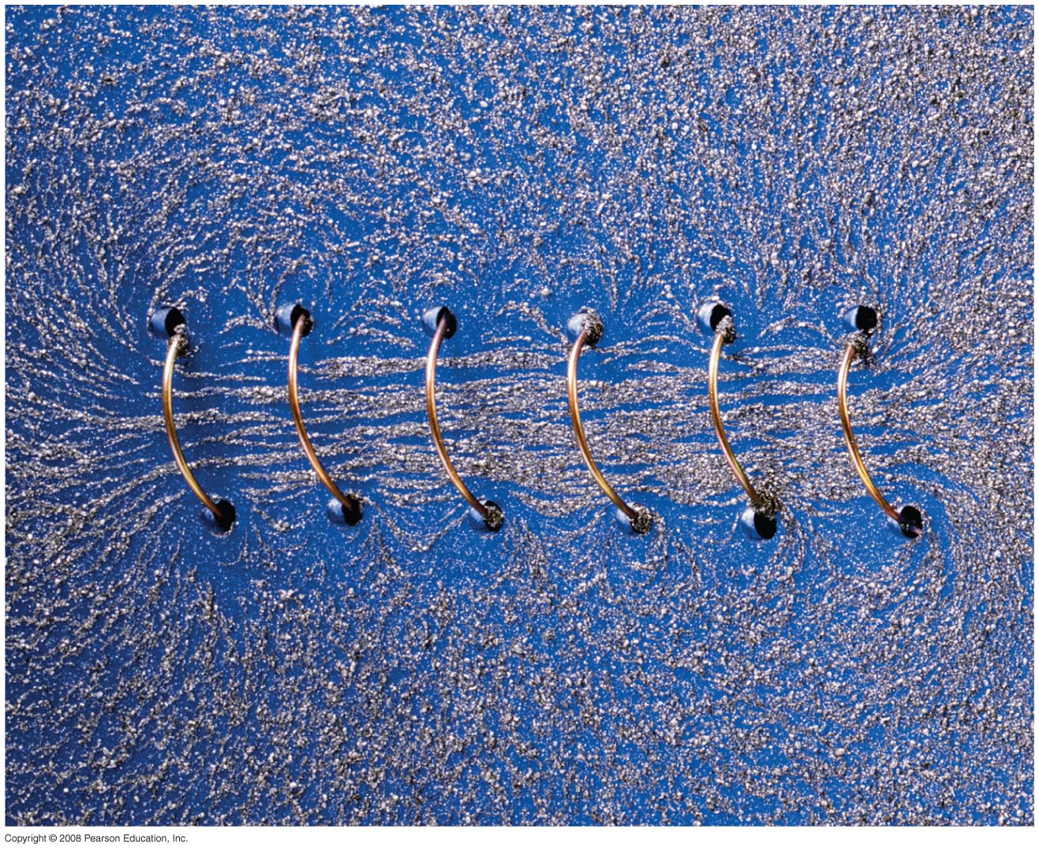
Chapter 28 Sources of Magnetic Field
HW 4: Chapter 26, Pb.11,Pb.18, Pb.28, Pb.32, Pb.50, Pb.51 due on Wednesday, March 20
No class on Friday, March 8
Notes:
Chapter 28 opener. A long coil of wire with many closely spaced loops is called a solenoid. When a long solenoid carries an electric current, a nearly uniform magnetic field is produced within the loops as suggested by the alignment of the iron filings in this photo. The magnitude of the field inside a solenoid is readily found using Ampère’s law, one of the great general laws of electromagnetism, relating magnetic fields and electric currents. We examine these connections in detail in this Chapter, as well as other means for producing magnetic fields.

Slide 2
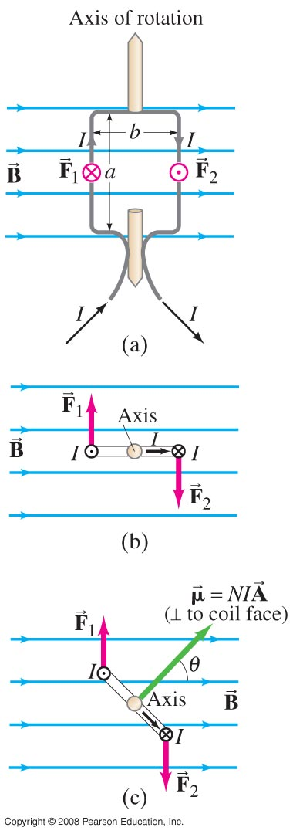
27-5 Torque on a Current Loop; Magnetic Dipole Moment
The forces on opposite sides of a current loop will be equal and opposite (if the field is uniform and the loop is symmetric), but there may be a torque.
The magnitude of the torque is given by
N :number of loops
A : Area of the coil
Θ: angle between B and the coil
Notes:
Figure 27-22. Calculating the torque on a current loop in a magnetic field B. (a) Loop face parallel to B field lines; (b) top view; (c) loop makes an angle to B, reducing the torque since the lever arm is reduced.

Slide 3
27-5 Torque on a Current Loop; Magnetic Dipole Moment
The quantity NIA is called the magnetic dipole moment, μ:
The potential energy of the loop depends on its orientation in the field:

Slide 4
27-5 Torque on a Current Loop; Magnetic Dipole Moment
Example 27-11: Torque on a coil.
A circular coil of wire has a diameter of 20.0 cm and contains 10 loops. The current in each loop is 3.00 A, and the coil is placed in a 2.00-T external magnetic field. Determine the maximum and minimum torque exerted on the coil by the field.
Notes:
Solution: The minimum torque is zero; the maximum is NIAB sin θ = 1.88 N·m.

Slide 5
27-6 Applications: Motors, Loudspeakers, Galvanometers
https://www.youtube.com/watch?v=WV2gul2SQNc

Slide 6
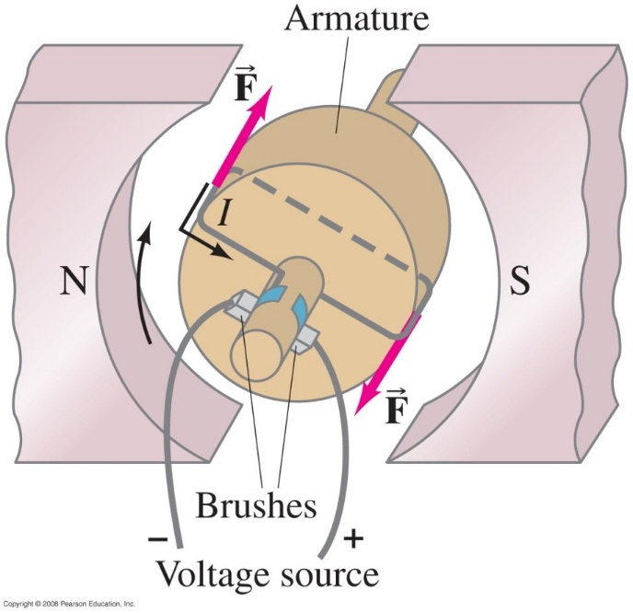
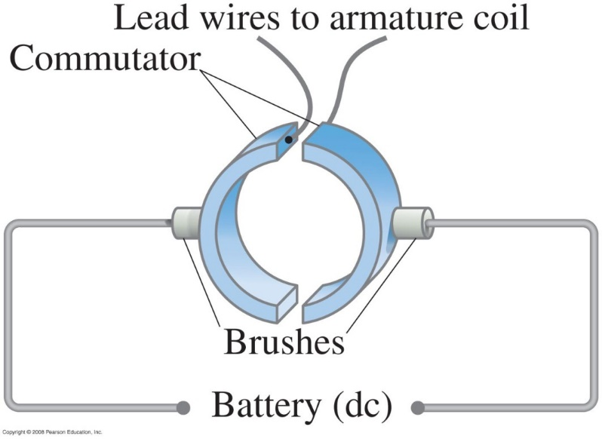
27-6 Applications: Motors, Loudspeakers, Galvanometers
An electric motor uses the torque on a current loop in a magnetic field to turn magnetic energy into kinetic energy.
https://www.youtube.com/watch?v=WV2gul2SQNc
Notes:
Figure 27-23. Diagram of a simple dc motor.
Figure 27-24. The commutator-brush arrangement in a dc motor ensures alternation of the current in the armature to keep rotation continuous. The commutators are attached to the motor shaft and turn with it, whereas the brushes remain stationary.

Slide 7
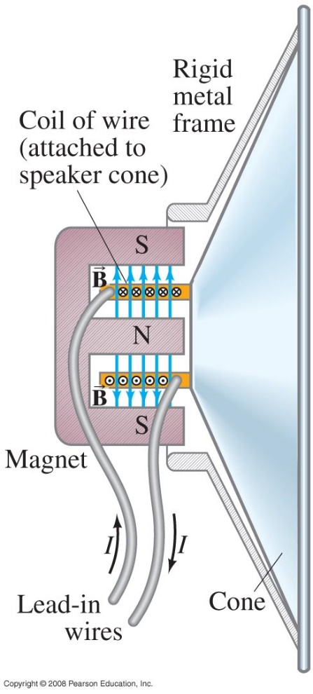
27-6 Applications: Motors, Loudspeakers, Galvanometers
Notes:
Figure 27-26. Loudspeaker.

Slide 8
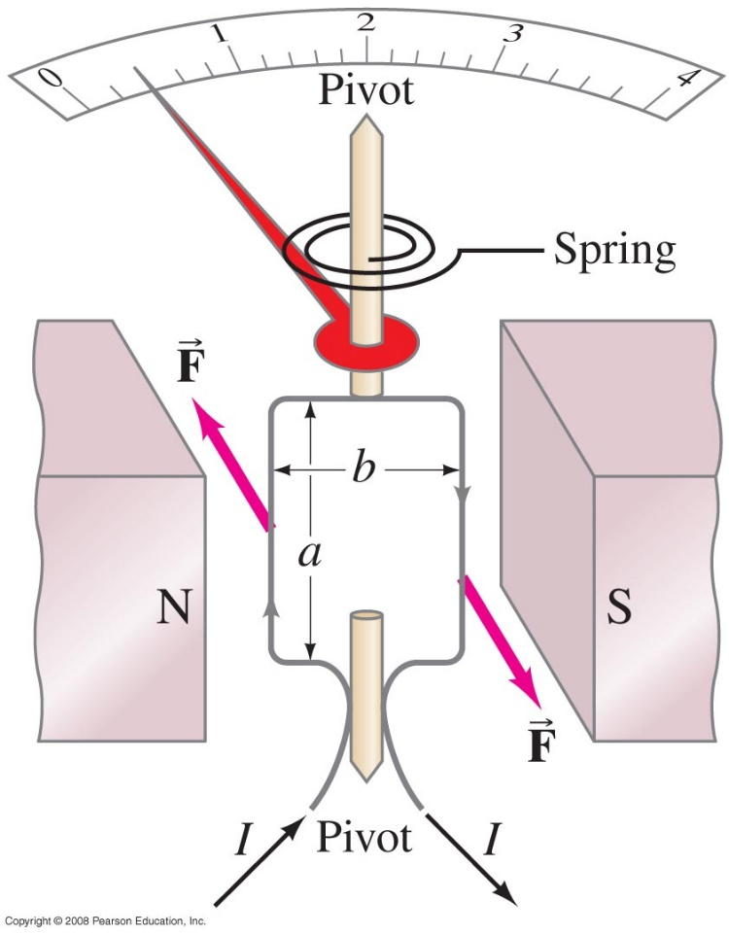
27-6 Applications: Motors, Loudspeakers, Galvanometers
A galvanometer takes advantage of the torque on a current loop to measure current; the spring constant is calibrated so the scale reads in amperes.
Forces move the spring and make the needle move.
Notes:
Figure 27-27. Galvanometer.

Slide 9
28-1 Magnetic Field Due to a Straight Wire
This video shows the direction of the magnetic field, with the right hand rule
https://www.youtube.com/watch?v=Z06W_PutPuQ

Slide 10
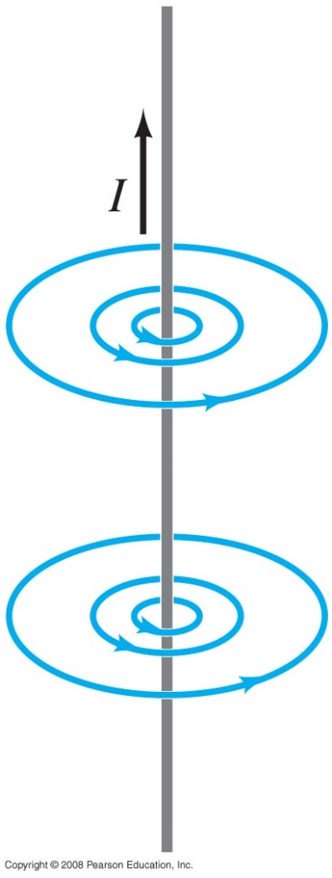
28-1 Magnetic Field Due to a Straight Wire
The magnetic field due to a straight wire is inversely proportional to the distance from the wire:
r
The constant μ₀ is called the permeability of free space, and has the value
μ₀ = 4π x 10⁻⁷ T·m/A.
Notes:
Figure 28-1. Same as Fig. 27–8b. Magnetic field lines around a long straight wire carrying an electric current I.

Slide 11
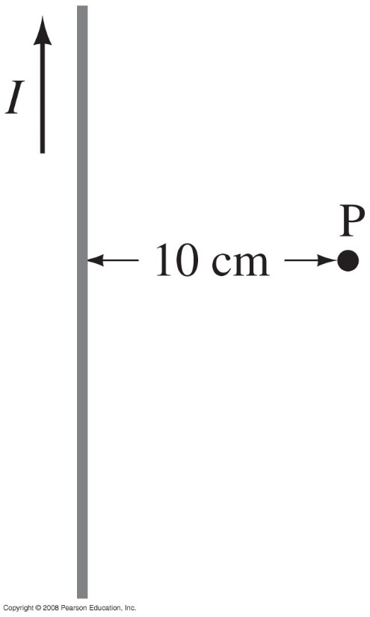
28-1 Magnetic Field Due to a Straight Wire
Example 28-1: Calculation of B near a wire.
An electric wire in the wall of a building carries a dc current of 25 A vertically upward. What is the magnetic field due to this current at a point P 10 cm due north of the wire?
Notes:
Solution: B = μ₀I/2πr = 5.0 x 10⁻⁵ T

Slide 12
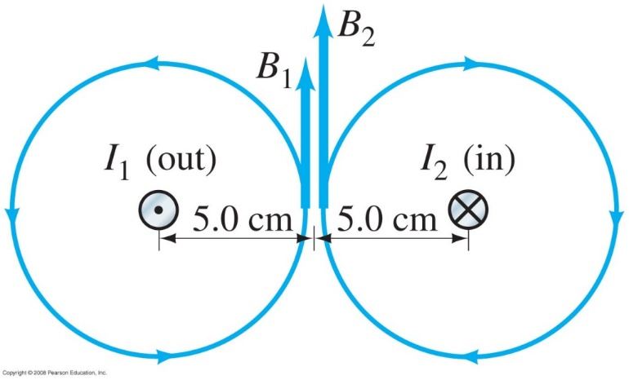
28-1 Magnetic Field Due to a Straight Wire
Example 28-2: Magnetic field midway between two currents.
Two parallel straight wires 10.0 cm apart carry currents in opposite directions. Current I₁ = 5.0 A is out of the page, and I₂ = 7.0 A is into the page. Determine the magnitude and direction of the magnetic field halfway between the two wires.
Notes:
Figure 28-3. Example 28–2. Wire 1 carrying current I₁ out towards us, and wire 2 carrying current I₂ into the page, produce magnetic fields whose lines are circles around their respective wires.
Solution: As the figure shows, the two fields are in the same direction midway between the wires. Therefore, the total field is the sum of the two, and points upward: B₁ = 2.0 x 10⁻⁵ T; B₂ = 2.8 x 10⁻⁵ T; so B = 4.8 x 10⁻⁵ T.

Slide 13
Problem 9
9. (II) A long horizontal wire carries 24.0 A of current due west. What is the net magnetic field due north 20.0 cm from the wire if the Earth’s field there points downward, 44° below the horizontal, and has magnitude 5.0X 10⁻⁵T.

Slide 14
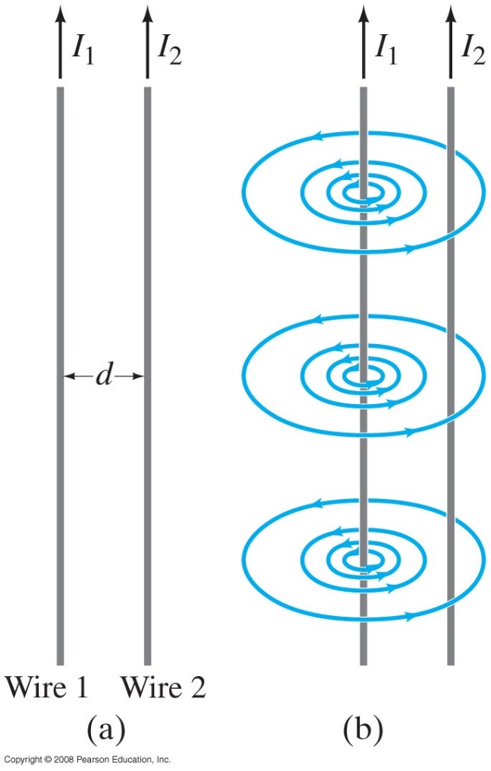
28-2 Force between Two Parallel Wires
The magnetic field produced at the position of wire 2 due to the current in wire 1 is
The force this field exerts on a length l₂ of wire 2 is
Notes:
Figure 28-5. (a) Two parallel conductors carrying currents I₁ and I₂. (b) Magnetic field B₁ produced by I₁ (Field produced by I₂ is not shown.) B₁ points into page at position of I₂.

Slide 15
28-2 Force between Two Parallel Wires
https://www.youtube.com/watch?v=DEgxjuOx8R4

