Slide 1
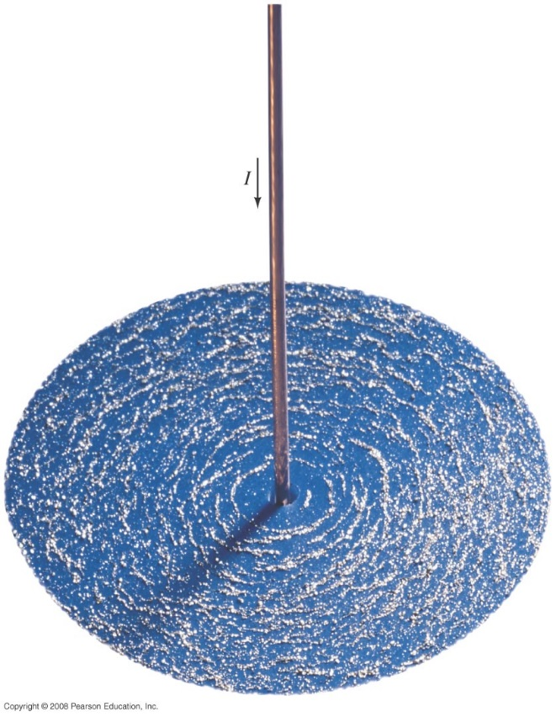
Chapter 27 Magnetism
Notes:
Chapter 27 opener. Magnets produce magnetic fields, but so do electric currents. An electric current flowing in this straight wire produces a magnetic field which causes the tiny pieces of iron (iron “filings”) to align in the field. We shall see in this Chapter how magnetic field is defined, and that the magnetic field direction is along the iron filings. The magnetic field lines due to the electric current in this long wire are in the shape of circles around the wire. We also discuss how magnetic fields exert forces on electric currents and on charged particles, as well as useful applications of the interaction between magnetic fields and electric currents and moving electric charges.

Slide 2
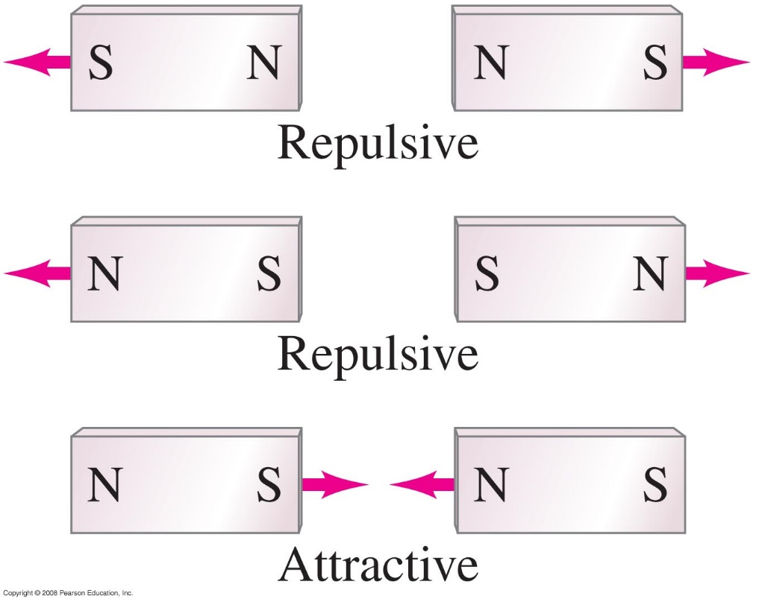
27-1 Magnets and Magnetic Fields
Magnets have two ends – poles – called north and south.
Like poles repel; unlike poles attract.
Notes:
Figure 27-2. Like poles of a magnet repel; unlike poles attract. Red arrows indicate force direction.

Slide 3
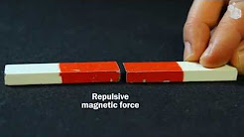
https://www.youtube.com/watch?v=Mp0Bu75MSj8

Slide 4
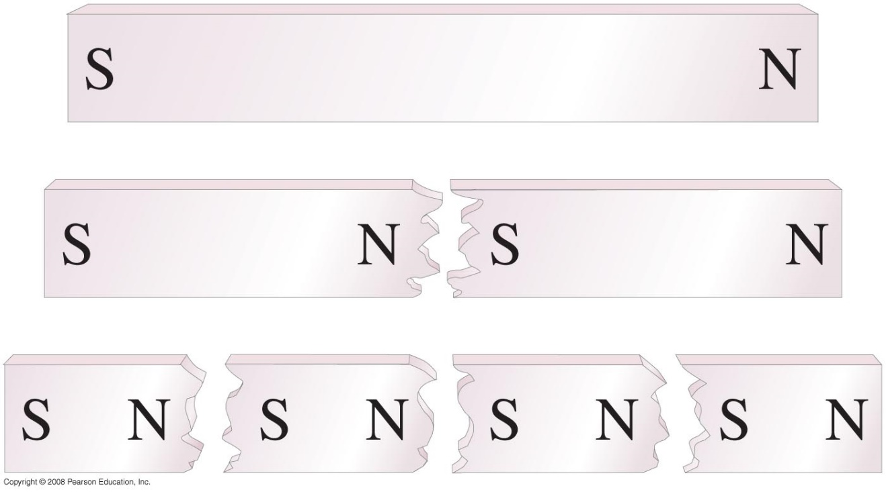
27-1 Magnets and Magnetic Fields
However, if you cut a magnet in half, you don’t get a north pole and a south pole – you get two smaller magnets.
Notes:
Figure 27-3. If you split a magnet, you won’t get isolated north and south poles; instead, two new magnets are produced, each with a north and a south pole.

Slide 5
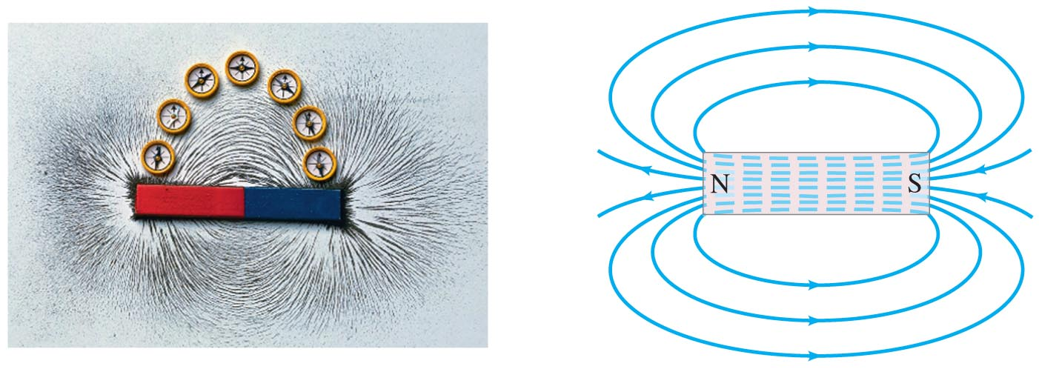
27-1 Magnets and Magnetic Fields
Magnetic fields can be visualized using magnetic field lines, which are always closed loops.
Notes:
Figure 27-4. (a) Visualizing magnetic field lines around a bar magnet, using iron filings and compass needles. The red end of the bar magnet is its north pole. The N pole of a nearby compass needle points away from the north pole of the magnet. (b) Magnetic field lines for a bar magnet.

Slide 6
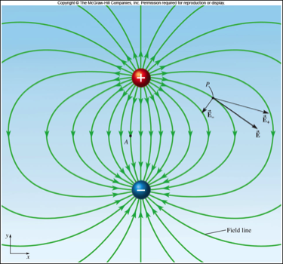
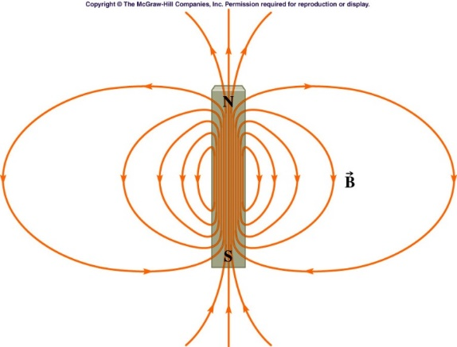
Magnetic Fields
Similarities with Electric Fields
Electric
Magnetic
Positive and Negative Charges
Like Charges repel
Opposite Charges attract
Field lines move from + to -
North and South poles
Like poles repel
Opposite poles attract
Field lines outside the material move from N to S

Slide 7
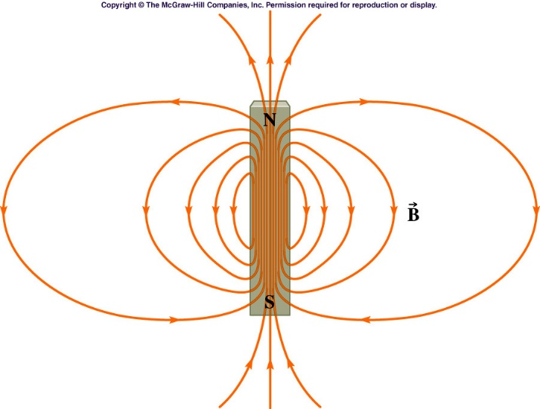
Magnetic Fields
Similarities with Electric Fields
Electric Field
Magnetic Field
•tangent to the field lines
•the strongest where the field lines are the closest
•tangent to the field lines
•the strongest where the field lines are the closest

Slide 8
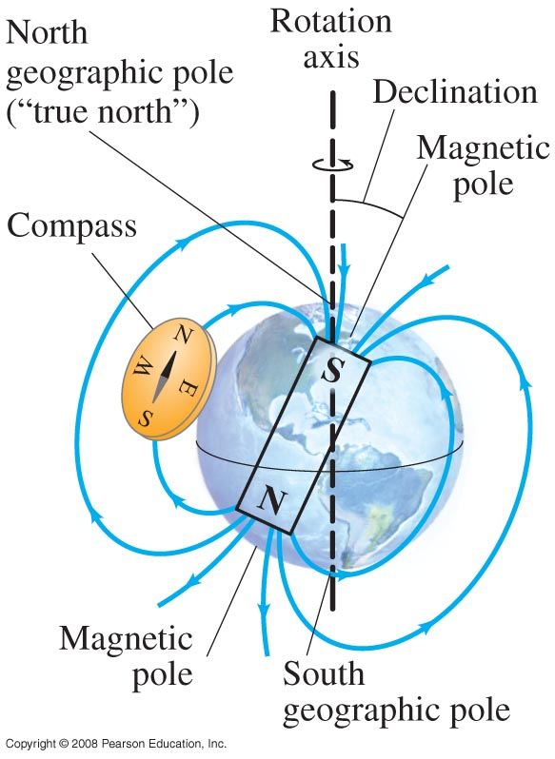
27-1 Magnets and Magnetic Fields
The Earth’s magnetic field is similar to that of a bar magnet.
Note that the Earth’s “North Pole” is really a south magnetic pole, as the north ends of magnets are attracted to it.
Canadian Artic
Notes:
Figure 27-5. The Earth acts like a huge magnet; but its magnetic poles are not at the geographic poles, which are on the Earth’s rotation axis.

Slide 9
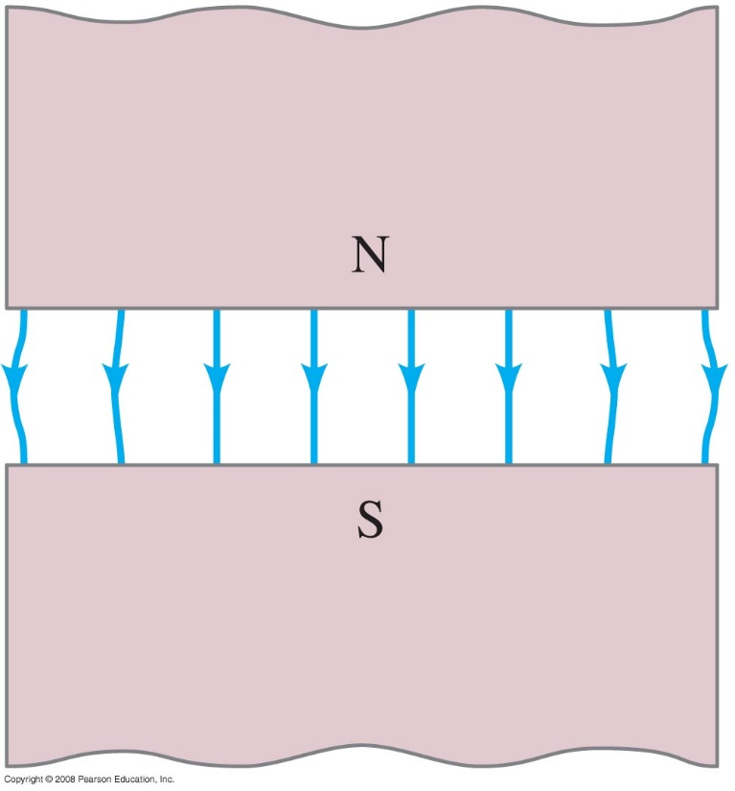
27-1 Magnets and Magnetic Fields
A uniform magnetic field is constant in magnitude and direction.
The field between these two wide poles is nearly uniform.
Notes:
Figure 27-7. Magnetic field between two wide poles of a magnet is nearly uniform, except near the edges.

Slide 10
27-2 Electric Currents Produce Magnetic Fields
https://www.youtube.com/watch?v=tKxFLH2Nhe4

Slide 11
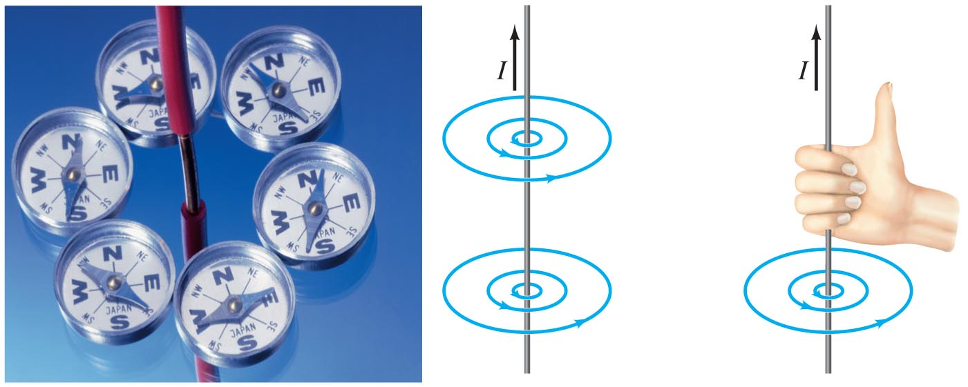
27-2 Electric Currents Produce Magnetic Fields
Experiment shows that an electric current produces a magnetic field. The direction of the field is given by a right-hand rule.
Notes:
Figure 27-8. (a) Deflection of compass needles near a current-carrying wire, showing the presence and direction of the magnetic field. (b) Magnetic field lines around an electric current in a straight wire. (c) Right-hand rule for remembering the direction of the magnetic field: when the thumb points in the direction of the conventional current, the fingers wrapped around the wire point in the direction of the magnetic field. See also the Chapter-Opening photo.

Slide 12
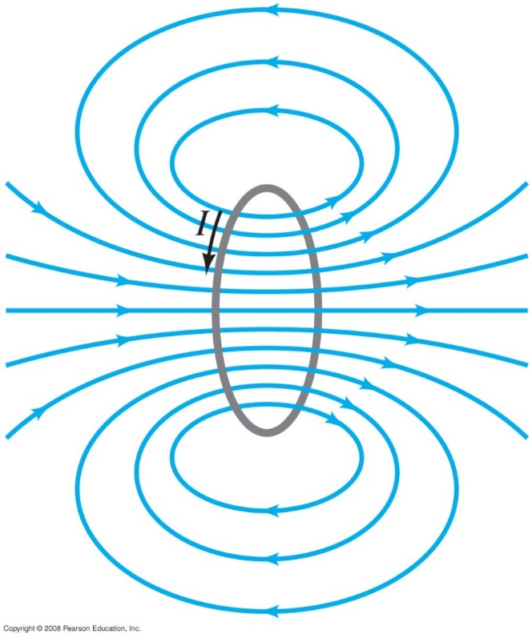
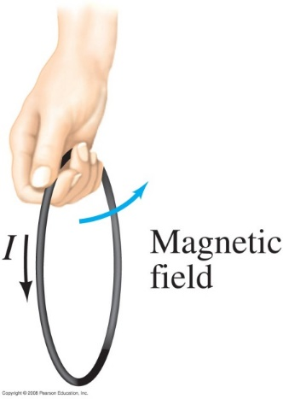
27-2 Electric Currents Produce Magnetic Fields
Here we see the magnetic field due to a current loop; the direction is again given by a right-hand rule.
Notes:
Figure 27-9. Magnetic field lines due to a circular loop of wire.
Figure 27-10. Right-hand rule for determining the direction of the magnetic field relative to the current.

Slide 13
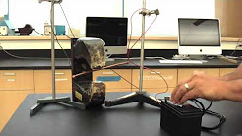
27-2 Electric Currents Produce Magnetic Fields
https://www.youtube.com/watch?v=F1PWnu01IQg

Slide 14
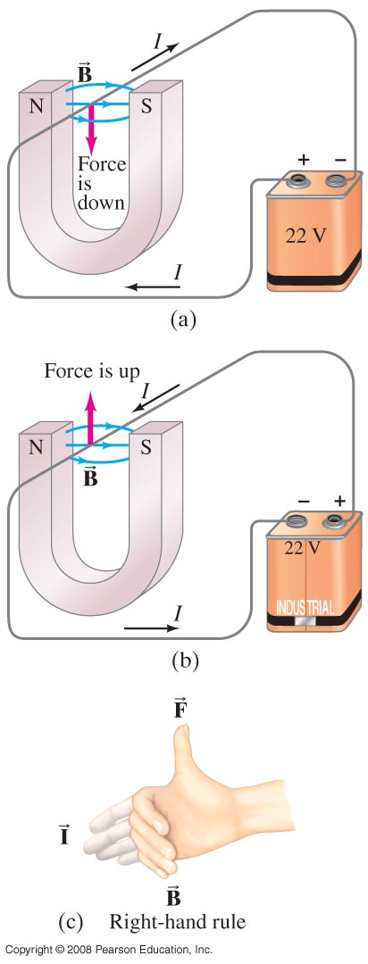
A magnet exerts a force on a current-carrying wire. The direction of the force is given by a right-hand rule.
Notes:
Figure 27-11. (a) Force on a current-carrying wire placed in a magnetic field B; (b) same, but current reversed; (c) right-hand rule for setup in (b).

Slide 15
27-3 Force on an Electric Current in a Magnetic Field; Definition of B
The force on the wire depends on the current, the length of the wire, the magnetic field, and its orientation:
In vector notation:

Slide 16
27-3 Force on an Electric Current in a Magnetic Field; Definition of B
Unit of B: the tesla, T:
1 T = 1 N/A·m.
Another unit sometimes used: the gauss (G):
1 G = 10⁻⁴ T.
Directions of the Magnetic Field:

Slide 17
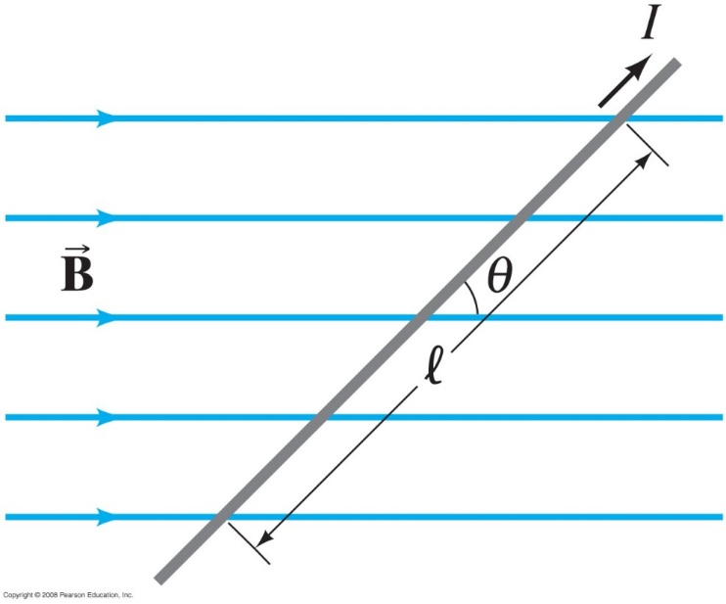
27-3 Force on an Electric Current in a Magnetic Field; Definition of B
Example 27-1: Magnetic Force on a current-carrying wire.
A wire carrying a 30-A current has a length l =12 cm between the pole faces of a magnet at an angle θ = 60, as shown. The magnetic field is approximately uniform at 0.90 T. We ignore the field beyond the pole pieces. What is the magnitude and direction of the force on the wire?
Notes:
Solution: F = IlBsin θ = 2.8 N.

Slide 18
Problem 8
(II) A long wire stretches along the x axis and carries a 3.0-A current to the right (+x). The wire is in a uniform magnetic field
Determine the components of the force on the wire per cm of length.

Slide 19
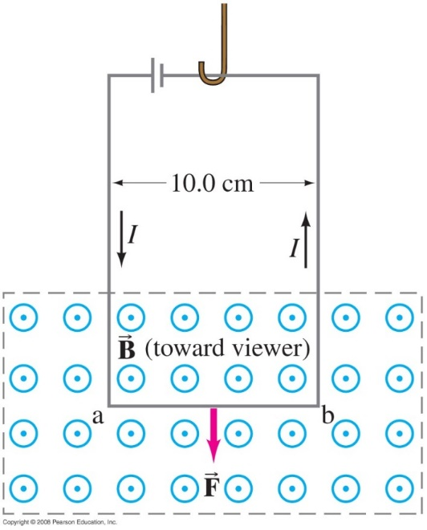
27-3 Force on an Electric Current in a Magnetic Field; Definition of B
Example 27-2: Measuring a magnetic field.
A rectangular loop of wire hangs vertically as shown. A magnetic field B is directed horizontally, perpendicular to the wire, and points out of the page at all points. The magnetic field is very nearly uniform along the horizontal portion of wire ab (length l = 10.0 cm) which is near the center of the gap of a large magnet producing the field. The top portion of the wire loop is free of the field. The loop hangs from a balance which measures a downward magnetic force (in addition to the gravitational force) of F = 3.48 x 10⁻² N when the wire carries a current I = 0.245 A. What is the magnitude of the magnetic field B?
Notes:
Solution: The wire is perpendicular to the field (the vertical wires feel no force), so B = F/Il = 1.42 T.

Slide 20
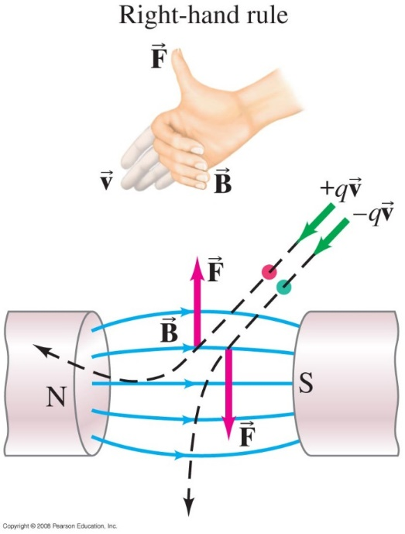
27-4 Force on an Electric Charge Moving in a Magnetic Field
The force on a moving charge is related to the force on a current:
Once again, the direction is given by a right-hand rule.
Notes:
Figure 27-15. Force on charged particles due to a magnetic field is perpendicular to the magnetic field direction.

Slide 21
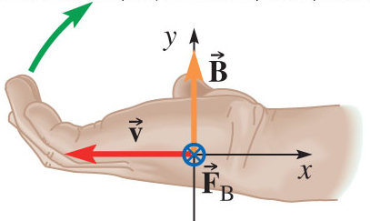
Magnetic Force on a point charge
Force on a moving charge
Direction: Right hand rule
is Perpendicular to both and
Lay hand along , curl fingers toward
q ⇒ Thumb points along
q ⇒ Thumb points opposite
= out of page
= into page
Arrow coming at you
Arrow leaving you
Be careful here with the sign of the charge q ! it will give you the direction of the force after you get the cross product direction
Notes:
21

Slide 22
Magnetic Force on a point charge
Direction: RIGHT Hand Rule
F Perpendicular to both v and B
Here Into or Out of the page
Run fingers along v, curl them towards B,
If q is positive, thumb points along F
• If q is negative, thumb point opposite F
Notes:
I think I made some vector arrows out of foam board that stick on meter sticks. I had one student be B, one be v and one be F.
Tried various configurations about the room.

Slide 23
Problem 17
17.(I) Determine the direction of for each case in Fig. 27–43, where represents the maximum magnetic force on a positively charged particle moving with velocity

