Slide 1
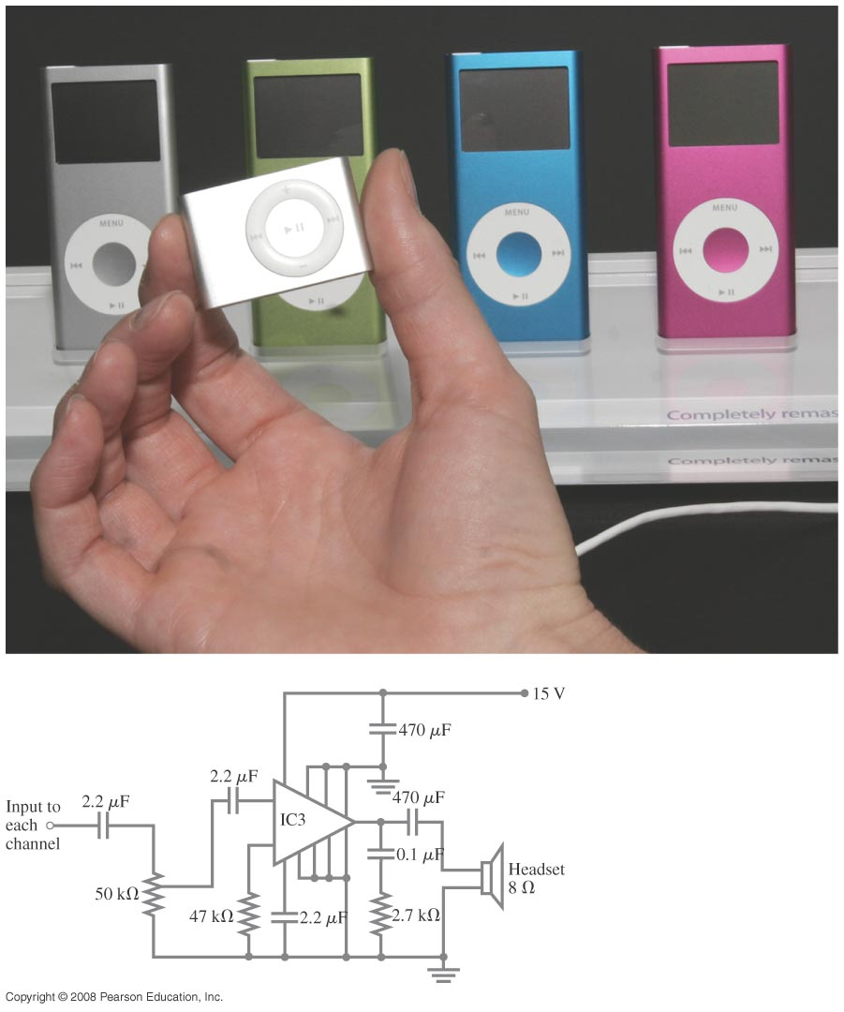
Chapter 26 DC Circuits
Study guide posted- Exam 2, March 1st.
Quiz on Friday
Notes:
Chapter 26 Opener. These MP3 players contain circuits that are dc, at least in part. (The audio signal is ac.) The circuit diagram below shows a possible amplifier circuit for each stereo channel. Although the large triangle is an amplifier chip containing transistors (discussed in Chapter 40), the other circuit elements are ones we have met, resistors and capacitors, and we discuss them in circuits in this Chapter. We also discuss voltmeters and ammeters, and how they are built and used to make measurements.

Slide 2
Problem 3
3.(II) A 1.5-V dry cell can be tested by connecting it to a low-resistance ammeter. It should be able to supply at least 25 A. What is the internal resistance of the cell in this case, assuming it is much greater than that of the ammeter?

Slide 3
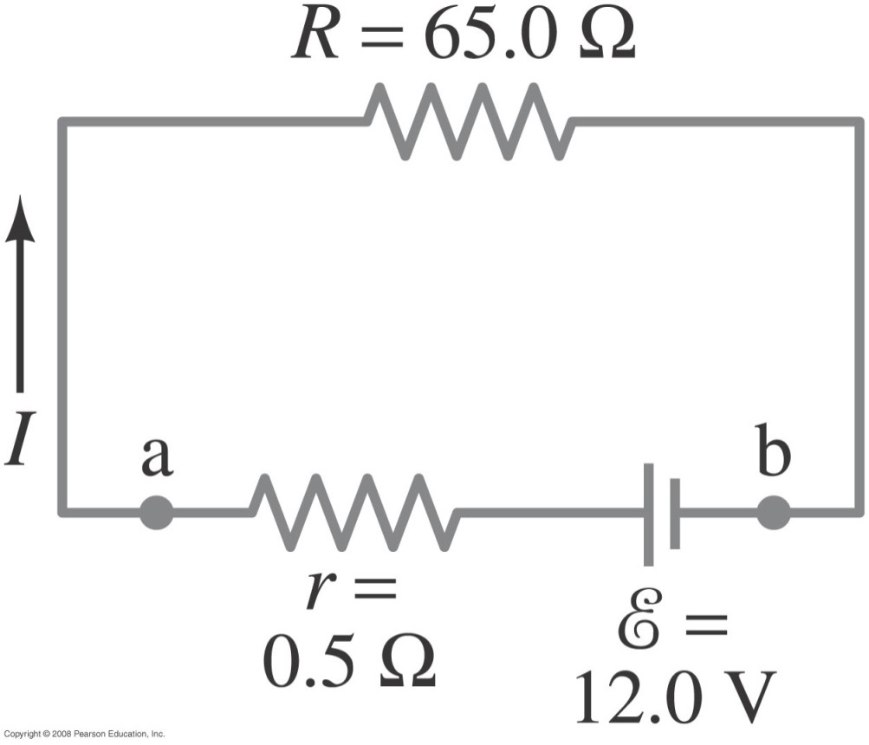
26-1 EMF and Terminal Voltage
Example 26-1: Battery with internal resistance.
A 65.0-Ω resistor is connected to the terminals of a battery whose emf is 12.0 V and whose internal
resistance is 0.5 Ω. Calculate (a) the current in the circuit,
(b) the terminal voltage of the battery, V_{ab}, and (c) the power dissipated in the resistor R and in the battery’s internal resistance r.
Notes:
Solution: a. The total resistance is 65.5 Ω, so the current is 0.183 A.
b. The voltage is the emf less the voltage drop across the internal resistance: V = 11.9 V.
c. The power is I²R; in the resistor it is 2.18 W and in the internal resistance it is 0.02 W.

Slide 4
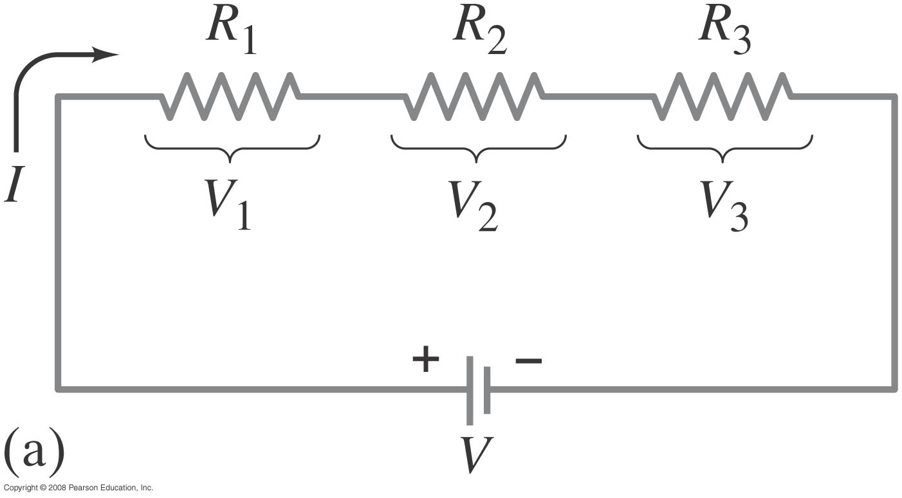
26-2 Resistors in Series and in Parallel
A series connection has a single path from the battery, through each circuit element in turn, then back to the battery.
Notes:
Figure 26-3a. Resistances connected in series.

Slide 5
26-2 Resistors in Series and in Parallel
The current through each resistor is the same; the voltage depends on the resistance. The sum of the voltage drops across the resistors equals the battery voltage:

Slide 6
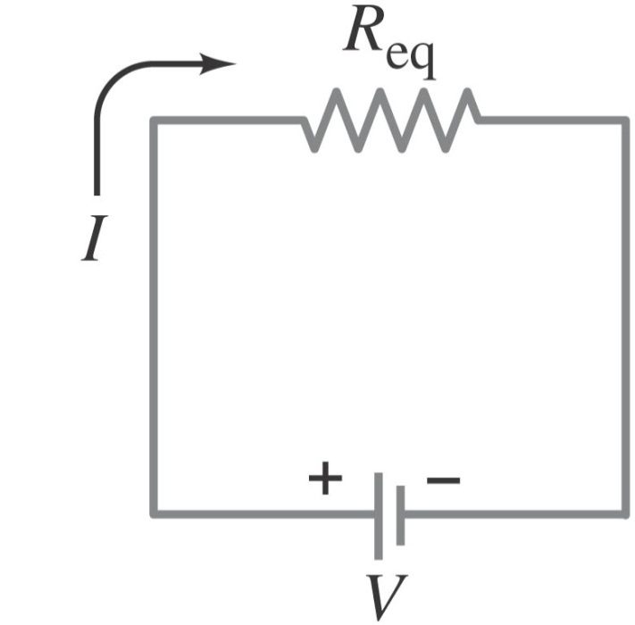
26-2 Resistors in Series and in Parallel
From this we get the equivalent resistance (that single resistance that gives the same current in the circuit):
Notes:
Figure 26-3c. Equivalent single resistance that draws the same current: R_{eq} = R₁ + R₂ + R₃ .

Slide 7
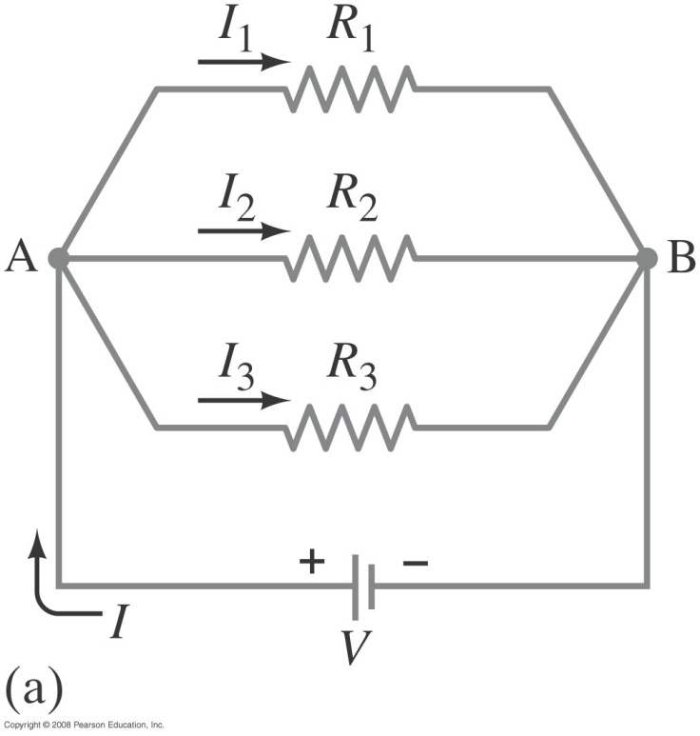
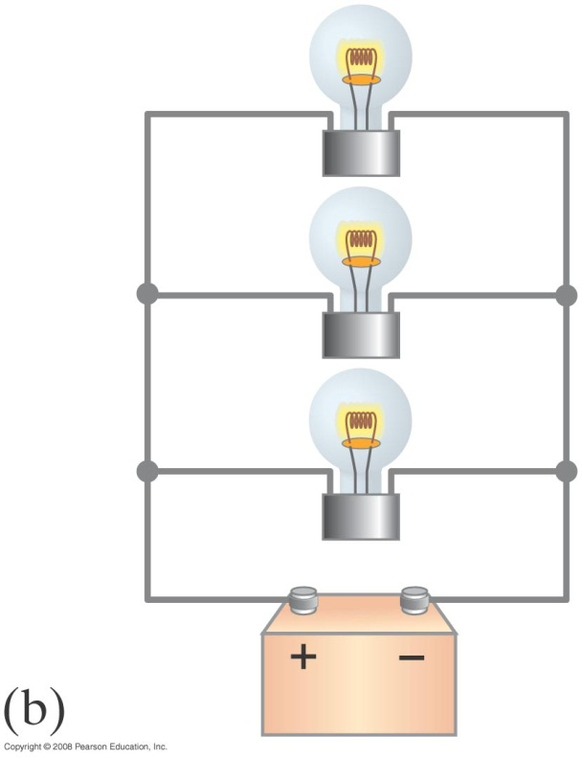
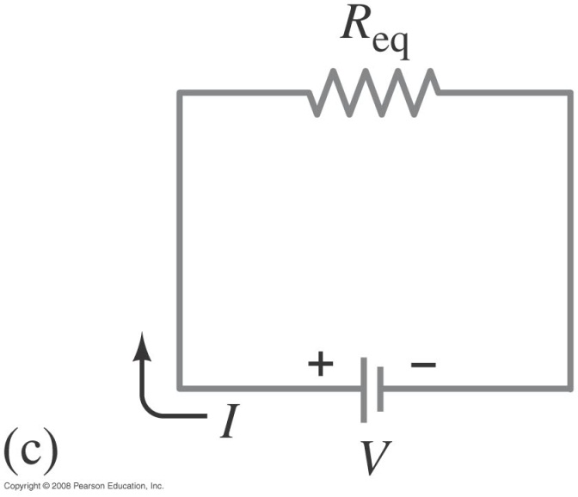
26-2 Resistors in Series and in Parallel
A parallel connection splits the current; the voltage across each resistor is the same:
Notes:
Figure 26-4. (a) Resistances connected in parallel. (b) The resistances could be lightbulbs. (c) The equivalent circuit with R_{e}q obtained from Eq. 26–4: 1/R_{eq} = 1/R₁ + 1/R₂ + 1/R₃

Slide 8
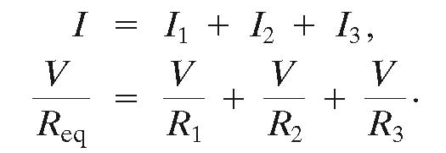
26-2 Resistors in Series and in Parallel
The total current is the sum of the currents across each resistor:
,

Slide 9
26-2 Resistors in Series and in Parallel
This gives the reciprocal of the equivalent resistance:
Note that the sum of resistors is the opposite
to the sum of capacitors, so be careful when solving problems with resistors.

Slide 10
Problem 8
8. (I) How many 10Ω resistors must be connected in series to give an equivalent resistance to five 100Ω resistors connected in parallel?

Slide 11
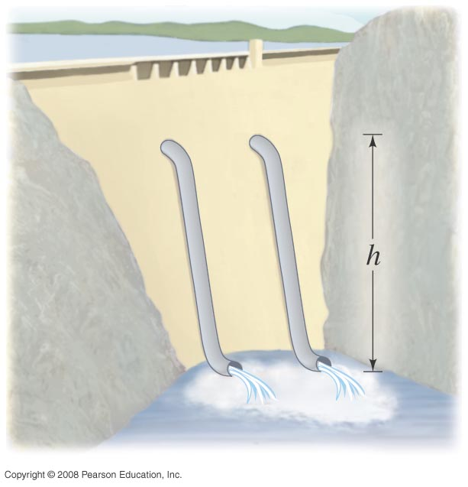
26-2 Resistors in Series and in Parallel
An analogy using water may be helpful in visualizing parallel circuits. The water (current) splits into two streams; each falls the same height, and the total current is the sum of the two currents. With two pipes open, the resistance to water flow is half what it is with one pipe open.
Notes:
Figure 26-4. Water pipes in parallel—analogy to electric currents in parallel.

Slide 12
Circuit Analysis Principles
Need to remember:
I through each element
Current (charge) splits in parallel
Current (charge) is the same in series
V across each element or set
Voltages add in series
Voltages are same in parallel
Voltages around a loop sum to zero

Slide 13
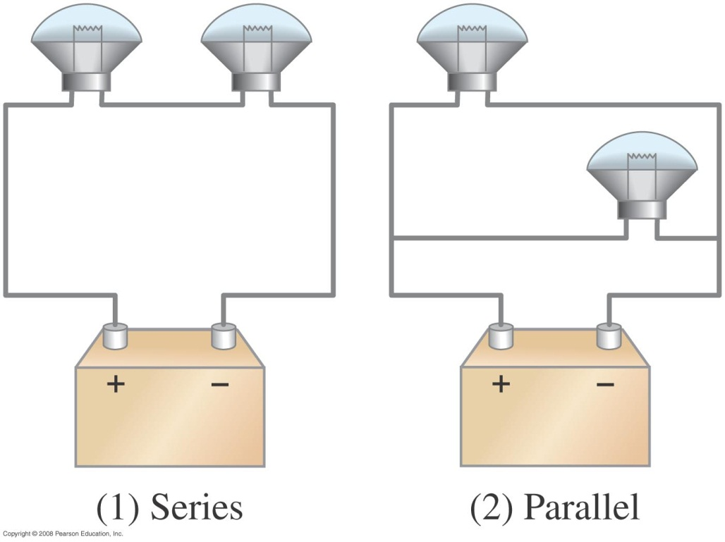
26-2 Resistors in Series and in Parallel
Conceptual Example 26-2: Series or parallel?
(a) The lightbulbs in the figure are identical. Which configuration produces more light? (b) Which way do you think the headlights of a car are wired? Ignore change of filament resistance R with current.
Notes:
Solution: a. In the parallel configuration, the equivalent resistance is less, so the current is higher and the lights will be brighter.
b. They are wired in parallel, so that if one light burns out the other one still stays on.

Slide 14
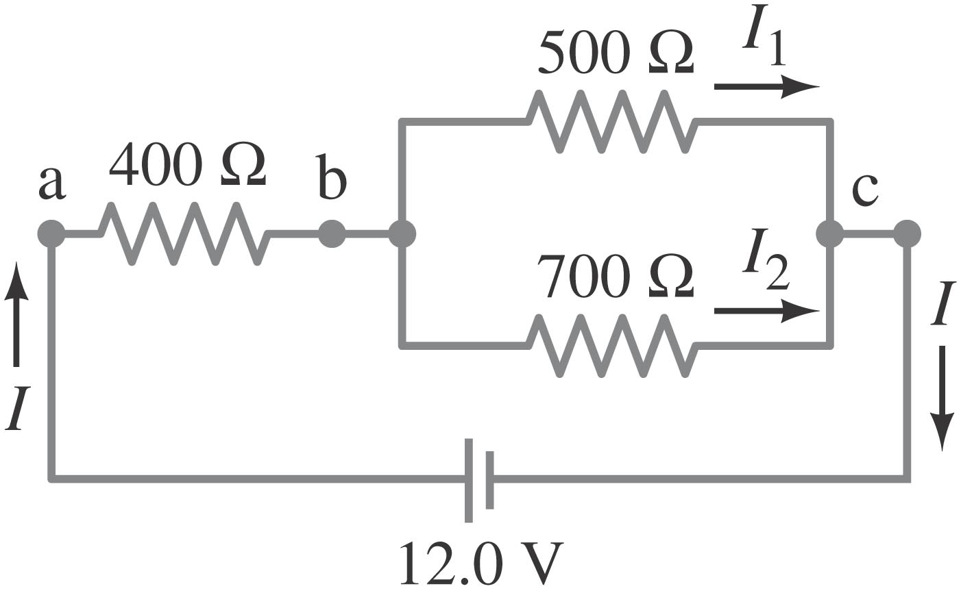
26-2 Resistors in Series and in Parallel
Example 26-4: Circuit with series and parallel resistors.
How much current is drawn from the battery shown?
Notes:
Solution: First we find the equivalent resistance of the two resistors in parallel, then the series combination of that with the third resistance. For the two parallel resistors, R = 290 Ω (remember that the usual equation gives the INVERSE of the resistance – students are often confused by this). The series combination is then 690 Ω, so the current in the battery is V/R = 17 mA.

Slide 15
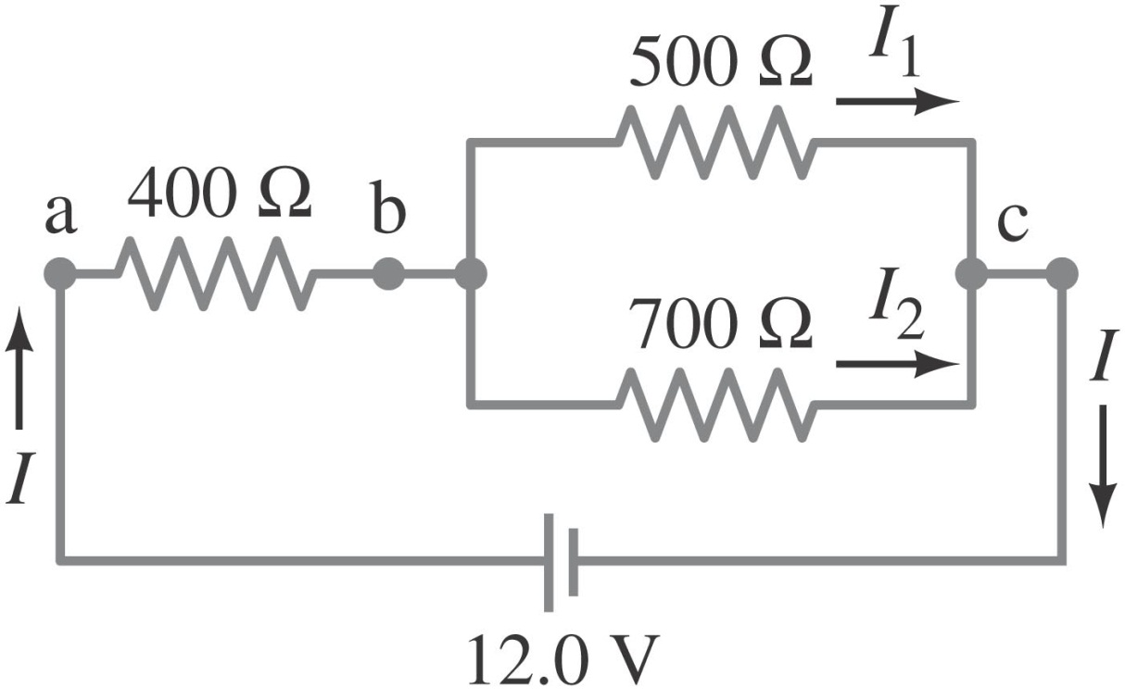
26-2 Resistors in Series and in Parallel
Example 26-5: Current in one branch.
What is the current through the 500-Ω resistor shown? (Note: This is the same circuit as in the previous problem.) The total current in the circuit was found to be 17 mA.
Notes:
Solution: The total current is 17 mA, so the voltage drop across the 400-Ω resistor is V = IR = 7.0 V. This means that the voltage drop across the 500-Ω resistor is 5.0 V, and the current through it is I = V/R = 10 mA.

Slide 16
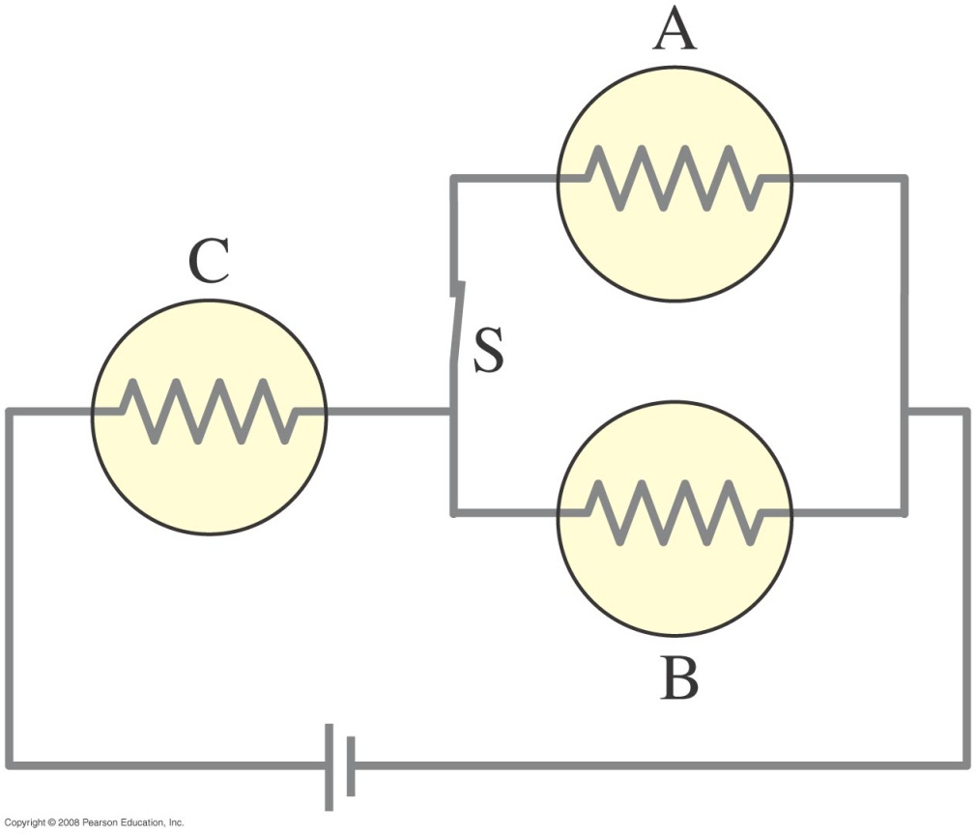
26-2 Resistors in Series and in Parallel
Conceptual Example 26-6: Bulb brightness in a circuit.
The circuit shown has three identical lightbulbs, each of resistance R. (a) When switch S is closed, how will the brightness of bulbs A and B compare with that of bulb C?
(b) What happens when switch S is opened? Use a minimum of mathematics in your answers.
Notes:
Solution: a. When S is closed, the bulbs in parallel have an equivalent resistance equal to half that of the series bulb. Therefore, the voltage drop across them is smaller. In addition, the current splits between the two of them. Bulbs A and B will be equally bright, but much dimmer than C.
b. With switch S open, no current flows through A, so it is dark. B and C are now equally bright, and each has half the voltage across it, so C is somewhat dimmer than it was with the switch closed, and B is brighter.

Slide 17
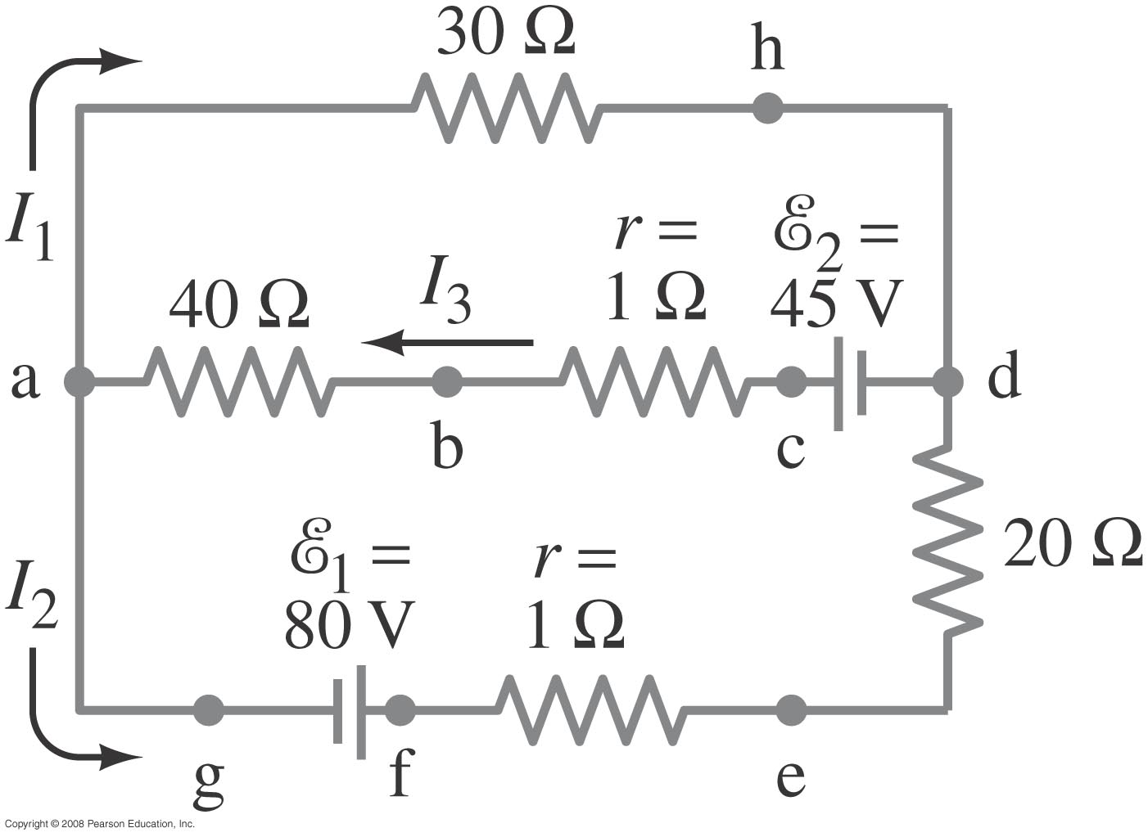
26-3 Kirchhoff’s Rules
Some circuits cannot be broken down into series and parallel connections. For these circuits we use Kirchhoff’s rules.
Junction rule or node rule: The sum of currents entering a junction equals the sum of the currents leaving it
I₃=I₁+I₂
Notes:
Figure 26-11. Currents can be calculated using Kirchhoff’s rules.

Slide 18
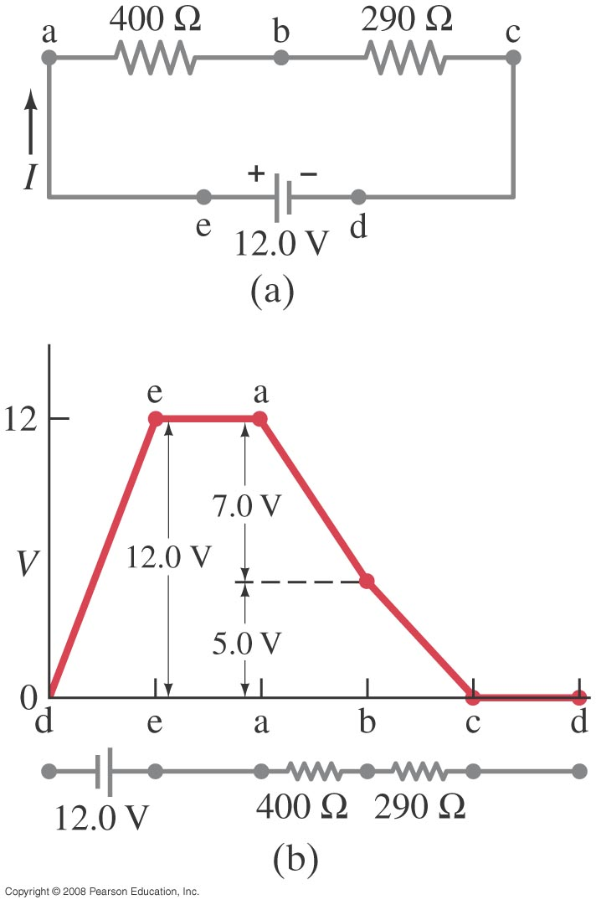
26-3 Kirchhoff’s Rules
Loop rule: The sum of the changes in potential around a closed loop is zero.
https://www.youtube.com/watch?v=0gRtVz4XrZM
Notes:
Figure 26-12. Changes in potential around the circuit in (a) are plotted in (b).

Slide 19
Loop Rule
Traveling around the loop from a to b
In (a), the resistor is traversed in the direction of the current, the potential across the resistor is –IR
In (b), the resistor is traversed in the direction opposite of the current, the potential across the resistor is +IR

Slide 20
Loop Rule, final
In (c), the source of emf is traversed in the direction of the emf (from – to +), the change in the electric potential is +ε
In (d), the source of emf is traversed in the direction opposite of the emf (from + to -), the change in the electric potential is -ε

Slide 21
Circuit Analysis Principles
Keep in mind that:
I through each element
Current (charge) splits at junctions
Current (charge) is the same in series
Apply junction rule
V across each element or set
Voltages add in series
Voltages are same in parallel
Voltages around a loop sum to zero (loop rule)

Slide 22
26-3 Kirchhoff’s Rules
Example 26-9: Using Kirchhoff’s rules.
Calculate the currents I₁, I₂, and I₃ in the three branches of the circuit in the figure.
Notes:
Solution: You will have two loop rules and one junction rule (there are two junctions but they both give the same rule, and only 2 of the 3 possible loop equations are independent). Algebraic manipulation will give I₁ = -0.87 A, I₂ = 2.6 A, and I₃ = 1.7 A.

