Slide 1
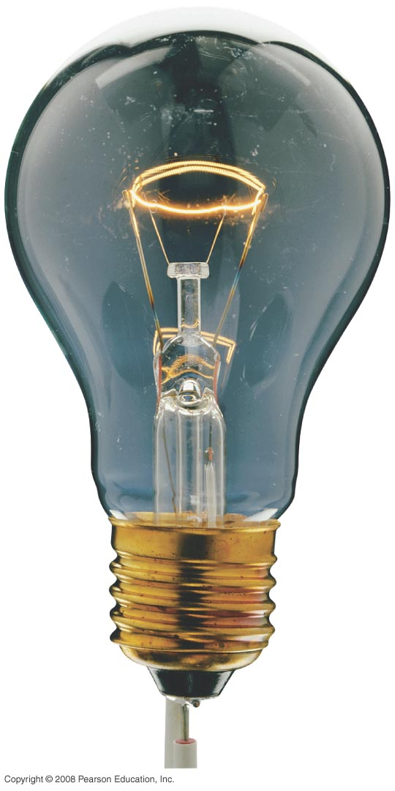
Chapter 25 Electric Currents and Resistance
HW#3: Chapter 22: Pb.1, Pb.6,Pb.24 Pb.27, Pb.35 due today.
Study guide posted- Exam 2, March 1st.
Notes:
Chapter 25 opener. The glow of the thin wire filament of a light bulb is caused by the electric current passing through it. Electric energy is transformed to thermal energy (via collisions between moving electrons and atoms of the wire), which causes the wire’s temperature to become so high that it glows. Electric current and electric power in electric circuits are of basic importance in everyday life. We examine both dc and ac in this Chapter, and include the microscopic analysis of electric current.

Slide 2
25-3 Ohm’s Law: Resistance and Resistors
Example 25-4: Flashlight bulb resistance.
A small flashlight bulb draws 300 mA from its 1.5-V battery. (a) What is the resistance of the bulb? (b) If the battery becomes weak and the voltage drops to 1.2 V, how would the current change?
Notes:
Figure 25-11. Flashlight (Example 25–4). Note how the circuit is completed along the side strip.
a. R = V/I = 5.0 Ω.
b. Assuming the resistance stays the same, the current will drop to 240 mA.

Slide 3
Problem 9
9. (II) A 12-V battery causes a current of 0.60 A through a resistor. (a) What is its resistance, and (b) how many joules of energy does the battery lose in a minute?

Slide 4
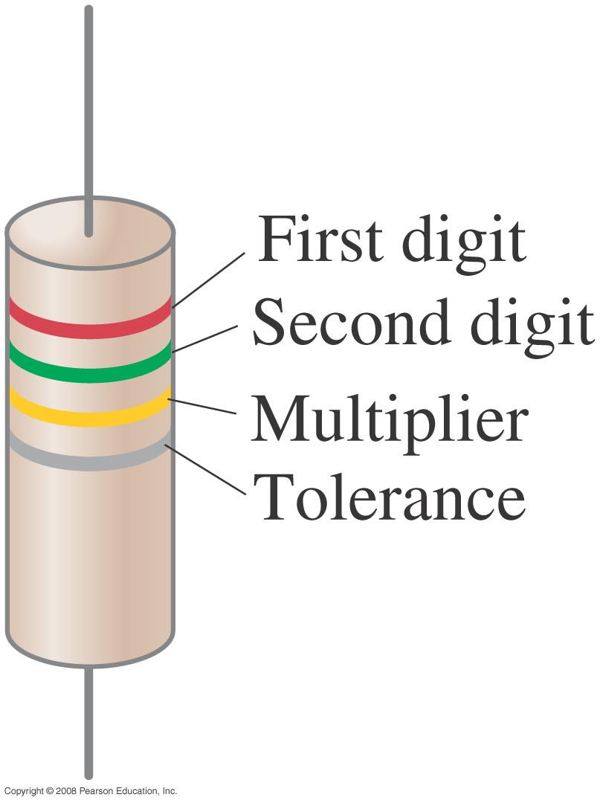
25-3 Ohm’s Law: Resistance and Resistors
Standard resistors are manufactured for use in electric circuits; they are color-coded to indicate their value and precision.
Notes:
Figure 25-13. The resistance value of a given resistor is written on the exterior, or may be given as a color code as shown above and in the Table: the first two colors represent the first two digits in the value of the resistance, the third color represents the power of ten that it must be multiplied by, and the fourth is the manufactured tolerance. For example, a resistor whose four colors are red, green, yellow, and silver has a resistance of 25 x 10⁴ Ω = 250,000 Ω = 250 kΩ, plus or minus 10%. An alternate example of a simple code is a number such as 104, which means R = 1.0 x 10⁴ Ω.

Slide 5
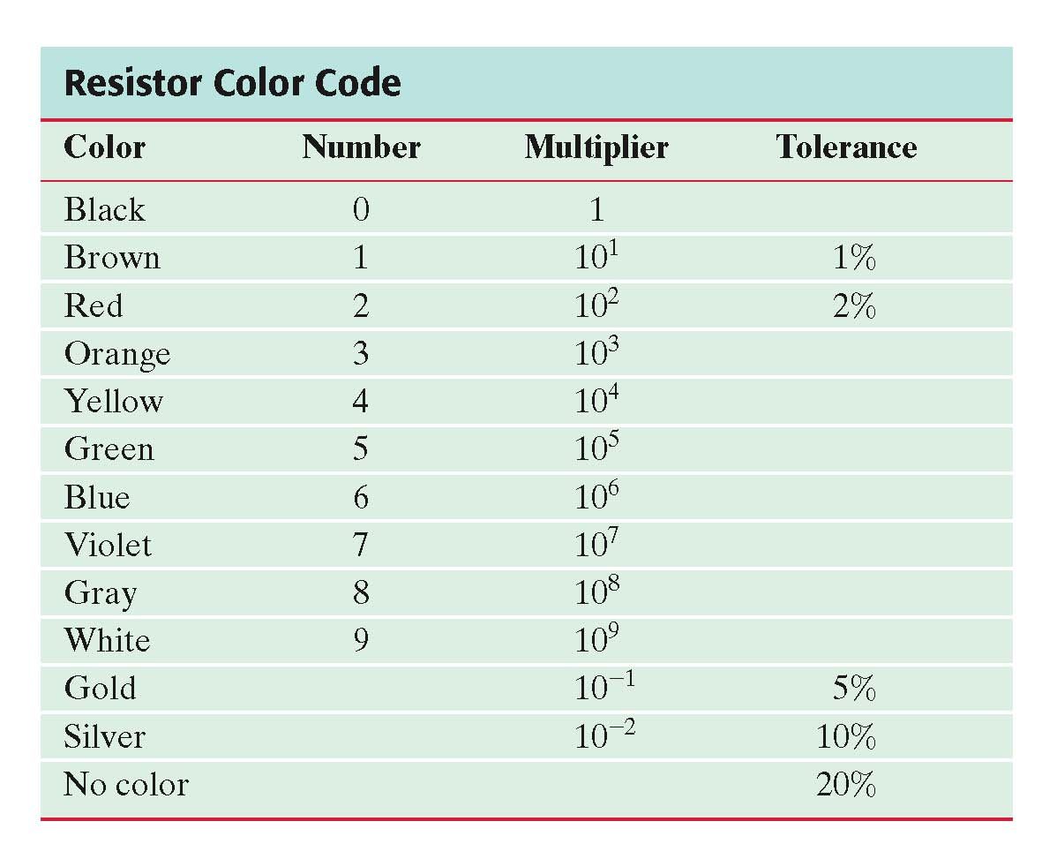
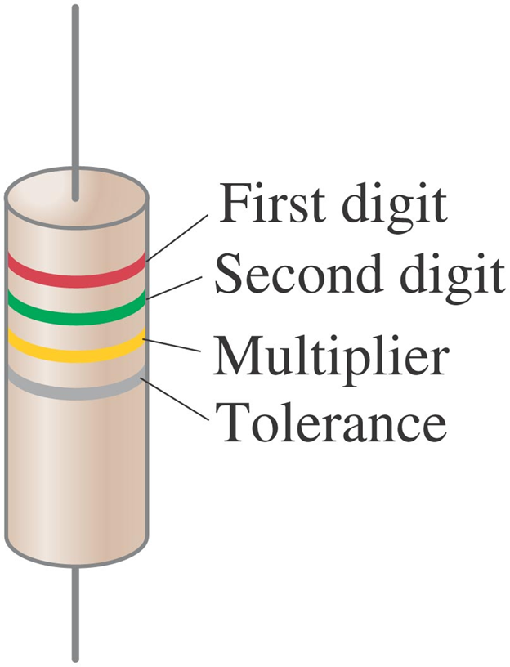
25-3 Ohm’s Law: Resistance and Resistors
This is the standard resistor color code. Note that the colors from red to violet are in the order they appear in a rainbow.

Slide 6
25-3 Ohm’s Law: Resistance and Resistors
Some clarifications:
Batteries maintain a (nearly) constant potential difference; the current varies.
Resistance is a property of a material or device.
Current is not a vector but it does have a direction.
Current and charge do not get used up. Whatever charge goes in one end of a circuit comes out the other end.

