Slide 1
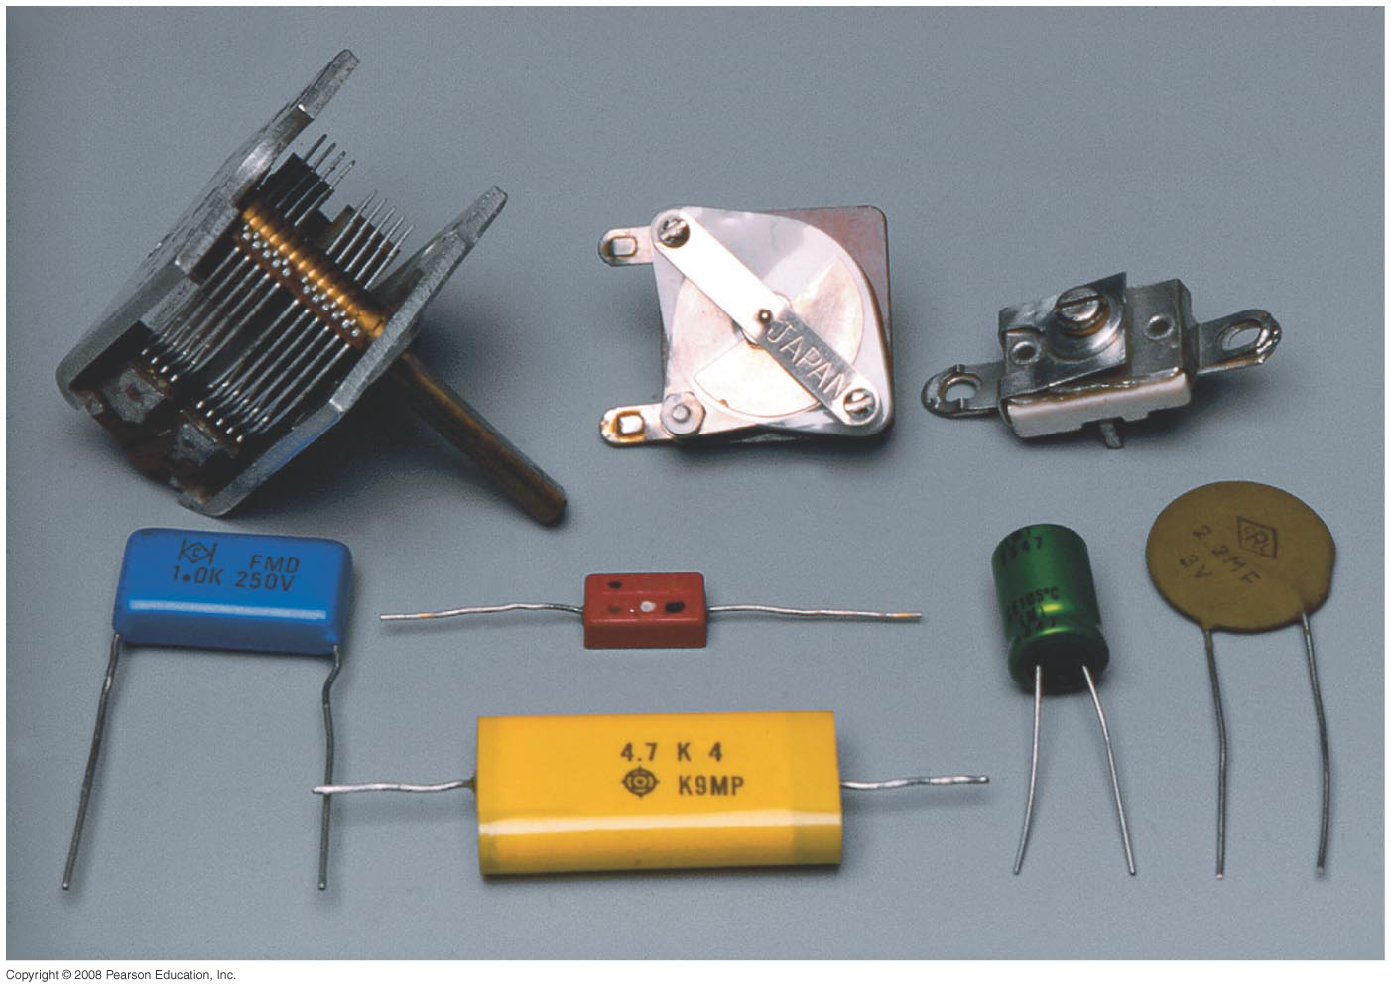
Chapter 24 Capacitance, Dielectrics, Electric Energy Storage
HW#3: Chapter 22: Pb.1, Pb.6,Pb.24 Pb.27, Pb.35 due on Friday, Feb. 16
Notes:
Chapter 24 opener. Capacitors come in a wide range of sizes and shapes, only a few of which are shown here. A capacitor is basically two conductors that do not touch, and which therefore can store charge of opposite sign on its two conductors. Capacitors are used in a wide variety of circuits, as we shall see in this and later Chapters.

Slide 2
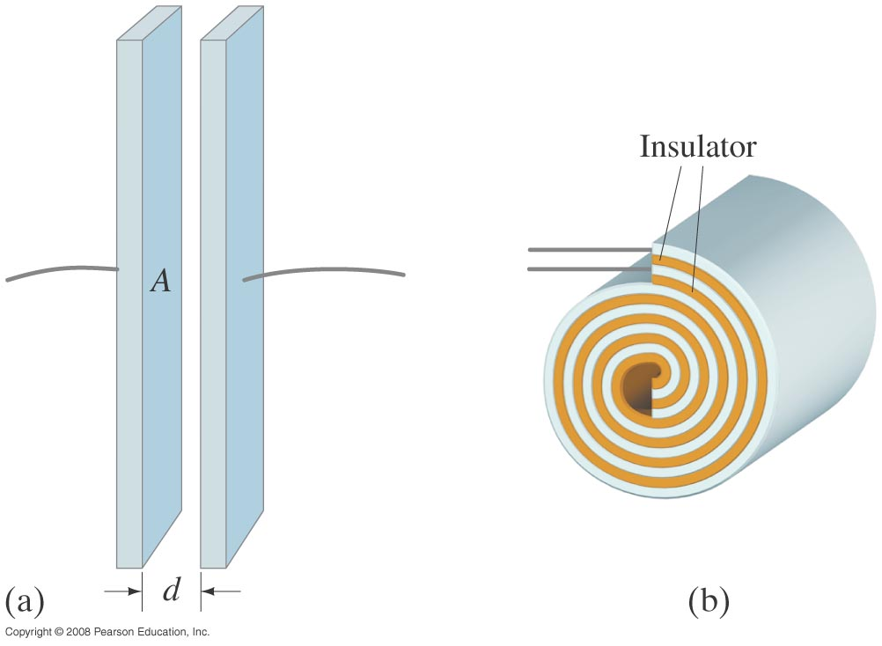
24-1 Capacitors
A capacitor consists of two conductors that are close but not touching. A capacitor has the ability to store electric charge.
Notes:
Figure 24-1. Capacitors: diagrams of (a) parallel plate, (b) cylindrical (rolled up parallel plate).

Slide 3
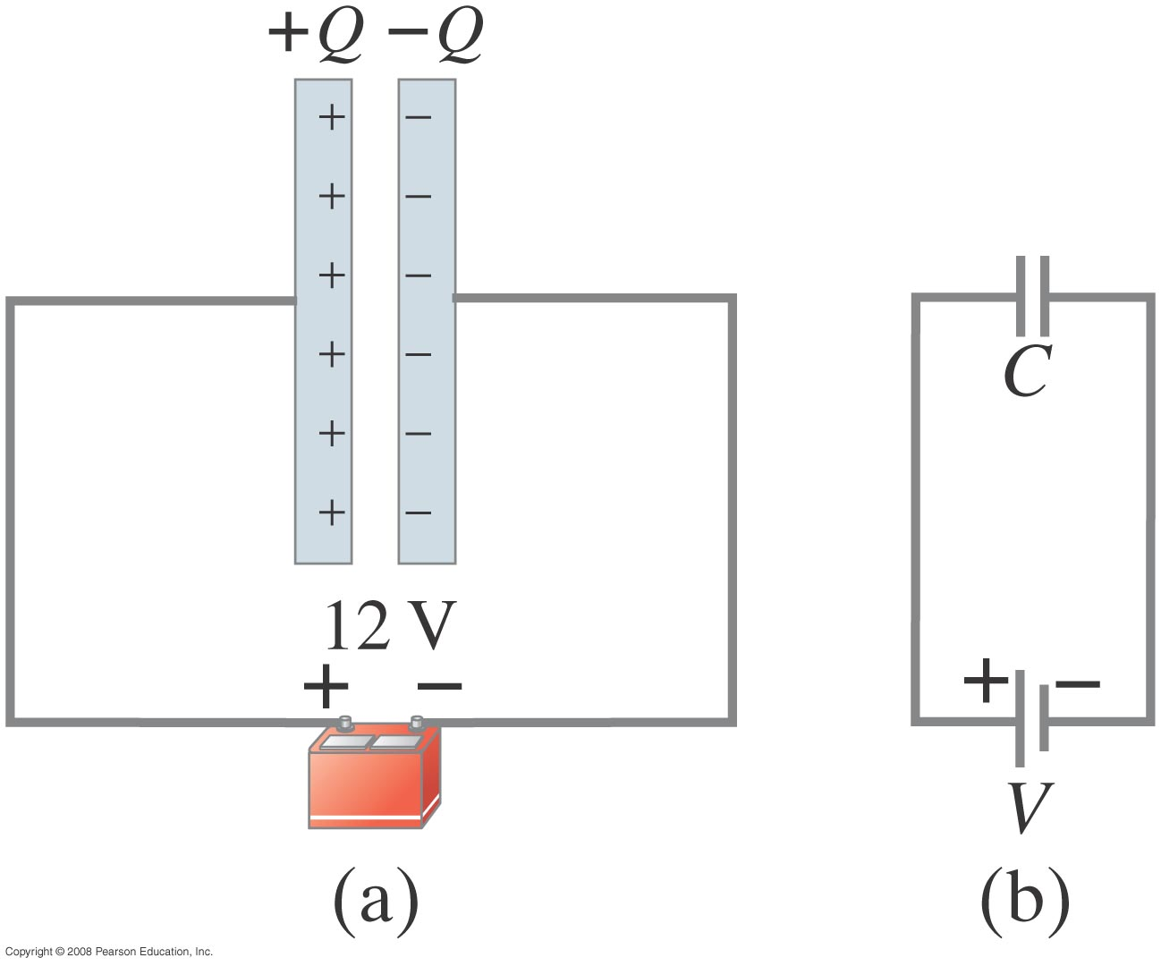
24-1 Capacitors
Parallel-plate capacitor connected to battery. (b) is a circuit diagram.
Notes:
Figure 24-2. (a) Parallel-plate capacitor connected to a battery. (b) Same circuit shown using symbols.

Slide 4
24-1 Capacitors
When a capacitor is connected to a battery, the charge on its plates is proportional to the voltage:
The quantity C is called the capacitance.
Unit of capacitance: the farad (F):
1 F = 1 C/V.

Slide 5
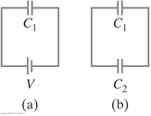
Problem 5
5. (II) A 7.7µF capacitor is charged by a 125-V battery (Fig. 24–20a) and then is disconnected from the battery. When this capacitor (C₁) is then connected (Fig. 24–20b) to a second (initially uncharged) capacitor, the final voltage on each capacitor is 15V. What is the value of C₂ [Hint: Charge is conserved.]

Slide 6
Problem 7
7. (II) It takes 15 J of energy to move a 0.20-mC charge from one plate of a 15µF capacitor to the other. How much charge is on each plate?

Slide 7
Problem 17
17. (II) How strong is the electric field between the plates of a 0.80µF air-gap capacitor if they are 2.0 mm apart and each has a charge of 92µC?

Slide 8
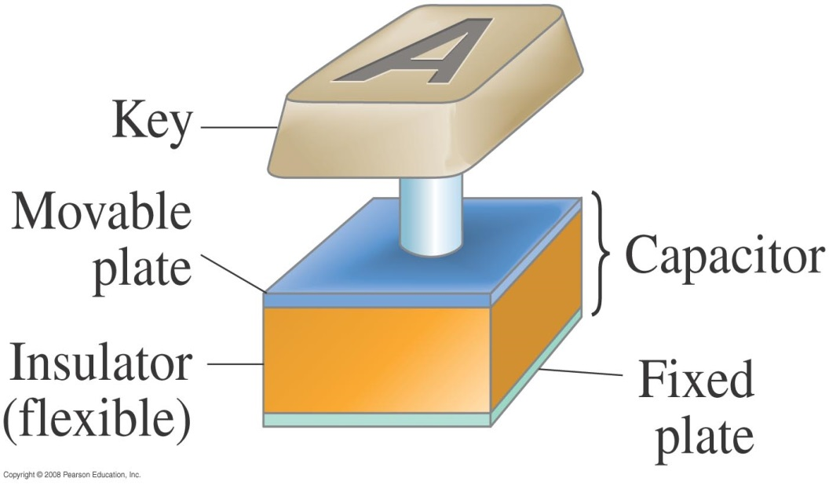
24-2 Determination of Capacitance
Capacitors are now made with capacitances of 1 farad and more, but they are not parallel-plate capacitors. Instead, they are electrochemical capacitors with activated carbon, which acts as a capacitor on a very small scale. The capacitance of 0.1 g of activated carbon is about 1 farad.
Some computer keyboards use capacitors; depressing the key changes the capacitance, which is detected in a circuit.
Notes:
Figure 24-5. Key on a computer keyboard. Pressing the key reduces the capacitor spacing thus increasing the capacitance which can be detected electronically.

Slide 9
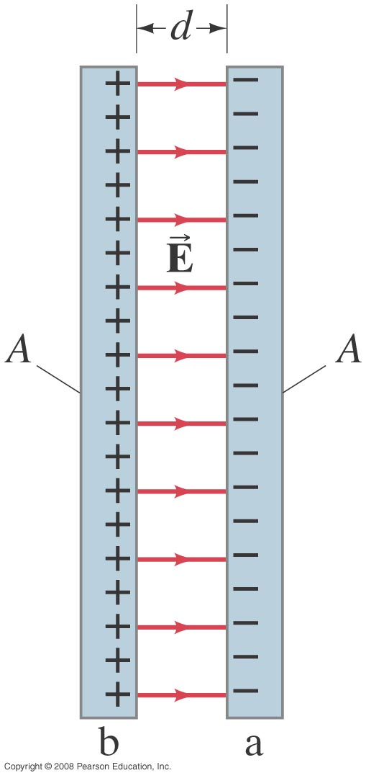
24-2 Determination of Capacitance
Notes:
Figure 24-4. Parallel-plate capacitor, each of whose plates has area A. Fringing of the field is ignored.

Slide 10
Question
While a parallel plate capacitor is attached to a battery, the plates are separated a little more so that
+Q
-Q
a) E increases and Q decreases
b) E remains constant and Q increases
c) E remains constant and Q decreases
d) E decreases and Q decreases
E
V

Slide 11
Question
While a parallel plate capacitor is attached to a battery, the plates are separated a little more so that
+Q
-Q
a) E increases and Q decreases
b) E remains constant and Q increases
c) E remains constant and Q decreases
d) E decreases and Q decreases
E
• C and Q decrease
V
• Q and E decrease

Slide 12
24-2 Determination of Capacitance
Example 24-1: Capacitor calculations.
(a) Calculate the capacitance of a parallel-plate capacitor whose plates are 20 cm × 3.0 cm and are separated by a 1.0-mm air gap. (b) What is the charge on each plate if a 12-V battery is connected across the two plates? (c) What is the electric field between the plates? (d) Estimate the area of the plates needed to achieve a capacitance of 1 F, given the same air gap d.
Notes:
Solution: a. C = 53 pF.
b. Q = CV = 6.4 x 10⁻¹⁰ C.
c. E = V/d = 1.2 x 10⁴ V/m.
d. A = Cd/ε₀ = 10⁸ m².

Slide 13
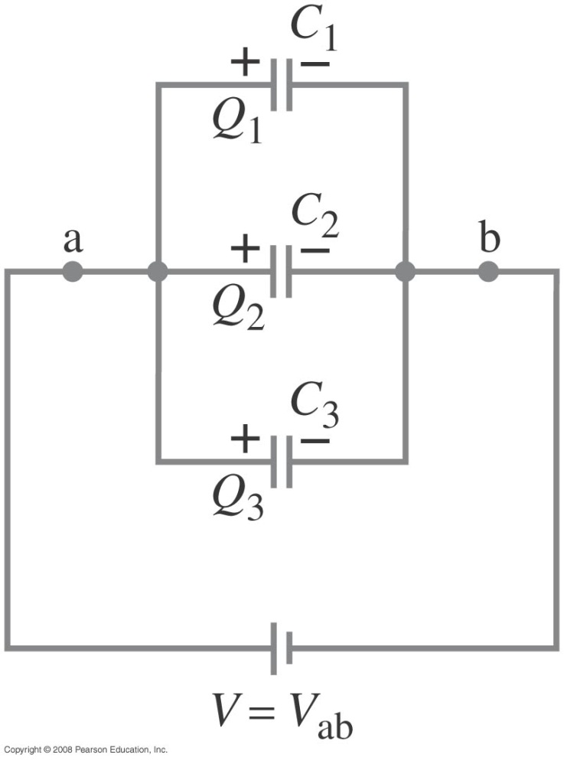
24-3 Capacitors in Series and Parallel
Capacitors in parallel have the same voltage across each one. The equivalent capacitor is one that stores the same charge when connected to the same battery:
Notes:
Figure 24-9. Capacitors in parallel: C_{eq} = C₁ + C₂ + C₃ .

Slide 14
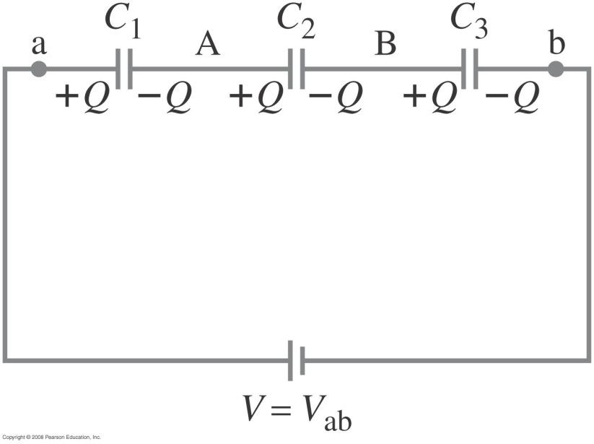
24-3 Capacitors in Series and Parallel
Capacitors in series have the same charge. In this case, the equivalent capacitor has the same charge across the total voltage drop. Note that the formula is for the inverse of the capacitance and not the capacitance itself!
Notes:
Figure 24-10. Capacitors in series: 1/C_{eq} = 1/C₁ + 1/C₂ + 1/C₃.

Slide 15
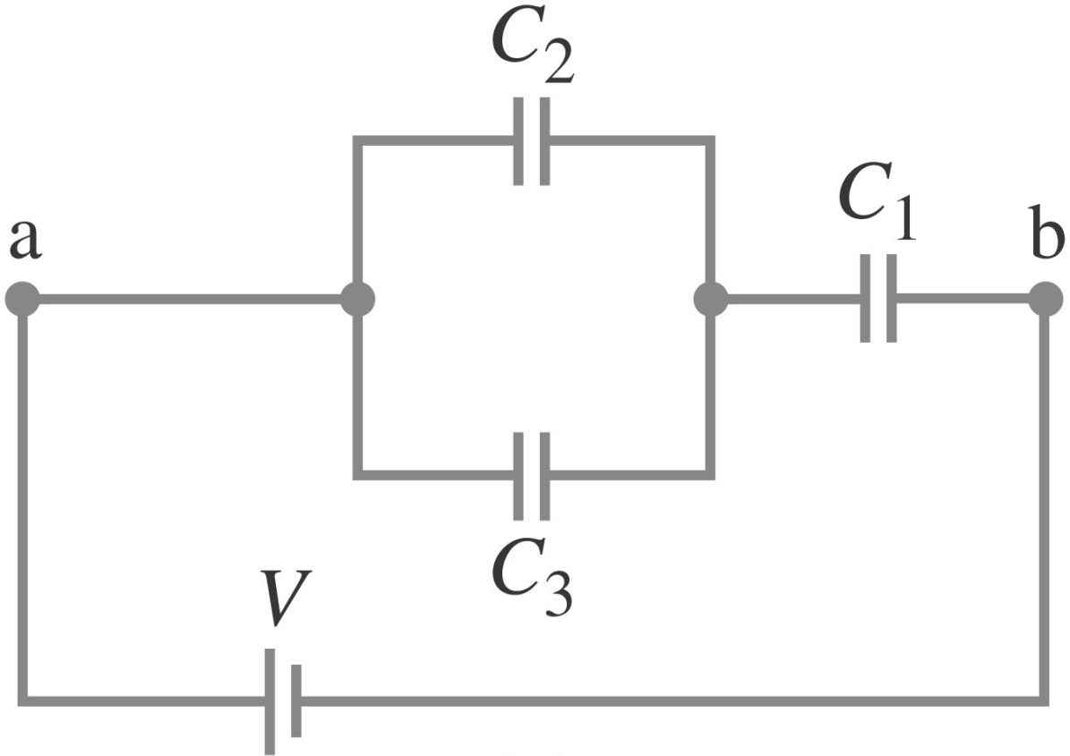
24-3 Capacitors in Series and Parallel
Example 24-5: Equivalent capacitance.
Determine the capacitance of a single capacitor that will have the same effect as the combination shown.Take C₁=C₂=C₃=C
Notes:
Solution: First, find the equivalent capacitance of the two capacitors in parallel (2C); then the equivalent of that capacitor in series with the third (2/3 C).

