Slide 1
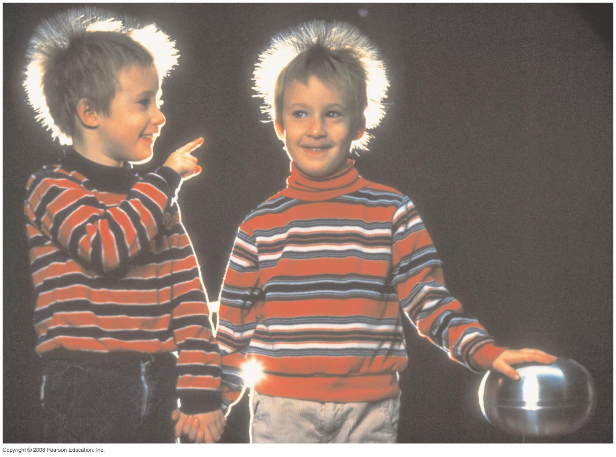
Chapter 23 Electric Potential
HW#3: Chapter 22: Pb.1, Pb.6,Pb.24 Pb.27, Pb.35 due on Friday, Feb. 16
Notes:
Chapter 23 opener. We are used to voltage in our lives—a 12-volt car battery, 110 V or 220 V at home, 1.5 volt flashlight batteries, and so on. Here we see a Van de Graaff generator, whose voltage may reach 50,000 V or more. Voltage is the same as electric potential difference between two points. Electric potential is defined as the potential energy per unit charge. The children here, whose hair stands on end because each hair has received the same sign of charge, are not harmed by the voltage because the Van de Graaff cannot provide much current before the voltage drops. (It is current through the body that is harmful, as we will see later.)

Slide 2
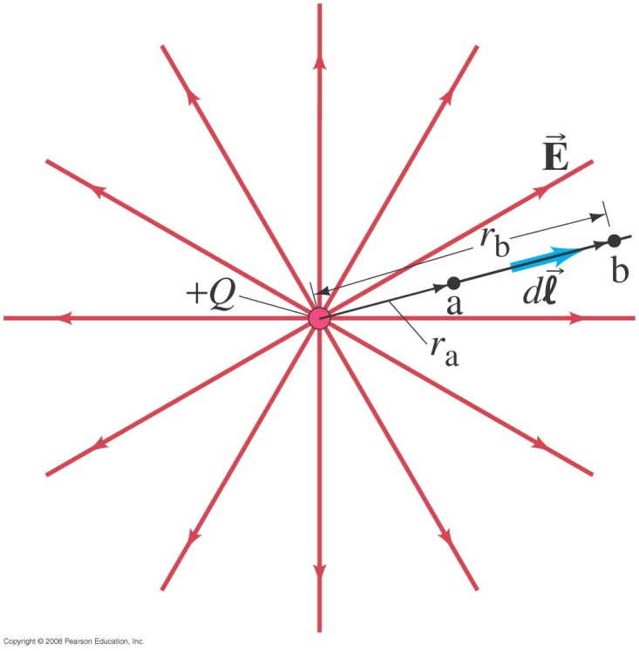
23-3 Electric Potential Due to Point Charges
To find the electric potential due to a point charge, we integrate the field along a field line:
Notes:
Figure 23-9. We integrate Eq. 23–4a along the straight line (shown in black) from point a to point b. The line ab is parallel to a field line.

Slide 3
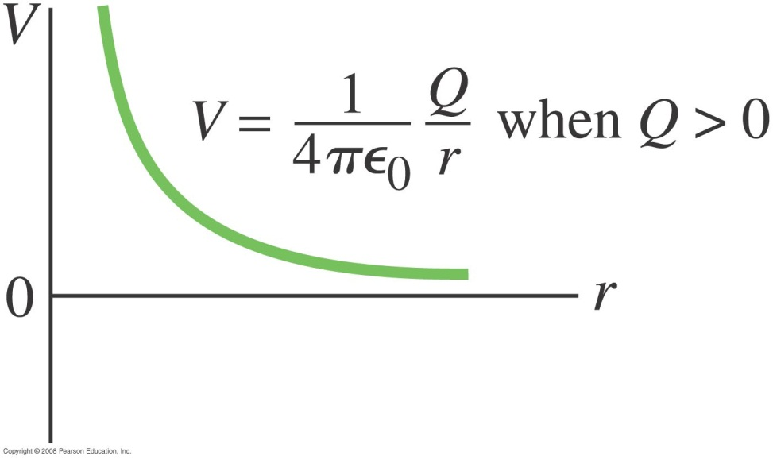
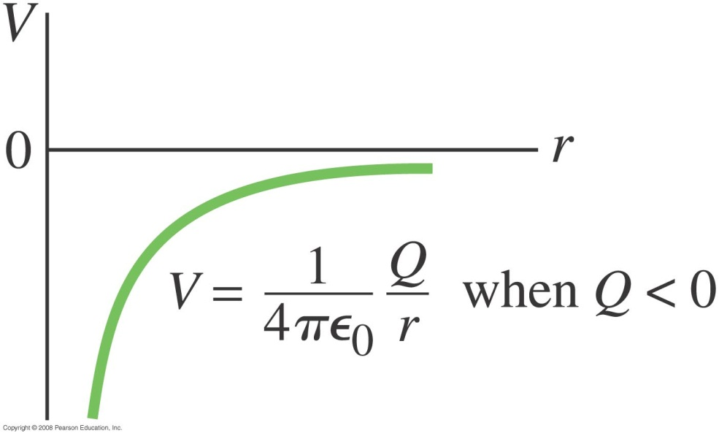
23-3 Electric Potential Due to Point Charges
Setting the potential to zero at r = ∞ gives the general form of the potential due to a point charge:
Notes:
Figure 23-10. Potential V as a function of distance r from a single point charge Q when the charge is positive.
Figure 23-11. Potential V as a function of distance r from a single point charge Q when the charge is negative.

Slide 4
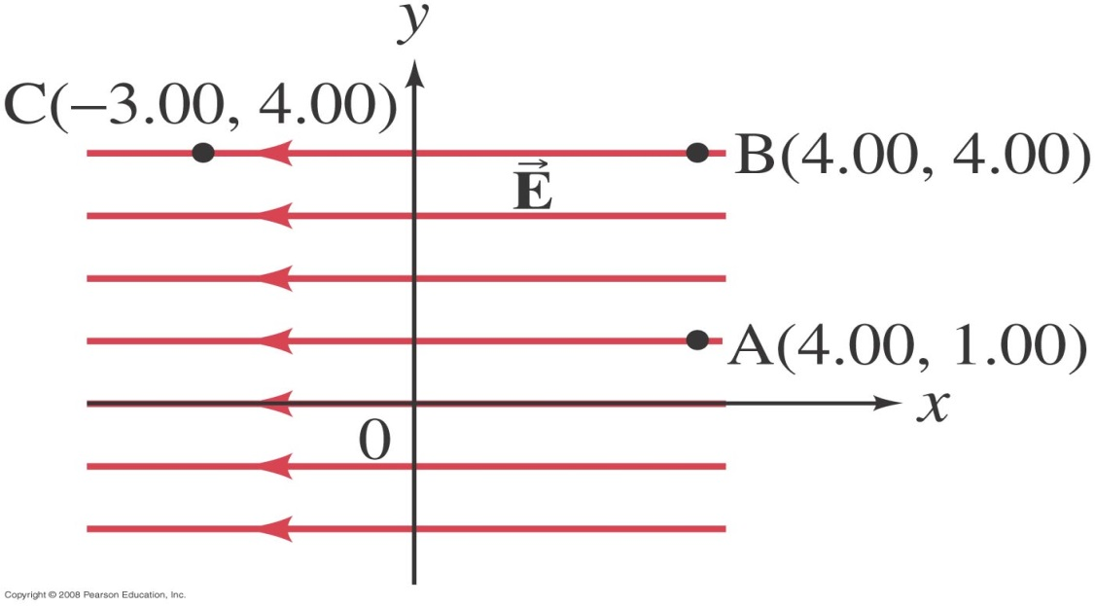
Problem 11

Slide 5
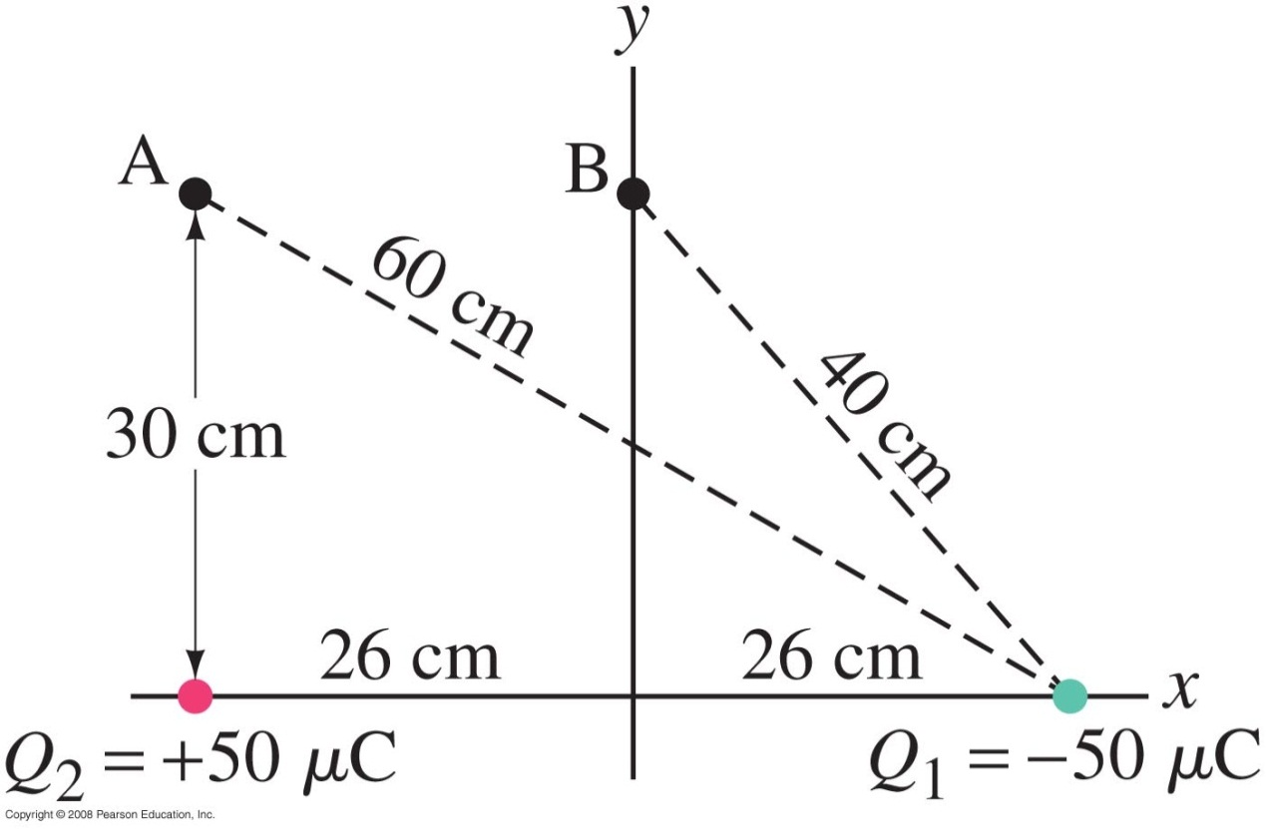
23-3 Electric Potential Due to Point Charges
Example 23-7: Potential above two charges.
Calculate the electric potential (a) at point A in the figure due to the two charges shown, and (b) at point B.
Notes:
Solution: The total potential is the sum of the potential due to each charge; potential is a scalar, so there is no direction involved, but we do have to keep track of the signs.
a. V = 7.5 x 10⁵ V
b. V = 0 (true at any point along the perpendicular bisector)

Slide 6
23-4 Potential Due to Any Charge Distribution
The potential due to an arbitrary charge distribution can be expressed as a sum or integral (if the distribution is continuous):
or

Slide 7
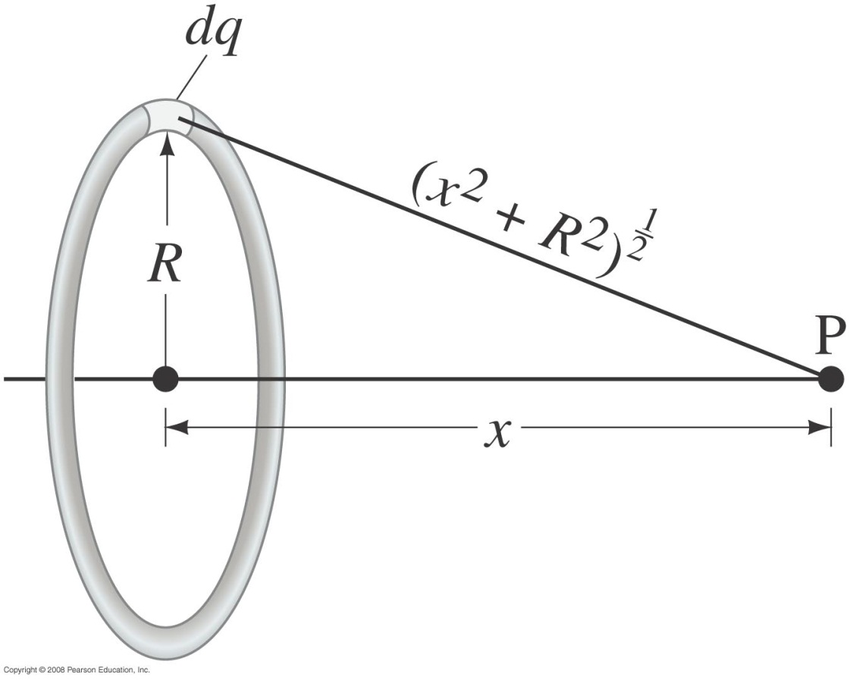
23-4 Potential Due to Any Charge Distribution
Example 23-8: Potential due to a ring of charge.
A thin circular ring of radius R has a uniformly distributed charge Q. Determine the electric potential at a point P on the axis of the ring a distance x from its center.
Notes:
Solution: Each point on the ring is the same distance from point P, so the potential is just that of a charge Q a distance (R² + x²)^{1/2} from point P.

Slide 8
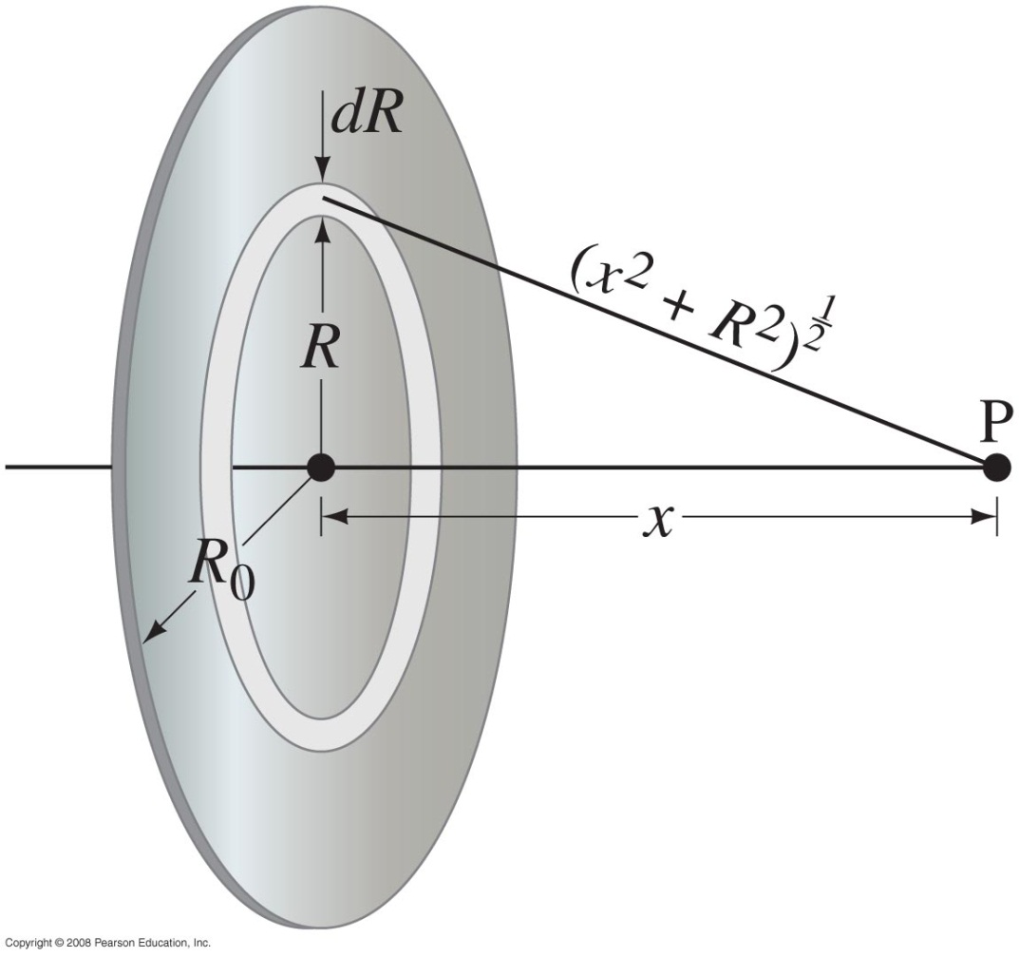
23-4 Potential Due to Any Charge Distribution
Example 23-9: Potential due to a charged disk.
A thin flat disk, of radius R₀, has a uniformly distributed charge Q. Determine the potential at a point P on the axis of the disk, a distance x from its center.
Notes:
Solution: Consider the disk to be made up of infinitely thin rings, each at a radius R with a thickness dR. Each ring then carries a charge dq = 2QR dR/R₀². Integrating to find V then gives the solution in the text.

Slide 9
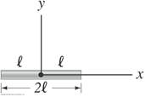
Problem 38
(II) A thin rod of length 2l is centered on the x axis as shown in Fig. 23–31. The rod carries a uniformly distributed charge Q. Determine the potential V as a function of y for points along the y axis. Let V=0 at infinity.

Slide 10
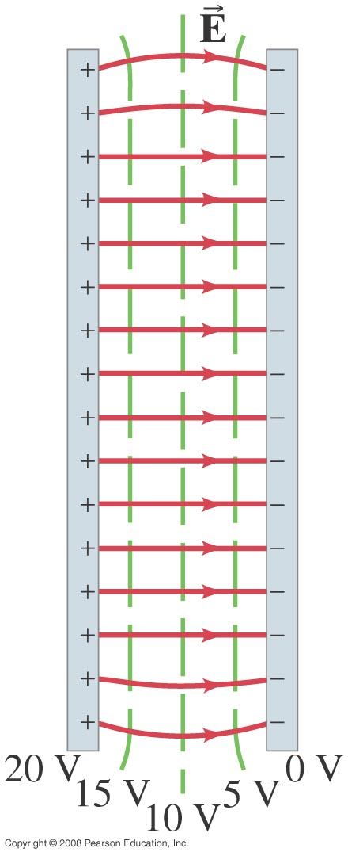
23-5 Equipotential Surfaces
An equipotential is a line or surface over which the potential is constant.
Electric field lines are perpendicular to equipotentials.
The surface of a conductor is an equipotential (same potential at the surface).
Notes:
Figure 23-16. Equipotential lines (the green dashed lines) between two oppositely charged parallel plates. Note that they are perpendicular to the electric field lines (solid red lines).

Slide 11
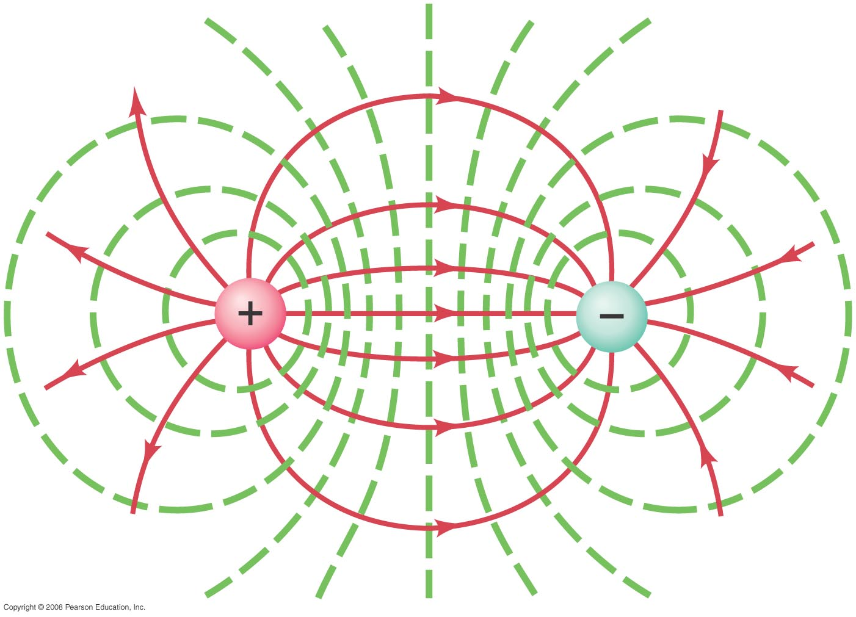
23-5 Equipotential Surfaces
Equipotential surfaces are always perpendicular to field lines; they are always closed surfaces (unlike field lines, which begin and end on charges).
Notes:
Figure 23-18. Equipotential lines (green, dashed) are always perpendicular to the electric field lines (solid red) shown here for two equal but oppositely charged particles.

Slide 12
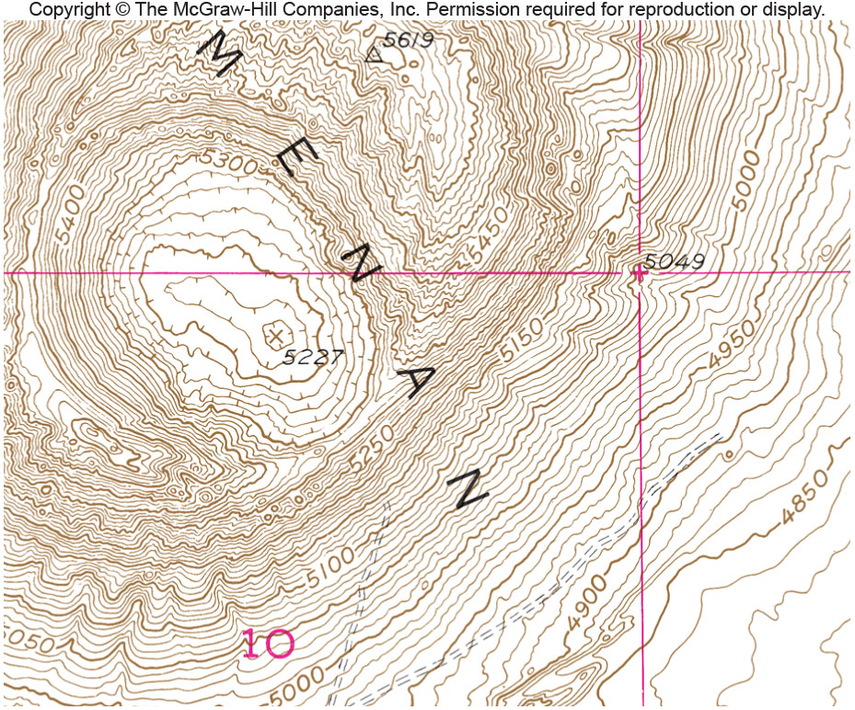
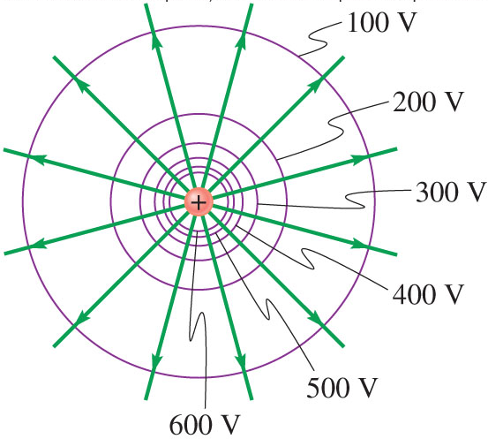
Equipotential Surfaces
Surfaces at same potential
like contours on topographic maps
Lines link places at same elevation (same U_{g})
Lines link places at same potential (same V)

Slide 13
Equipotential Surfaces
Surfaces that have the same potential (voltage) at every point
Electric Field lines are perpendicular to equipotential surfaces
Potential difference between surfaces is constant
Surfaces are closer where the potential is stronger
Electric field always points in the direction of the potential DECREASE

Slide 14
Question
Which image below best shows the equipotential and Electric field lines
A
B
-
+
-
+
C
D
-
+
-
+

Slide 15
23-5 Equipotential Surfaces
Example 23-10: Point charge equipotential surfaces.
For a single point charge with Q = 4.0 × 10⁻⁹ C, sketch the equipotential surfaces (or lines in a plane containing the charge) corresponding to V₁ = 10 V, V₂ = 20 V, and V₃ = 30 V.
Notes:
Solution: Equipotential surfaces are spheres surrounding the charge; radii are shown in the figure (in meters).

Slide 16
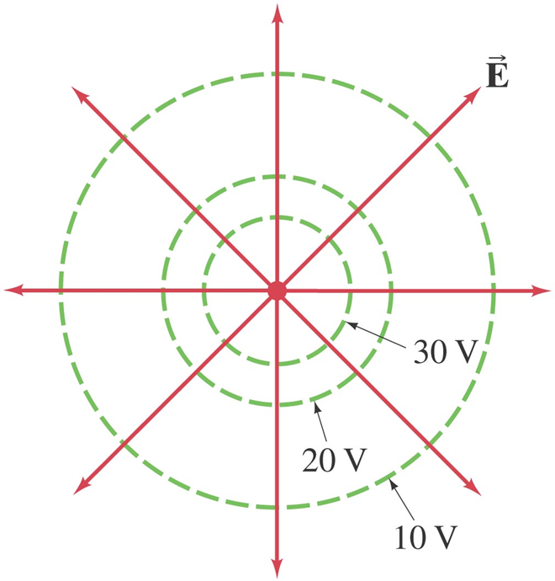
23-5 Equipotential Surfaces

Slide 17
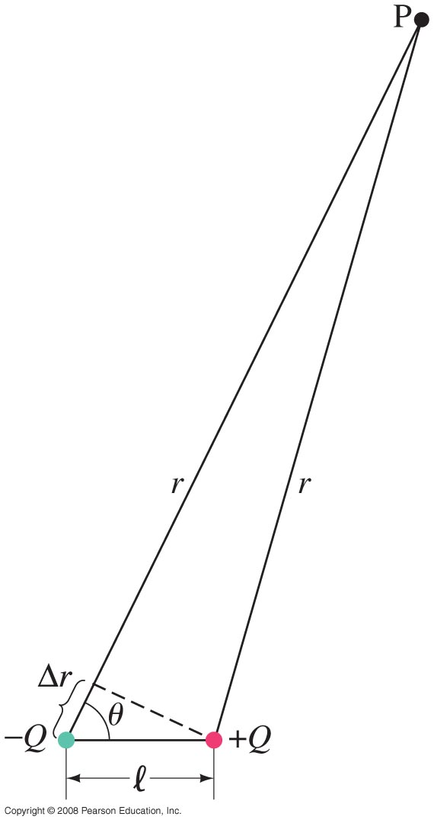
23-6 Electric Dipole Potential
The potential due to an electric dipole is just the sum of the potentials due to each charge, and can be calculated exactly. For distances large compared to the charge separation:
Notes:
Figure 23-20. Electric dipole. Calculation of potential V at point P.

Slide 18
23-7 Determined from V
If we know the field, we can determine the potential by integrating. Inverting this process, if we know the potential, we can find the field by differentiating:
This is a vector differential equation; here it is in component form:
Look at example 23-11 in the book

Slide 19
23-8 Electrostatic Potential Energy; the Electron Volt
The potential energy of a charge in an electric potential is U=qV. To find the electric potential energy of two charges, imagine bringing each in from infinitely far away.
The first one takes no work as there is no field. To bring in the second one, we must do work due to the field of the first one; this means the potential energy of the pair is:

Slide 20
23-8 Electrostatic Potential Energy; the Electron Volt
One electron volt (eV) is the energy gained by an electron moving through a potential difference of one volt:
1 eV = 1.6 × 10⁻¹⁹ J.
The electron volt is often a much more convenient unit than the joule for measuring the energy of individual particles.

Slide 21
Relationships….
Property of a charge q
Property of a Point P
Electric Force
Electric Field
Vector
quantities
Per unit
Charge=
Is the negative
derivative (change) of
Is the negative
Derivative of
Scalar
quantities
Electric Potential
Energy
Per unit
Charge=
Electric Potential

