Slide 1
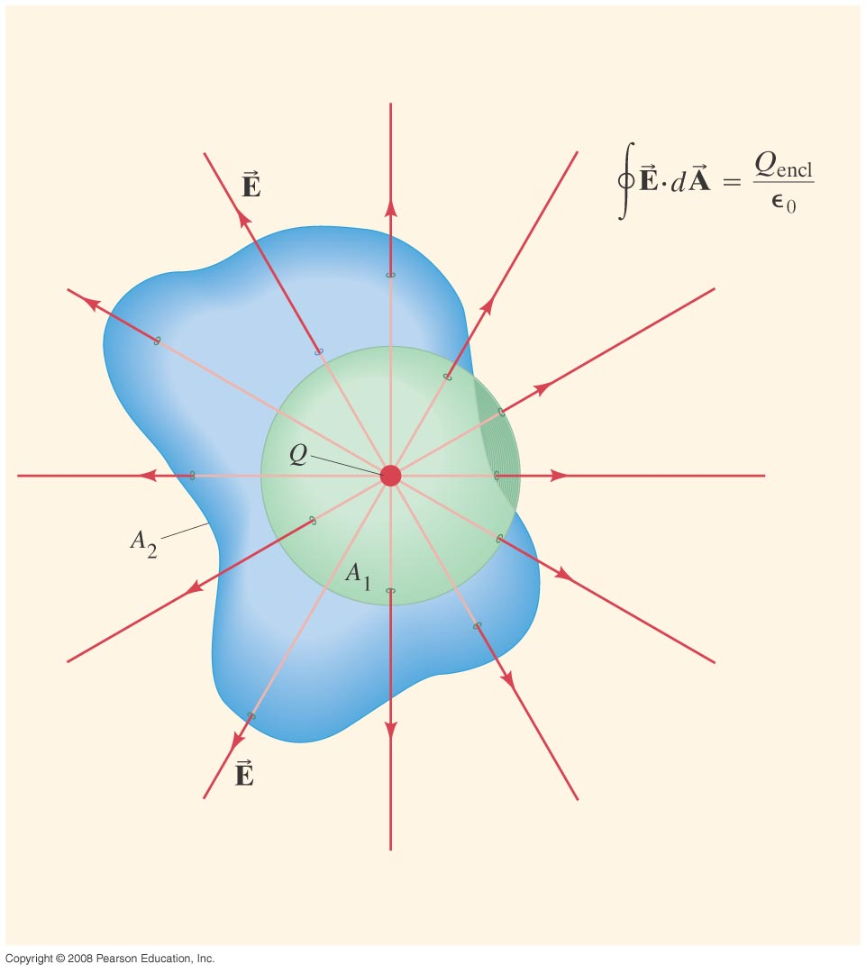
Chapter 22 Gauss’s Law
Exam Friday, Feb. 2
Study Guide posted
HW#2: Chapter 21: Pb.25, Pb.31,Pb.35 Pb.36, Pb.38, Pb.46 due Wednesday, Feb.7
Notes:
Chapter 22 opener. Gauss’s law is an elegant relation between electric charge and electric field. It is more general than Coulomb’s law. Gauss’s law involves an integral of the electric field E at each point on a closed surface. The surface is only imaginary, and we choose the shape and placement of the surface so that we can figure out the integral. In this drawing, two different surfaces are shown, both enclosing a point charge Q. Gauss’s law states that the product E·dA, where dA is an infinitesimal area of the surface, integrated over the entire surface, equals the charge enclosed by the surface Q_{encl} divided by ε₀. Both surfaces here enclose the same charge Q. Hence ∫E·dA will give the same result for both surfaces.

Slide 2
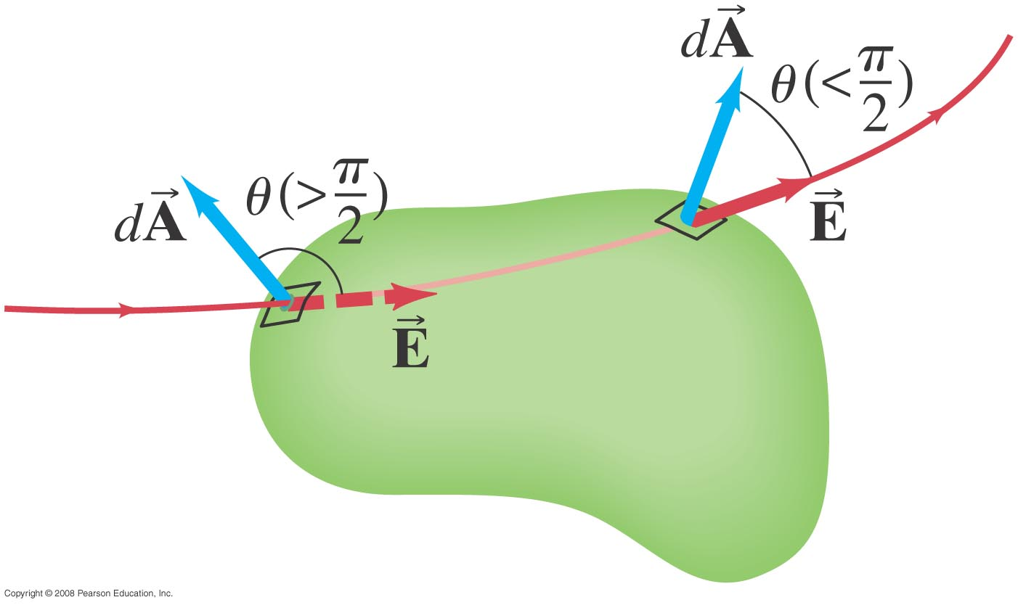
22-1 Electric Flux
Flux through a closed surface:
If the flux is negative there is no net flux into the volume
For E leaving the surface θ < π/2
For E entering the surface θ > π/2

Slide 3
22-2 Gauss’s Law
The net number of field lines through the surface is proportional to the charge enclosed, and also to the flux, giving Gauss’s law:
This can be used to find the electric field in situations with a high degree of symmetry.

Slide 4
22-2 Gauss’s Law-Problem 7
Problem 7.(II): In Fig. 22–27, two objects O₁ and O₂, have charges 1.0 μC and -2.0 μC respectively, and a third object, O₃ is electrically neutral. (a) What is the electric flux through the surface A₁ that encloses all the three objects? (b) What is the electric flux through the surface A₂ that encloses the third object only?

Slide 5
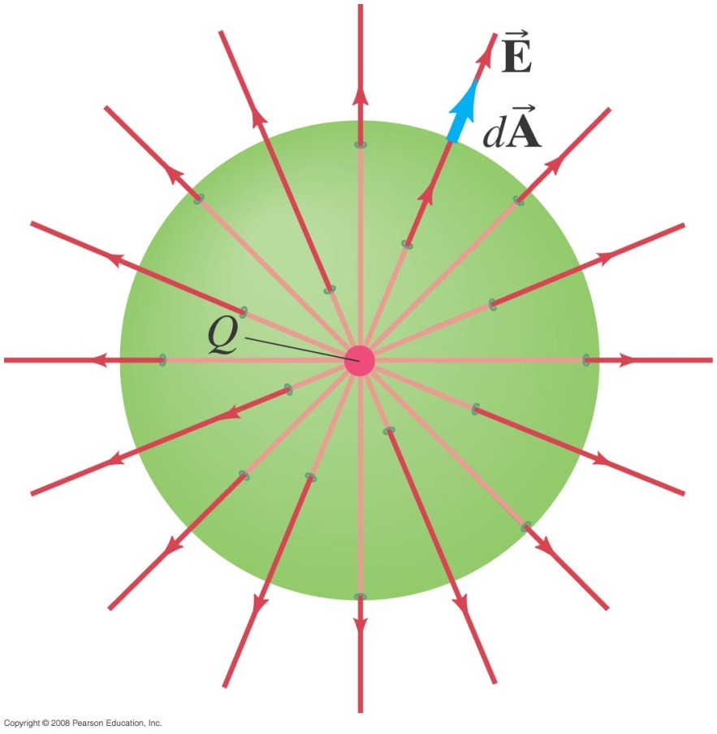
22-2 Gauss’s Law
For a point charge,
Therefore,
Solving for E gives the result we expect from Coulomb’s law:
Notes:
Figure 22-7. A single point charge Q at the center of an imaginary sphere of radius r (our “gaussian surface”—that is, the closed surface we choose to use for applying Gauss’s law in this case).

Slide 6
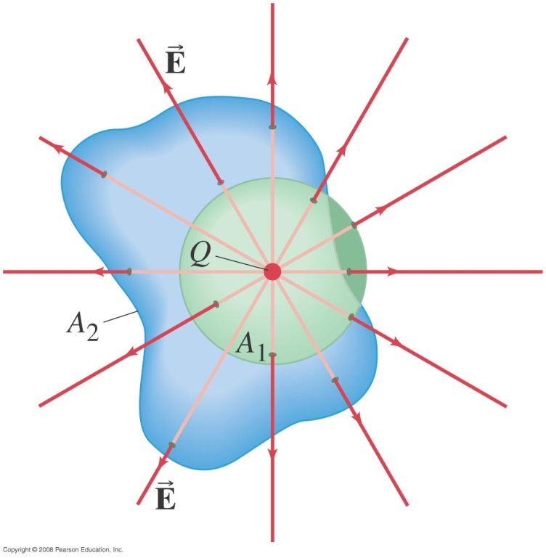
22-2 Gauss’s Law
Using Coulomb’s law to evaluate the integral of the field of a point charge over the surface of a sphere surrounding the charge gives:
Looking at the arbitrarily shaped surface A₂, we see that the same flux passes through it as passes through A₁. Therefore, this result should be valid for any closed surface.
Notes:
Figure 22-8. A single point charge surrounded by a spherical surface, A₁, and an irregular surface,A₂.

Slide 7
22-2 Gauss’s Law
Finally, if a Gaussian surface encloses several point charges, the superposition principle shows that:
Therefore, Gauss’s law is valid for any charge distribution. Note, however, that it only refers to the field due to charges within the gaussian surface – charges outside the surface will also create fields.

Slide 8
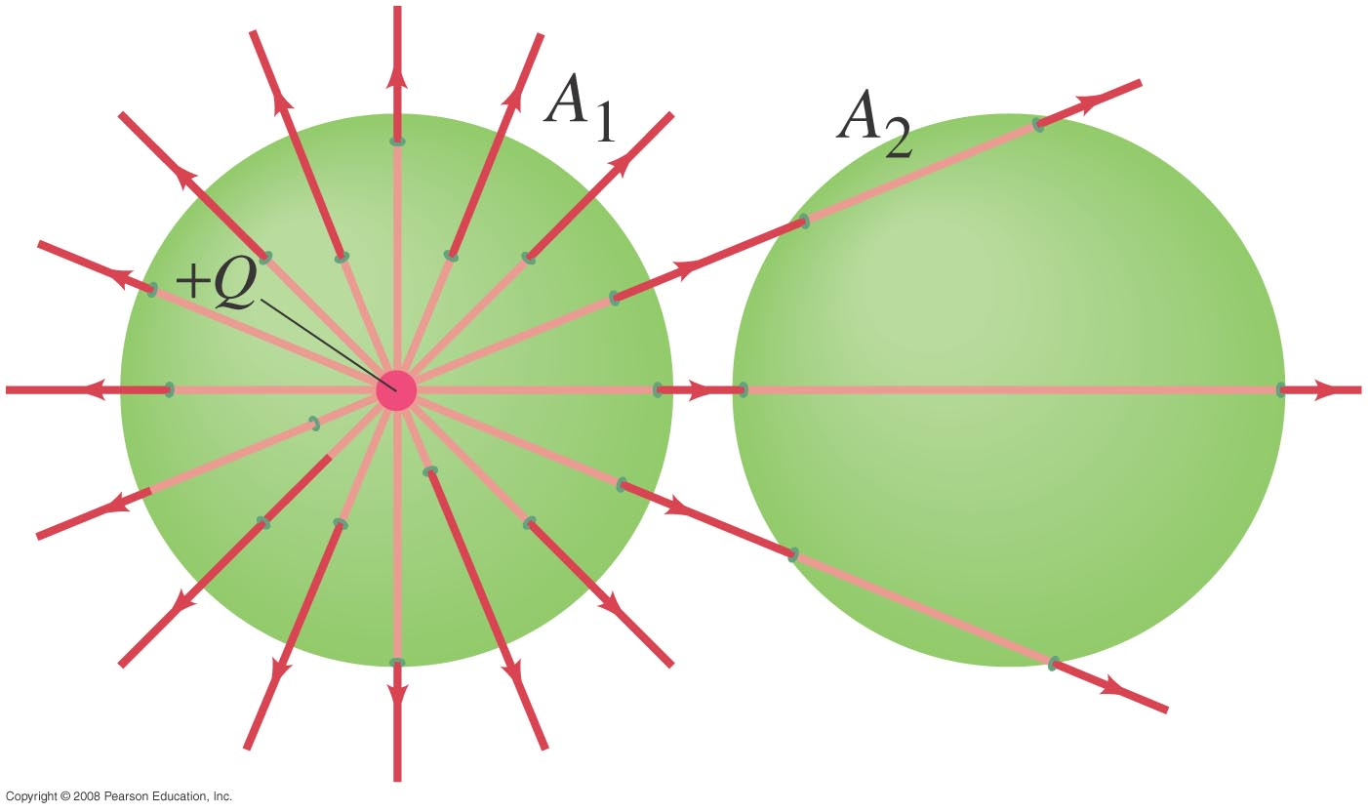
22-2 Gauss’s Law
Conceptual Example 22-2: Flux from Gauss’s law.
Consider the two Gaussian surfaces, A₁ and A₂, as shown. The only charge present is the charge Q at the center of surface A₁. What is the net flux through each surface, A₁ and A₂?
Notes:
Solution: The net flux through A₁ is Q/ε₀, as it encloses charge Q. The net flux through surface A₂ is zero, even though the field is not zero on the surface.

Slide 9
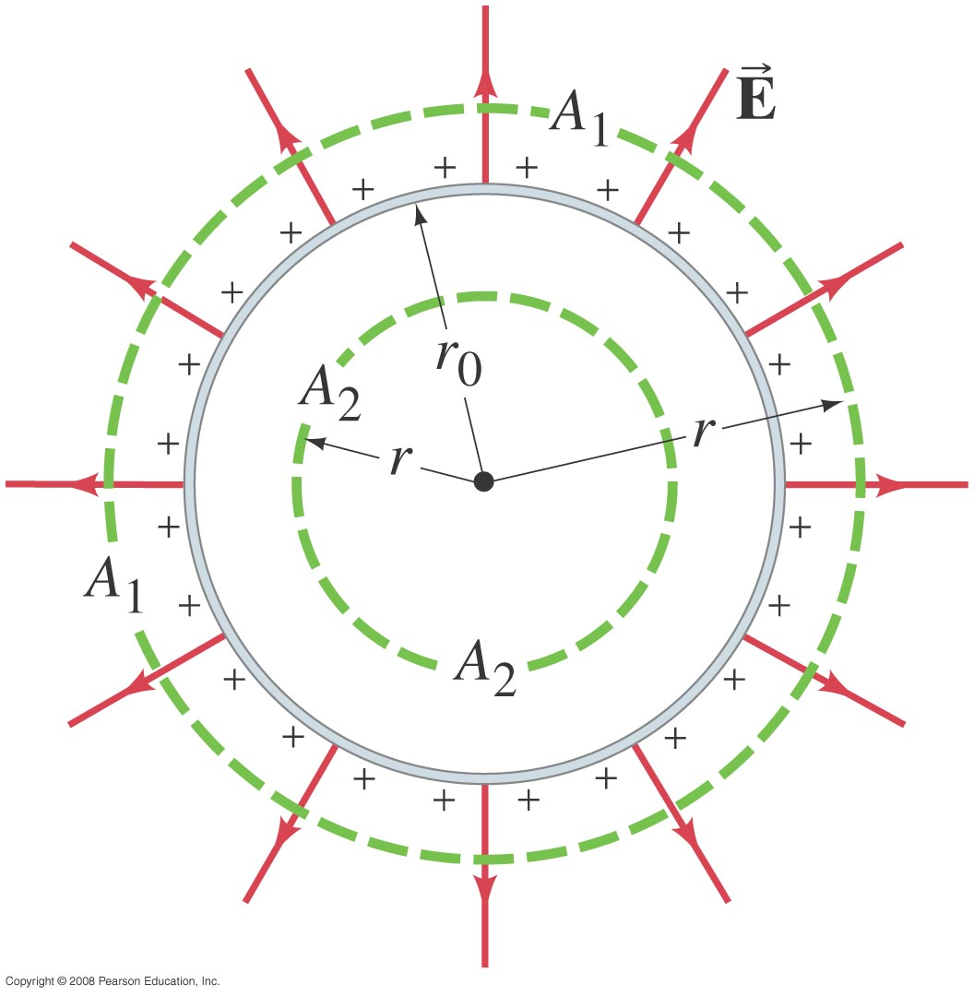
22-3 Applications of Gauss’s Law
Example 22-3: Spherical conductor.
A thin spherical shell of radius r₀ possesses a total net charge Q that is uniformly distributed on it. Determine the electric field at points (a) outside the shell, and (b) within the shell. (c) What if the conductor were a solid sphere?
Notes:
Figure 22-11. Cross-sectional drawing of a thin spherical shell of radius r₀ carrying a net charge Q uniformly distributed. A₁ and A₂ represent two gaussian surfaces we use to determine Example 22–3.
Solution: a. The gaussian surface A₁, outside the shell, encloses the charge Q. We know the field must be radial, so E = Q/(4πε₀r²).
b. The gaussian surface A₂, inside the shell, encloses no charge; therefore the field must be zero.
c. All the excess charge on a conductor resides on its surface, so these answers hold for a solid sphere as well.

Slide 10
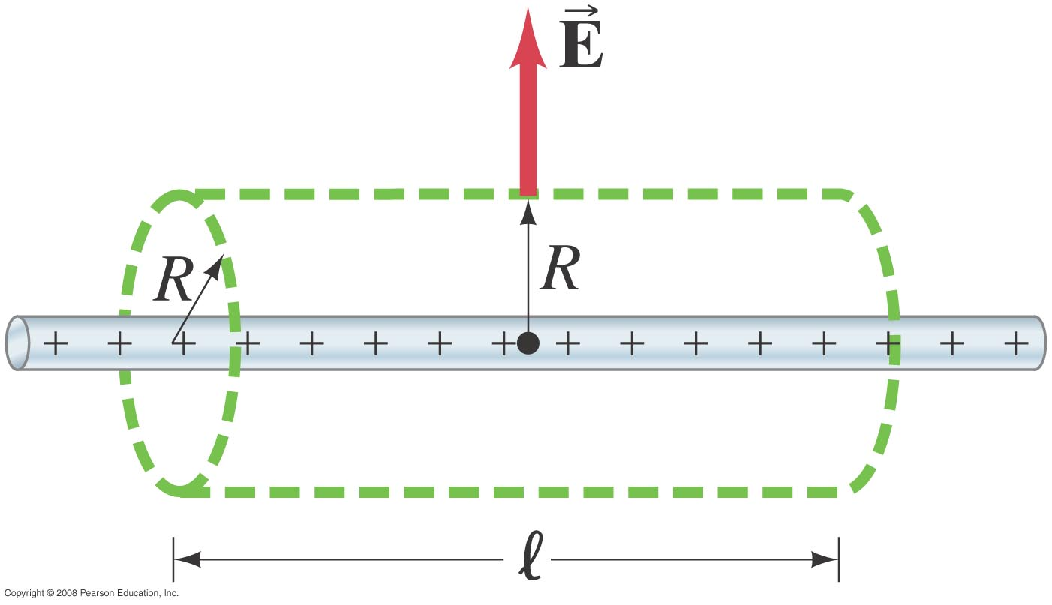
22-3 Applications of Gauss’s Law
Example 22-6: Long uniform line of charge. A very long straight wire possesses a uniform positive charge per unit length, λ. Calculate the electric field at points near (but outside) the wire, far from the ends.
Notes:
Solution: If the wire is essentially infinite, it has cylindrical symmetry and we expect the field to be perpendicular to the wire everywhere. Therefore, a cylindrical gaussian surface will allow the easiest calculation of the field. The field is parallel to the ends and constant over the curved surface; integrating over the curved surface gives E = λ/2πε₀R.

Slide 11
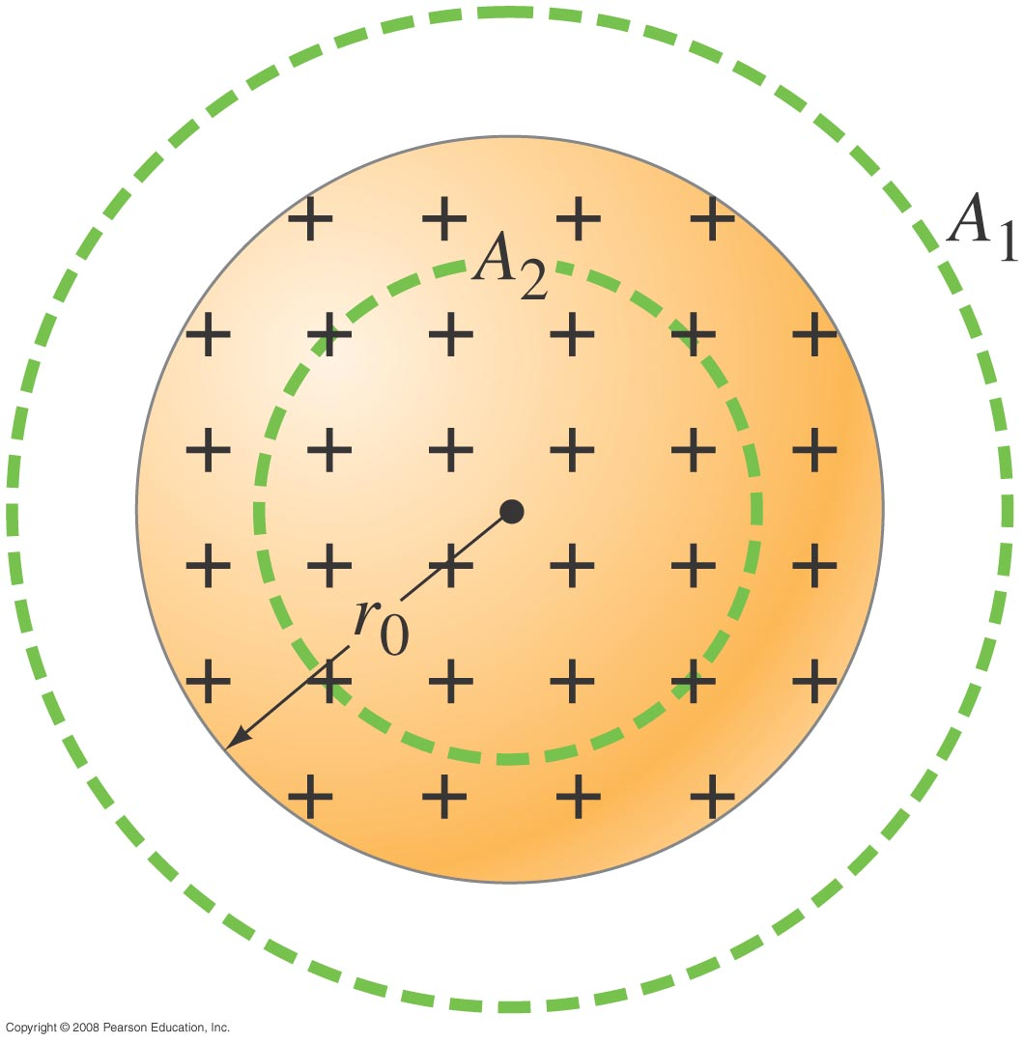
22-3 Applications of Gauss’s Law
Example 22-4: Solid sphere of charge.
An electric charge Q is distributed uniformly throughout a nonconducting sphere of radius r₀. Determine the electric field (a) outside the sphere (r > r₀) and (b) inside the sphere (r < r₀).
Notes:
Solution: a. Outside the sphere, a gaussian surface encloses the total charge Q. Therefore, E = Q/(4πε₀r²).
b. Within the sphere, a spherical gaussian surface encloses a fraction of the charge Qr³/r₀³ (the ratio of the volumes, as the charge density is constant). Integrating and solving for the field gives E = Qr/(4πε₀r₀³).

Slide 12
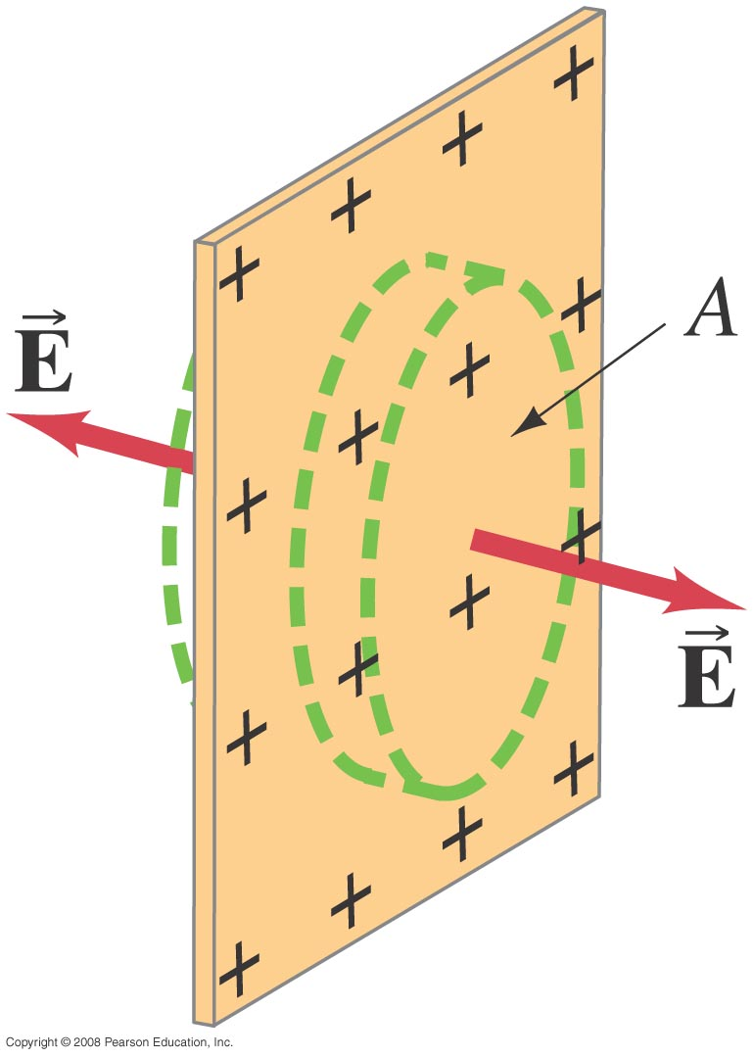
22-3 Applications of Gauss’s Law
Example 22-7: Infinite plane of charge.
Charge is distributed uniformly, with a surface charge density σ (σ = charge per unit area = dQ/dA) over a very large but very thin nonconducting flat plane surface. Determine the electric field at points near the plane.
Notes:
Solution: We expect E to be perpendicular to the plane, and choose a cylindrical gaussian surface with its flat sides parallel to the plane. The field is parallel to the curved side; integrating over the flat sides gives E = σ/2ε₀.

Slide 13
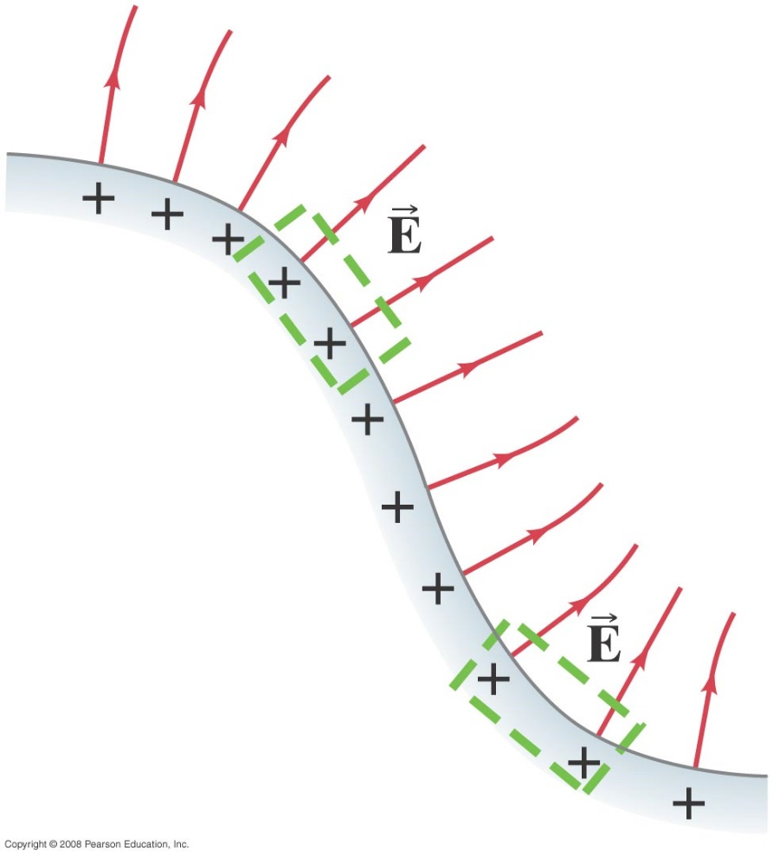
22-3 Applications of Gauss’s Law
Example 22-8: Electric field near any conducting surface.
Show that the electric field just outside the surface of any good conductor of arbitrary shape is given by
E = σ/ε₀
where σ is the surface charge density on the conductor’s surface at that point.
Notes:
Solution: Again we choose a cylindrical gaussian surface. Now, however, the field inside the conductor is zero, so we only have a nonzero integral over one surface of the cylinder. Integrating gives E = σ/ε₀.

Slide 14
22-3 Applications of Gauss’s Law
The difference between the electric field outside a conducting plane of charge and outside a non-conducting plane of charge can be thought of in two ways:
The field inside the conductor is zero, so the flux is all through one end of the cylinder.
The conducting plane has a total charge density σ, whereas the non-conducting plane has a charge density σ on each side, effectively giving it twice the charge density.

