Slide 1
Chapter 21, Electric Charge, and electric Field
No Homework this week
Exam Friday, Feb. 2
Study Guide posted
Quiz on Friday

Slide 2
21.6 Electric Field 2-D
Problem: Two charges are positioned as seen below. Q₁= +2.0 µC and Q₂= +8.0µC.
What is the magnitude and the direction of the Electric Field at point P?
y
q₁
r₁=0.090m
P
q₂
x
r₂=0.12m
k = 8.99x10⁺⁹ Nm²/C² = Coulomb’s constant

Slide 3
Problem 34
34.(II) Calculate the electric field at the center of a square 52.5 cm on a side if one corner is occupied by a -38.6μC charge and the other three are occupied by-27μC charges.

Slide 4
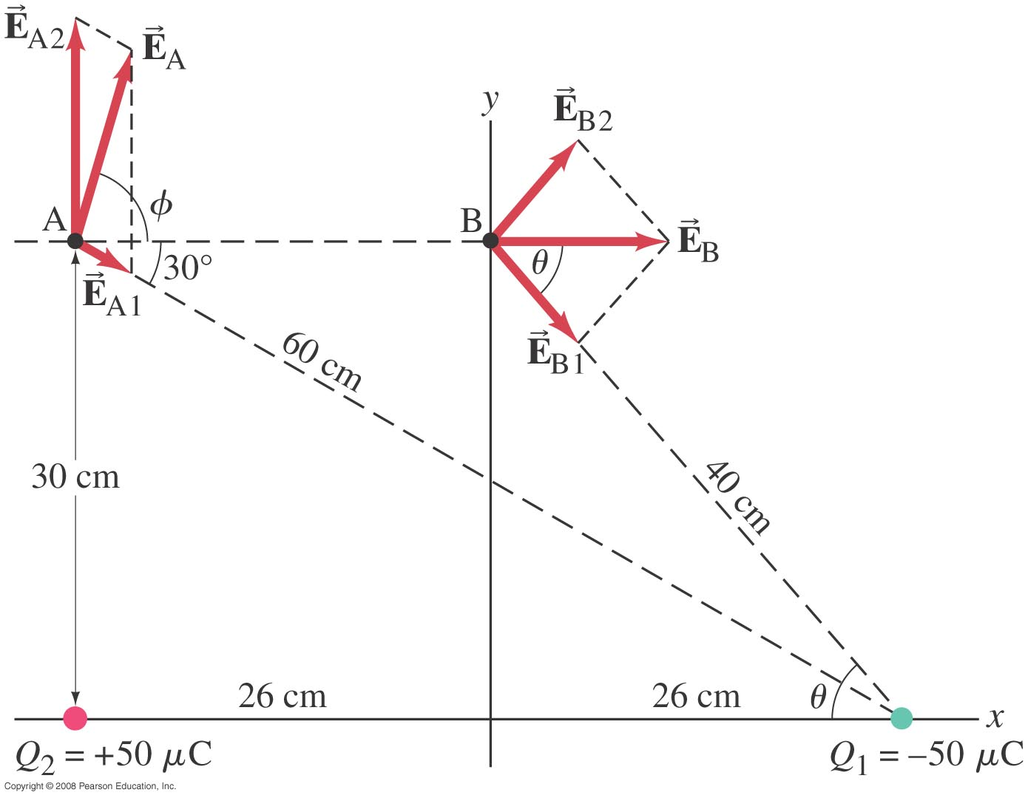
21-6 The Electric Field
Example 21-8: above two point charges.
Calculate the total electric field :
(a) at point A and (b) at point B in the figure due to both charges, Q₁ and Q₂.
Notes:
Solution: The geometry is shown in the figure. For each point, the process is: calculate the magnitude of the electric field due to each charge; calculate the x and y components of each field; add the components; recombine to give the total field.
a. E = 4.5 x 10⁶ N/C, 76° above the x axis.
b. E = 3.6 x 10⁶ N/C, along the x axis.

Slide 5
21-6 The Electric Field
Problem solving in electrostatics: electric forces and electric fields
Draw a diagram; show all charges, with signs, and electric fields and forces with directions.
Calculate forces using Coulomb’s law.
Add forces and Electric fields vectorially to get result.
Check your answer!

Slide 6
21-7 Electric Field Calculations for Continuous Charge Distributions
A continuous distribution of charge may be treated as a succession of infinitesimal (point) charges. The total field is then the integral of the infinitesimal fields due to each bit of charge:
Remember that the electric field is a vector; you will need a separate integral for each component.

Slide 7
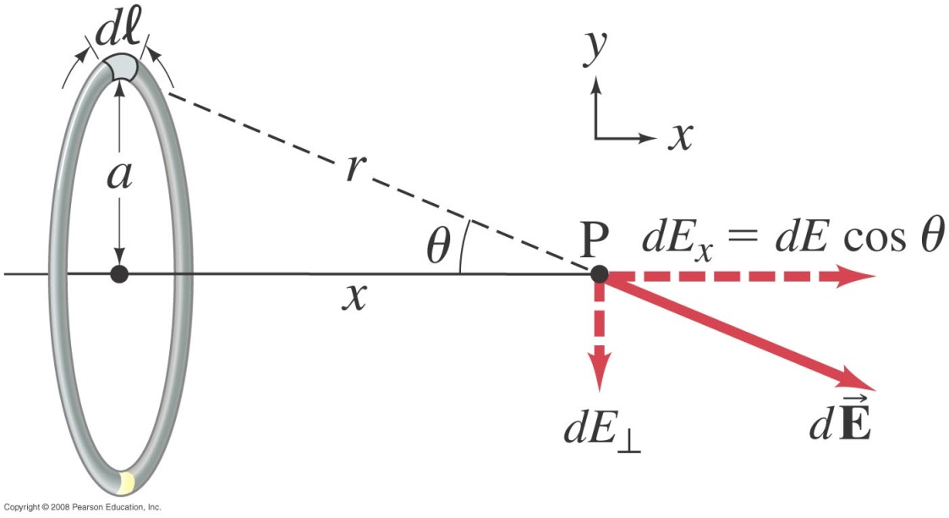
21-7 Electric Field Calculations for Continuous Charge Distributions
Example 21-9: A ring of charge.
A thin, ring-shaped object of radius a holds a total charge +Q distributed uniformly around it. Determine the electric field at a point P on its axis, a distance x from the center. Let λ be the charge per unit length (C/m).
Notes:
Solution: Because P is on the axis, the transverse components of E must add to zero, by symmetry. The longitudinal component of dE is dE cos θ, where cos θ = x/(x² + a²)^{1/2}. Write dQ = λdl, and integrate dl from 0 to 2πa. Answer: E = (1/4πε₀)(Qx/[x² + a²]^{3/2})

