Slide 1
Chapter 21, Electric Charge, and electric Field
No Homework this week
Exam Friday, Feb. 2
Study Guide posted

Slide 2
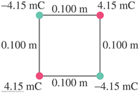
Problem 16
16. (II) Two negative and two positive point charges (magnitude Q=4.15mC) are placed on opposite corners of a square as shown in Fig. 21–54. Determine the magnitude and direction of the force on the charge at the top right of the square.

Slide 3
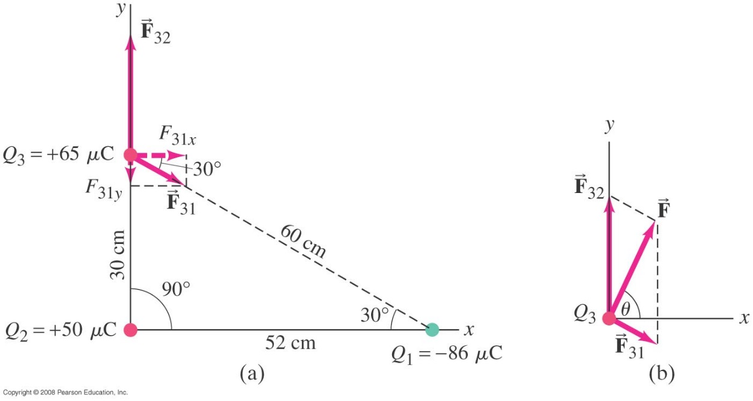
21-5 Coulomb’s Law
Example 21-3: Electric force using vector components.
Calculate the net electrostatic force on charge Q₃ shown in the figure due to the charges Q₁ and Q₂.
Notes:
Figure 21-18. Determining the forces for Example 21–3. (a) The directions of the individual forces are as shown because F₃₂ is repulsive (the force on Q₃ is in the direction away from Q₂ because Q₃ and Q₂ are both positive) whereas F₃₁ is attractive (Q₃ and Q₁ have opposite signs), so F₃₁ points toward Q₁. (b) Adding F₃₂ to F₃₁ to obtain the net force.
Solution: The forces, components, and signs are as shown in the figure. Result: The magnitude of the force is 290 N, at an angle of 65° to the x axis.

Slide 4
21-6 Electric Field
https://www.youtube.com/watch?v=xg0Lg-uSMSQ

Slide 5
21-6 The Electric Field
Gravitational Field
Electric Field
Units N/C
+
+
-e
+
+
Electric field is a vector , just like the electric force

Slide 6
21-6 Electric Field: point charge
If we have a charge (or a system of charges) we can ask ourselves what the electric field is at any point in space, P, a distance r from the charge.
-e
P
r
+e
P
Units: N/C
r

Slide 7
21-6 The Electric Field
The electric field is defined as the force on a small charge, divided by the magnitude of the charge:
The electric field is a vector
Notes:
Figure 21-22. Force exerted by charge Q on a small test charge, q, placed at points A, B, and C.

Slide 8
21-6 The Electric Field
For a point charge:
ε₀ is the permittivity of the free space=8.85x10⁻¹²C²/N.m²

Slide 9
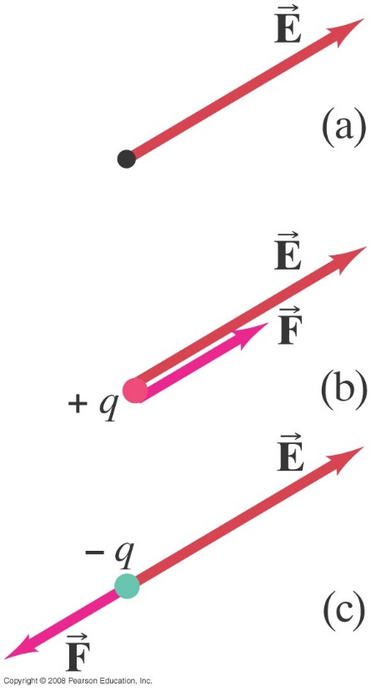
21-6 The Electric Field
Force on a point charge in an electric field, the direction of the force depends on the sign of the charge
Notes:
Figure 21-23. (a) Electric field at a given point in space. (b) Force on a positive charge at that point. (c) Force on a negative charge at that point.

Slide 10
Electric Field: system of charges
If we have a system of charges we can ask ourselves what the electric field is at any point in space, P?
In this case we find the Electric field due to each charge in the system at that point, P, and we do a vector sum of these fields.
r₂
P
Q₂
r₁
r₃
Q₁
Q₃

Slide 11
Problem 26

Slide 12
Problem 27

Slide 13
21-6 The Electric Field
Example 21-7: E at a point between two charges.
Two point charges are separated by a distance of 10.0 cm. One has a charge of -25 μC and the other +50 μC. (a) Determine the direction and magnitude of the electric field at a point P between the two charges that is 2.0 cm from the negative charge. (b) If an electron (mass = 9.11 x 10⁻³¹ kg) is placed at rest at P and then released, what will be its initial acceleration (direction and magnitude)?
Notes:
Figure 21-26. Example 21–7. In (b), we don’t know the relative lengths of E₁ and E₂ until we do the calculation.
Solution: a. The electric fields add in magnitude, as both are directed towards the negative charge. E = 6.3 x 10⁸ N/C.
b. The acceleration is the force (charge times field) divided by the mass, and will be opposite to the direction of the field (due to the negative charge of the electron). Substitution gives a = 1.1 x 10²⁰ m/s².

