Slide 1
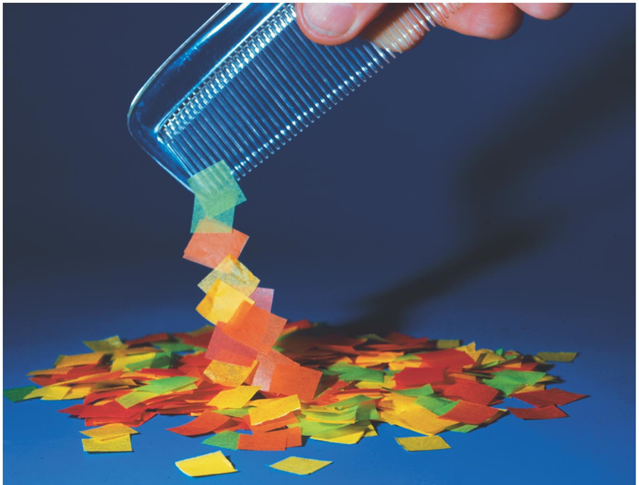
Chapter 21, Electric Charge, and electric Field
Exam 1 of Feb 2,
study guide posted

Slide 2
Problem 10

Slide 3
Problem 11
11. (II) Two positive point charges are a fixed distance apart. The sum of their charges is Q_{T} .What charge must each have in order to (a) maximize the electric force between them, and (b) minimize it?

Slide 4
Problem 12
12.(II) Particles of charge +75 μC, +48μC, and -85μC are placed in a line (Fig. 21–52). The center one is 0.35 m from each of the others. Calculate the net force on each charge due to the other two.

