Slide 1
Chapter 21, Electric Charge, and electric Field
HW1 due on Wednesday, Jan 17
Chapt.17:Pb. 3, Pb.13, Pb. 18
Chapt.19: Pb.2, Pb.11, Pb.24
Exam 1 of Feb 1, study guide to be posted

Slide 2
19-5 Latent Heat
Problem Solving: Calorimetry
Is the system isolated? Are all significant sources of energy transfer known or calculable?
Apply conservation of energy.
If no phase changes occur, the heat transferred will depend on the mass, specific heat, and temperature change.
(continued)

Slide 3
19-5 Latent Heat
4. If there are, or may be, phase changes, terms that depend on the mass and the latent heat may also be present. Determine or estimate what phase the final system will be in.
5. Make sure that each term is in the right place.
6. There is only one final temperature when the system reaches equilibrium.
7. Solve.

Slide 4
19-6 The First Law of Thermodynamics
The change in internal energy of a closed system will be equal to the energy added to the system minus the work done by the system on its surroundings.
This is the law of conservation of energy, written in a form useful to systems involving heat transfer.

Slide 5
19-6 The First Law of Thermodynamics
Example 19-7: Using the first law.
2500 J of heat is added to a system, and 1800 J of work is done on the system. What is the change in internal energy of the system?
Notes:
Solution: Both the heat added and the work done ON the system add to the system’s internal energy, which increases by 4300 J.

Slide 6
19-6 The First Law of Thermodynamics
The first law can be extended to include changes in mechanical energy—kinetic energy and potential energy:
Notes:
Solution: The kinetic energy is transformed into internal energy of the bullet and tree (we won’t worry about which of them gets how much of it!). The total energy transferred is 180 J.

Slide 7
19-7 The First Law of Thermodynamics Applied; Calculating the Work
The following table is a simple summary of the various thermodynamic processes.

Slide 8
Problem 34
34.(II) In an engine, an almost ideal gas is compressed ­adiabatically to half its volume. In doing so, 2850 J of work is done on the gas. (a) How much heat flows into or out of the gas? (b) What is the change in internal energy of the gas? (c) Does its temperature rise or fall?

Slide 9
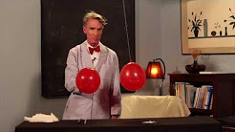
21. 1 Electric Charges
https://www.youtube.com/watch?v=oU8Fe6846d4

Slide 10
21.1 Electric Charge, q or Q
Charge comes in two types
1e = 1.6x10⁻¹⁹ Coulombs (unit of charge) fundamental unit of charge
Law of Conservation of Charge: The net charge on a closed system never changes.
Charge can be transferred
Charges are added algebraically
Electricity comes from the Greek , and the word “elektron” (amber), the Greeks noticed that when rubbing a piece of amber with a cloth they a had static effect or “amber effect.”
+e
-e

Slide 11
21.1 Electric Charge
Like charges
Opposite charges
Polarization
repel
+e
+e
attract
+e
-e
Charge separation in a
neutral
object
0e
+
-
+
-
+
-

Slide 12
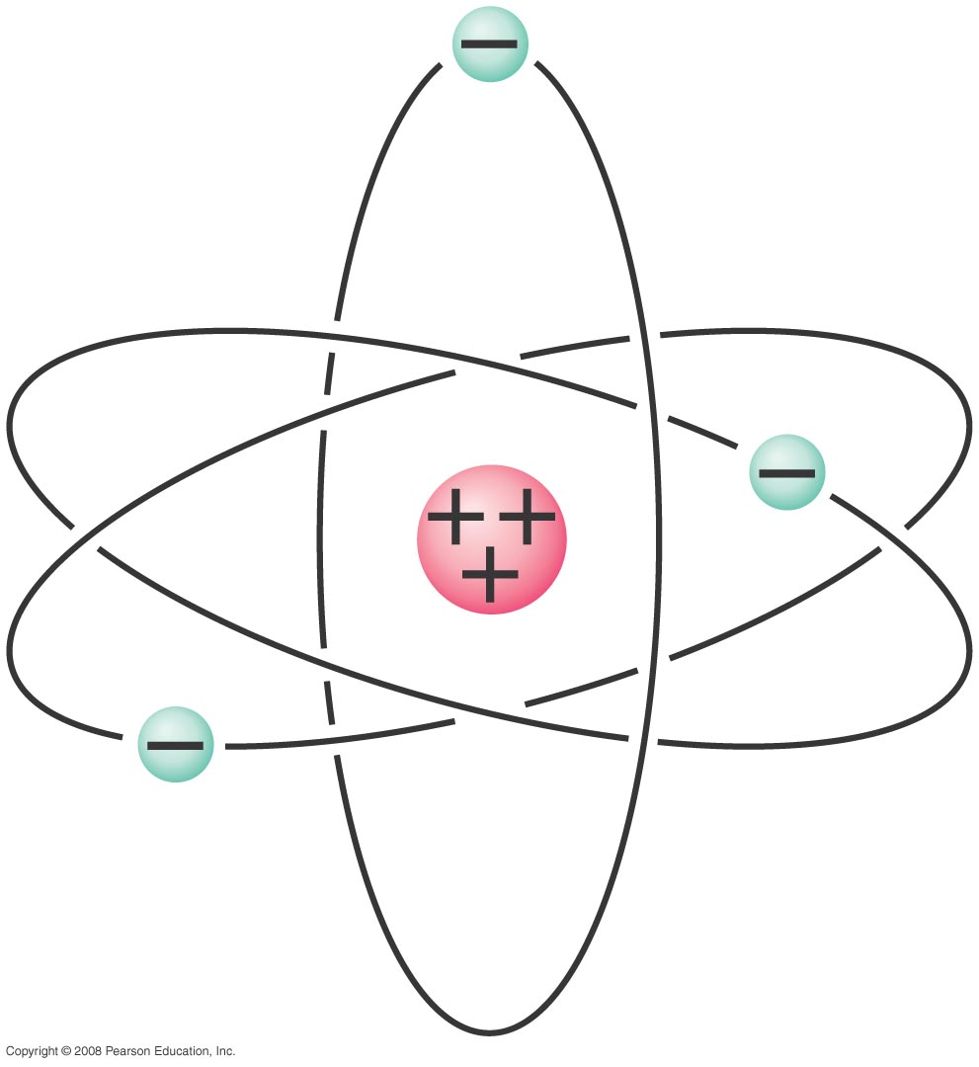
21-2 Electric Charge in the Atom
Atom:
Nucleus (small, massive, positive charge)
Electron cloud (large, very low density, negative charge)
Notes:
Figure 21-3. Simple model of the atom.

Slide 13
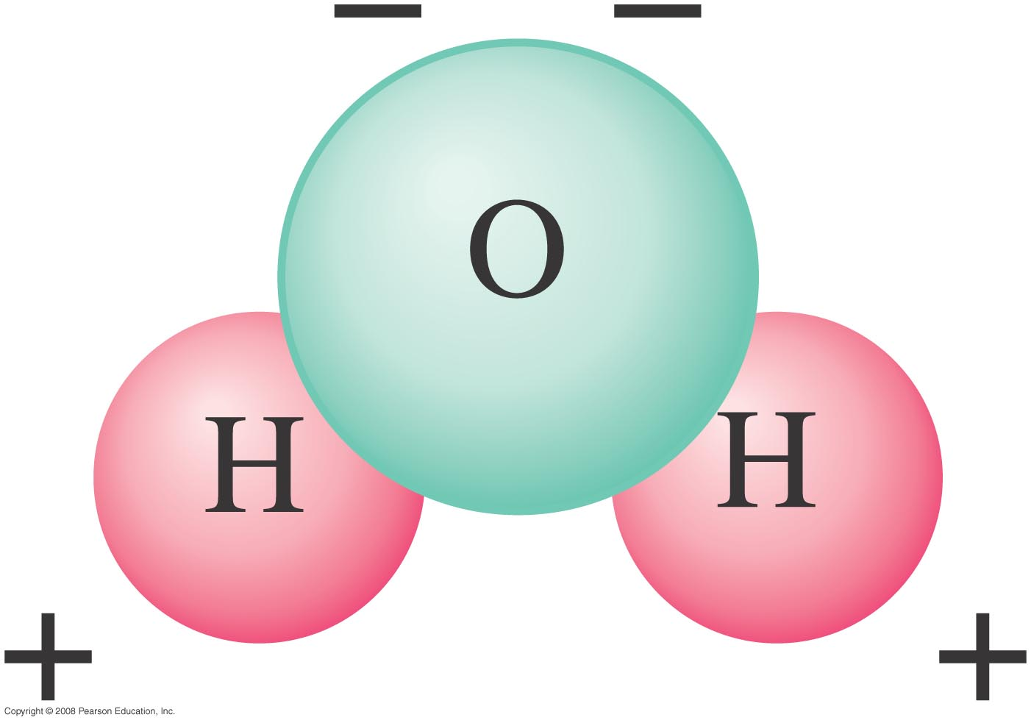
21-2 Electric Charge in the Atom
Polar molecule: neutral overall, but charge not evenly distributed
Notes:
Figure 21-4. Diagram of a water molecule. Because it has opposite charges on different ends, it is called a “polar” molecule.

Slide 14
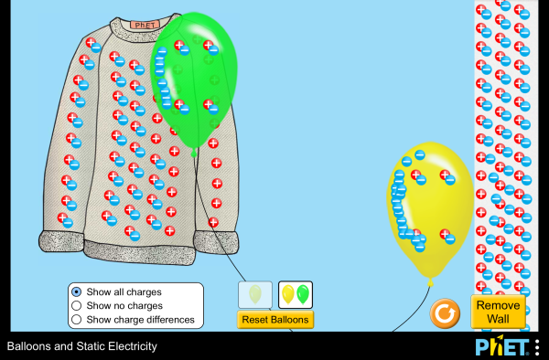
Balloons and Static Electricity
https://phet.colorado.edu/en/simulation/balloons-and-static-electricity

Slide 15
Ways to charge things
1) Charge Insulators by rubbing
2) Charge Conductors by contact
0e
0e
Charge
transfers
-e
+e
-e
-e
0e
Notes:
Balloon and chalk board
Fur and rod
Coke can and rod
Aluminum on string

Slide 16
Question
Starting with a neutral rubber rod and piece of fur, you rub them together. If the rubber rod gets a charge of -7µC, what is the charge on the fur?
A) There is not enough information to determine the answer
B) -7 µC
C) +7 µC
D) -3.5 µC
E) + 3.5 µC

Slide 17
Question
A metal sphere A has charge Q. Two other spheres, B and C, are identical to A except they have zero net charge.
A touches B then the two spheres are separated. B touches C, then the two spheres are separated.
What are the charges on each sphere.
A) A=Q, B=0, C=0
B)A=Q/2, B=Q/2, C=Q/2
C) A=Q/3, B=Q/3, C=Q/3
D) A=Q/2, B=Q/4, C=Q/4
A
B
C
Notes:
17

Slide 18
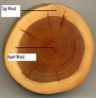
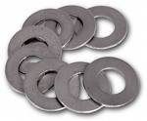
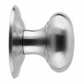
21.3 Conductors and Insulators
Conductors
-Charges move easily
-metals
Insulators
-Charges do NOT move easily
-wood
-glass
-rubber

Slide 19
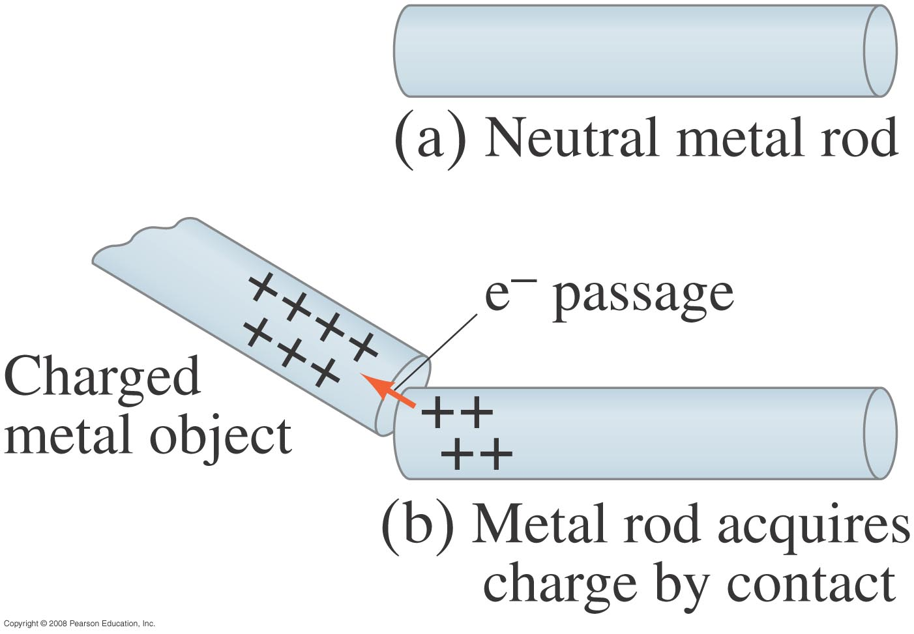
21-4 Induced Charge; the Electroscope
Metal objects can be charged by conduction:
Notes:
Figure 21-6. A neutral metal rod in (a) will acquire a positive charge if placed in contact (b) with a positively charged metal object. (Electrons move as shown by the orange arrow.) This is called charging by conduction.

Slide 20
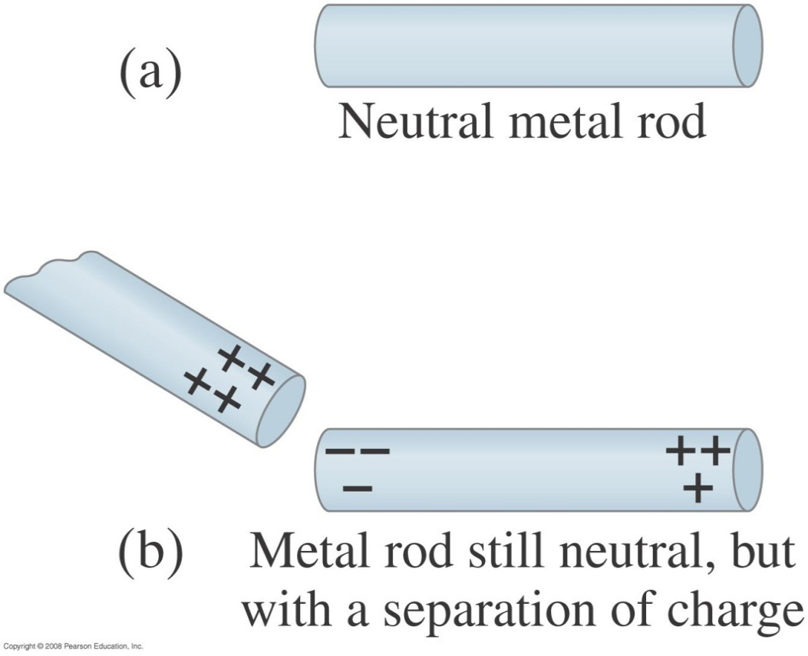
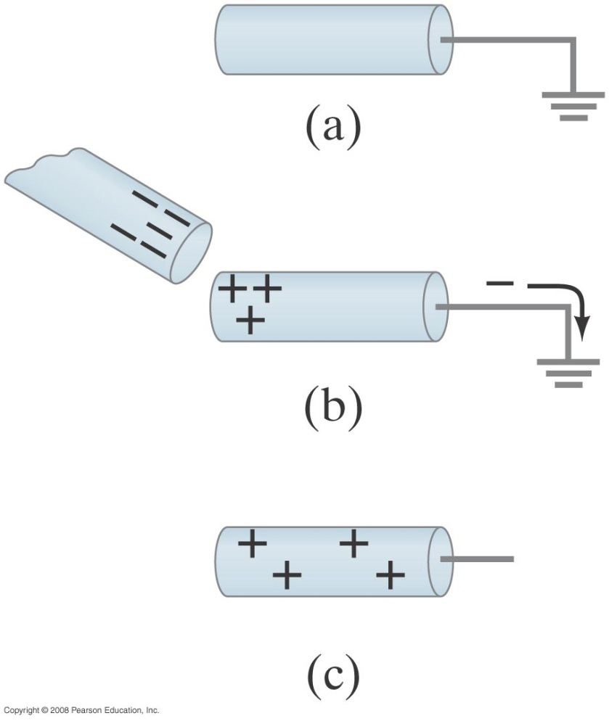
21-4 Induced Charge; the Electroscope
They can also be charged by induction, either while connected to ground or not:
Notes:
Figure 21-7. Charging by induction.
Figure 21-8. Inducing a charge on an object connected to ground.

Slide 21
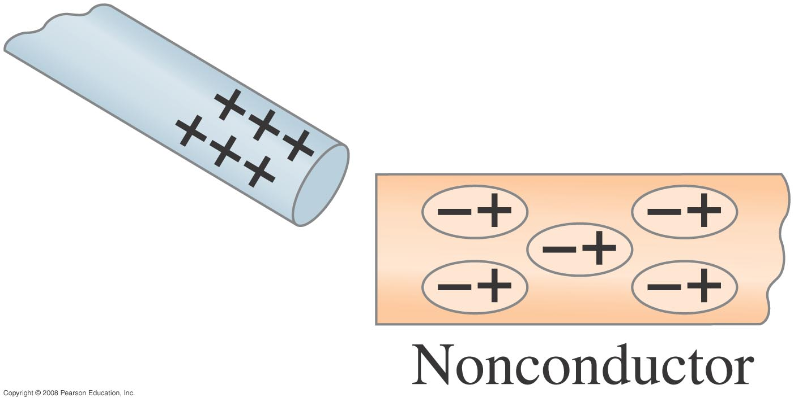
21-4 Induced Charge; the Electroscope
Nonconductors won’t become charged by conduction or induction, but will experience charge separation:
Notes:
Figure 21-9. A charged object brought near an insulator causes a charge separation within the insulator’s molecules.

Slide 22
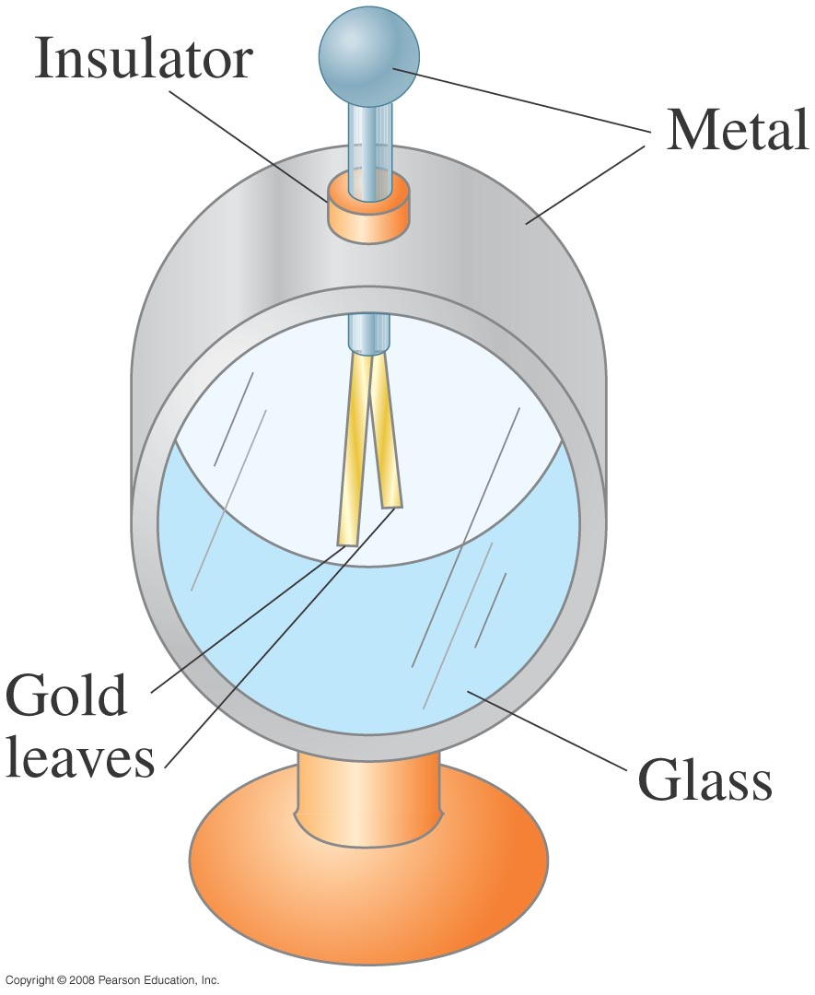
21-4 Induced Charge; the Electroscope
The electroscope can be used for detecting charge.
Notes:
Figure 21-10. Electroscope.

Slide 23
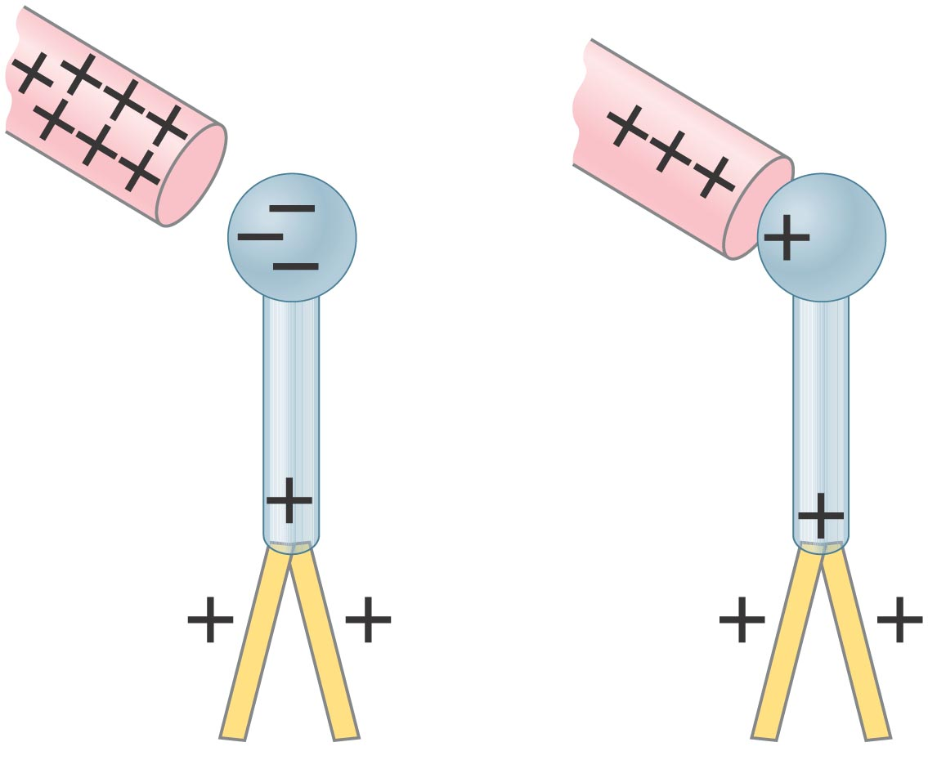
21-4 Induced Charge; the Electroscope
The electroscope can be charged either by induction or by conduction.
Notes:
Figure 21-11. Electroscope charged (a) by induction, (b) by conduction.

Slide 24
Electroscope
https://www.youtube.com/watch?v=-JsVZwc1dOo

Slide 25
21-5 Coulomb’s Law
Experiment shows that the electric force between two charges is proportional to the product of the charges and inversely proportional to the distance between them.
Notes:
Figure 21-14. Coulomb’s law, Eq. 21–1, gives the force between two point charges, Q₁ and Q₂, a distance r apart.

Slide 26
Coulomb’s Law
The magnitude of the electric force two charges exert on each other
This is the magnitude of the force
Direction:
always along a line between the two charges
Can be attractive or repulsive depending on the signs of the charges
Forces on the two charges are equal in magnitude and opposite in direction
q₁
q₂
k = 8.99x10⁺⁹ Nm²/C² = coulomb’s constant

Slide 27
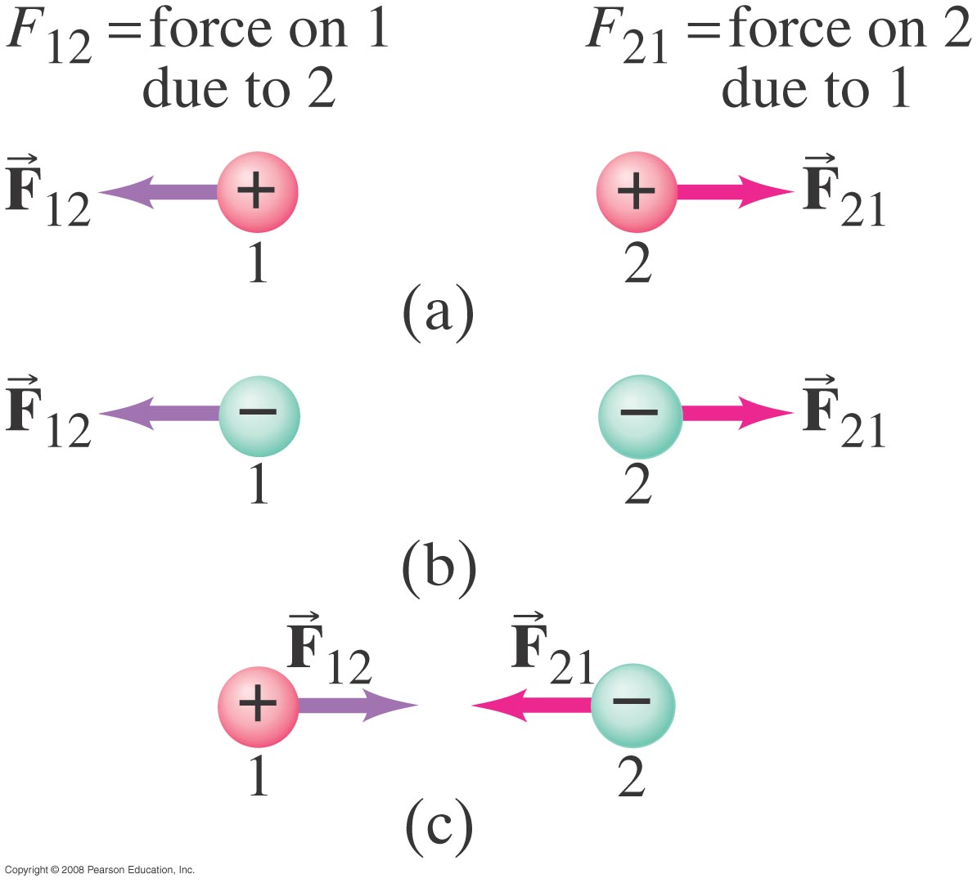
21-5 Coulomb’s Law
The force is along the line connecting the charges, and is attractive if the charges are opposite, and repulsive if they are the same.
Notes:
Figure 21-15. The direction of the static electric force one point charge exerts on another is always along the line joining the two charges, and depends on whether the charges have the same sign as in (a) and (b), or opposite signs (c).

Slide 28
21-5 Coulomb’s Law
Unit of charge: coulomb, C.
The proportionality constant in Coulomb’s law is then:
k = 8.99 x 10⁹ N·m²/C².
Charges produced by rubbing are typically around a microcoulomb:
1 μC = 10⁻⁶ C.

Slide 29
Question
21-5 Coulomb’s Law
What is the correct Forces Diagram for charge 3 where F₃₁ is the force on Q₃ due to Q₁ and F₃₂ is the force on Q₃ due to Q₂?
Q₁ Q₂ Q₃
+
-
+
F₃₁
F₃₁
3
a) b)
c) d)
3
F₃₂
F₃₂
F₃₁
F₃₁
3
3
F₃₂
F₃₂

Slide 30
Question
An α particle with a charge +2e and a mass of 4m_{p} is on a collision course with a proton with a charge +e and mass m_{p}. The only force acting is the electrostatic force. Which of the following statements is true about the magnitudes of the forces on the two particles?
A) F_{α}= F_{p}
B) 2F_{α}= F_{p}
C) 4F_{α}= F_{p}
D) F_{α}= 2F_{p}
E) F_{α}= 4F_{p}
 | α | p
Charge | +2e | +e
Mass | 4m_{p} | m_{p}

Slide 31
Question
An α particle with a charge +2e and a mass of 4m_{p} is on a collision course with a proton with a charge +e and mass m_{p}. The only force acting is the electrostatic force. Which of the following statements is true about the accelerations of the two particles?
A) a_{α}= a_{p}
B) 2a_{α}= a_{p}
C) 4a_{α}= a_{p}
D) a_{α}= 2a_{p}
E) a_{α}= 4a_{p}
 | α | p
Charge | +2e | +e
Mass | 4m_{p} | m_{p}

