Slide 1
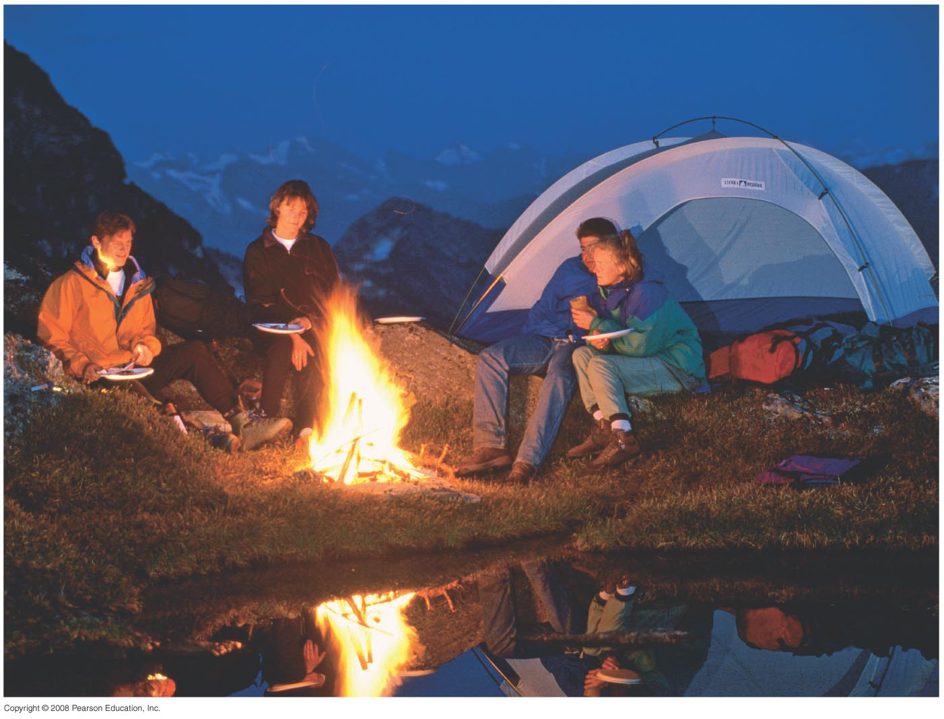
Chapter 19 Heat and the First Law of Thermodynamics
HW1 due on Friday, Jan 30
Chapt.17:Pb. 3, Pb.13, Pb. 18
Chapt.19: Pb.2, Pb.11, Pb.24
Notes:
Chapter opener. When it is cold, warm clothes act as insulators to reduce heat loss from the body to the environment by conduction and convection. Heat radiation from a campfire can warm you and your clothes. The fire can also transfer energy directly by heat convection and conduction to what you are cooking. Heat, like work, represents a transfer of energy. Heat is defined as a transfer of energy due to a difference of temperature. Work is a transfer of energy by mechanical means, not due to a temperature difference. The first law of thermodynamics links the two in a general statement of energy conservation: the heat Q added to a system minus the net work W done by the system equals the change in internal energy ΔE_{int} of the system: ΔE_{int} = Q – W. Internal energy E_{int} is the sum total of all the energy of the molecules of the system.

Slide 2
19-5 Latent Heat
Example 19-6: Determining a latent heat.
The specific heat of liquid mercury is 140 J/kg·°C. When 1.0 kg of solid mercury at its melting point of -39°C is placed in a 0.50-kg aluminum calorimeter filled with 1.2 kg of water at 20.0°C, the mercury melts and the final temperature of the combination is found to be 16.5°C. What is the heat of fusion of mercury in J/kg?
Notes:
Solution: Again, use conservation of energy; we know the final system is liquid, so the heat required to melt the mercury and then raise its temperature to 16.5 degrees equals the heat lost by the water. Solving gives L_{Hg} = 11 kJ/kg.

Slide 3
19-5 Latent Heat
Problem Solving: Calorimetry
Is the system isolated? Are all significant sources of energy transfer known or calculable?
Apply conservation of energy.
If no phase changes occur, the heat transferred will depend on the mass, specific heat, and temperature change.
(continued)

Slide 4
19-5 Latent Heat
4. If there are, or may be, phase changes, terms that depend on the mass and the latent heat may also be present. Determine or estimate what phase the final system will be in.
5. Make sure that each term is in the right place.
6. There is only one final temperature when the system reaches equilibrium.
7. Solve.

Slide 5

19-6 The First Law of Thermodynamics
The change in internal energy of a closed system will be equal to the energy added to the system minus the work done by the system on its surroundings.
This is the law of conservation of energy, written in a form useful to systems involving heat transfer.

Slide 6
19-6 The First Law of Thermodynamics
Example 19-7: Using the first law.
2500 J of heat is added to a system, and 1800 J of work is done on the system. What is the change in internal energy of the system?
Notes:
Solution: Both the heat added and the work done ON the system add to the system’s internal energy, which increases by 4300 J.

Slide 7

19-6 The First Law of Thermodynamics
The first law can be extended to include changes in mechanical energy—kinetic energy and potential energy:
Notes:
Solution: The kinetic energy is transformed into internal energy of the bullet and tree (we won’t worry about which of them gets how much of it!). The total energy transferred is 180 J.

Slide 8
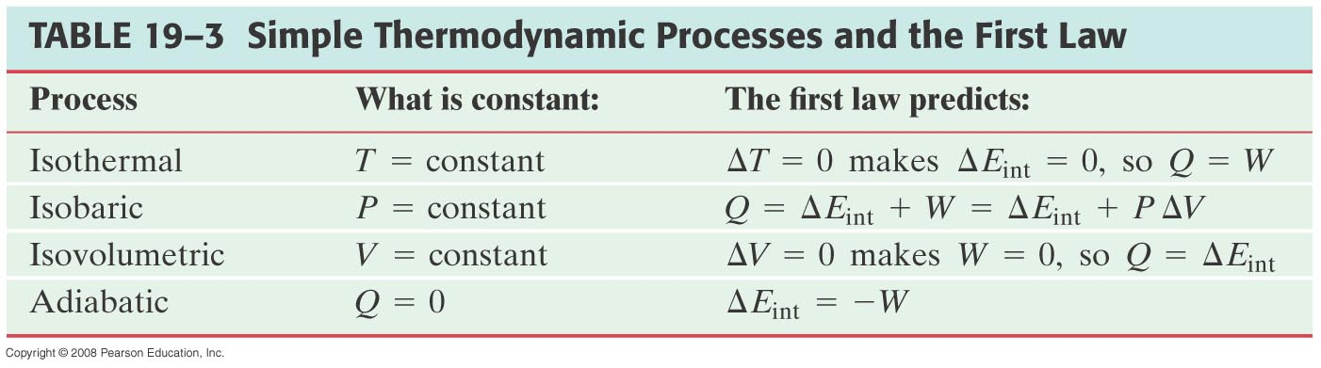
19-7 The First Law of Thermodynamics Applied; Calculating the Work
The following table is a simple summary of the various thermodynamic processes.

Slide 9
Problem 34
34.(II) In an engine, an almost ideal gas is compressed ­adiabatically to half its volume. In doing so, 2850 J of work is done on the gas. (a) How much heat flows into or out of the gas? (b) What is the change in internal energy of the gas? (c) Does its temperature rise or fall?

