Slide 1
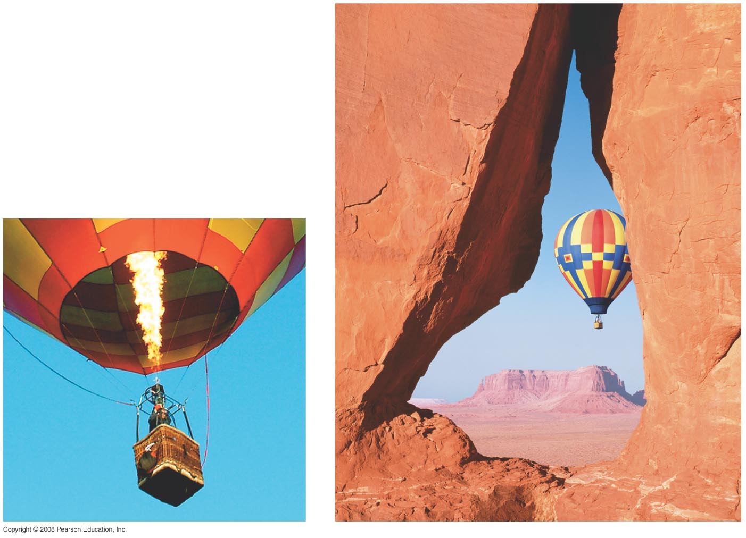
Chapter 17 Temperature, Thermal Expansion
Notes:
Chapter opener. Heating the air inside a “hot-air” balloon raises the air’s temperature, causing it to expand, and forces air out the opening at the bottom. The reduced amount of air inside means its density is lower than the outside air, so there is a net buoyant force upward on the balloon. In this Chapter we study temperature and its effects on matter: thermal expansion and the gas laws.

Slide 2
Course Overview
http://chem.winthrop.edu
Webpage
Syllabus
Class notes
Homework
Office: SIMS, 203
Office Hours : W 1:00 - 3:00, or by appointment

Slide 3
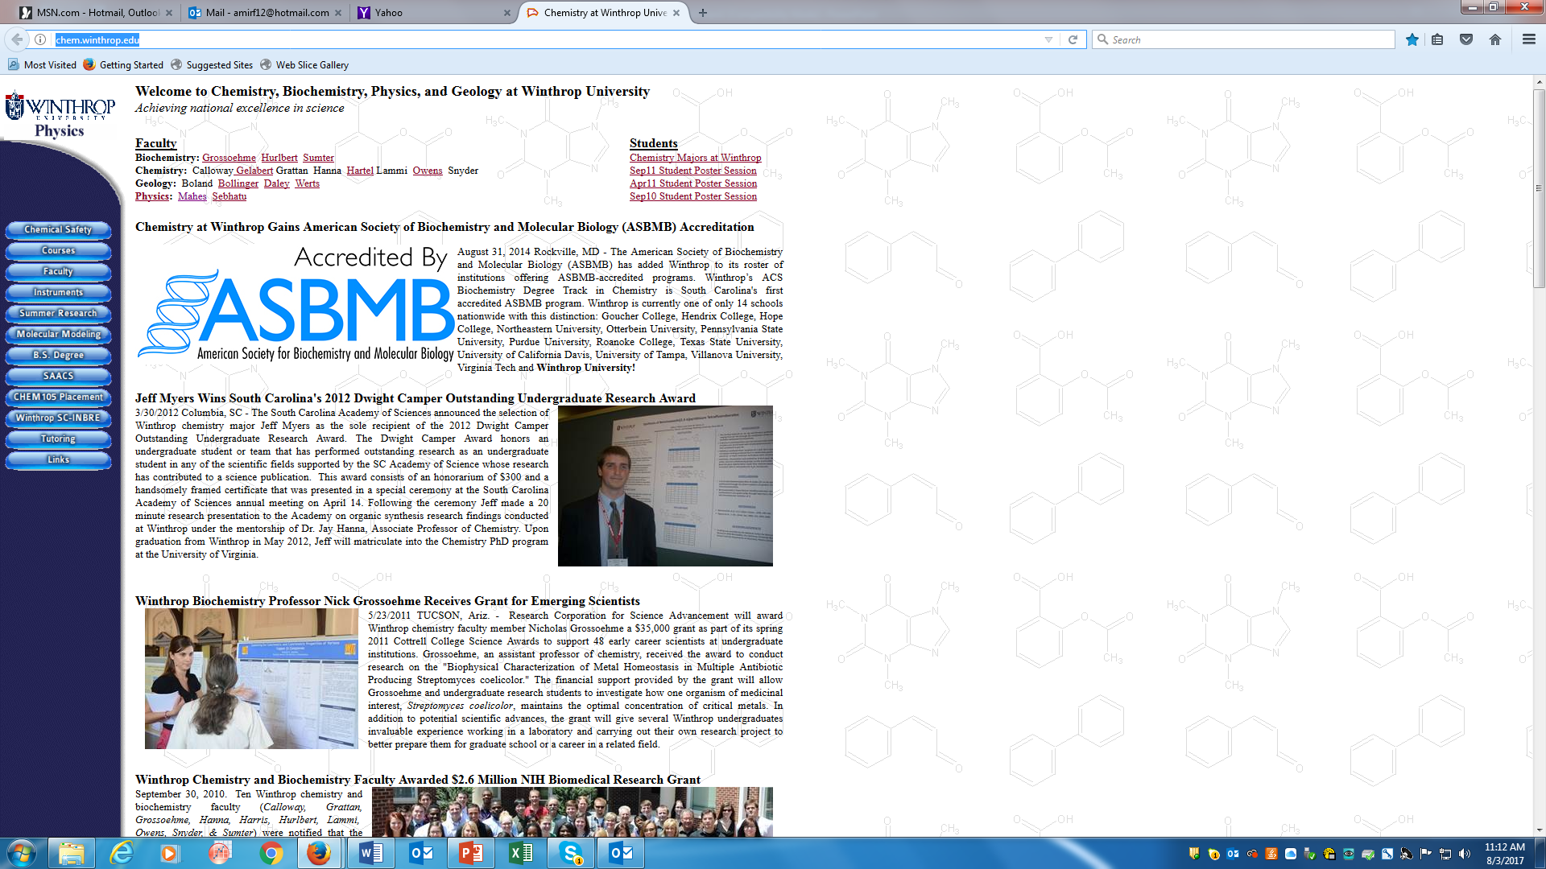
Webpage and Class notes
http://chem.winthrop.edu/

Slide 4
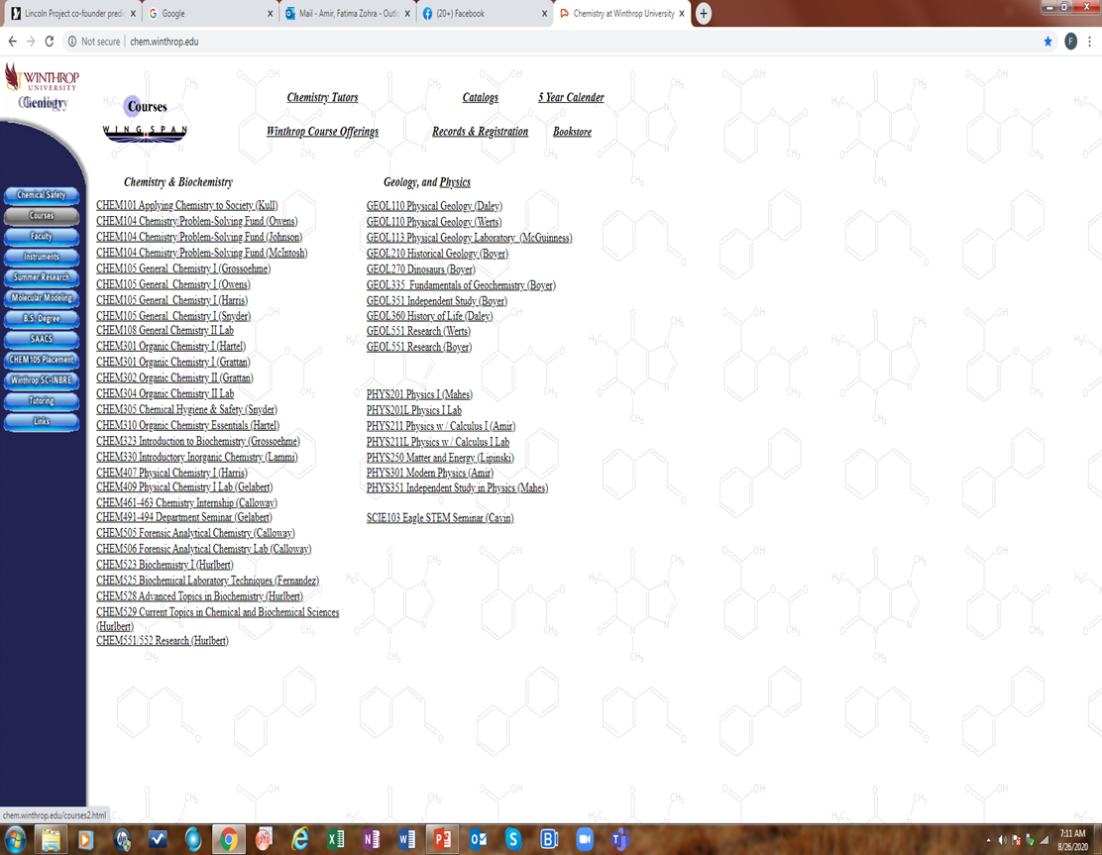

Slide 5
Syllabus- Attendance
Although roll is not formally taken in class, I strongly recommend regular attendance. The course has a significant component of interactive learning, and the activities done in class reinforce the material discussed. The attendance policy described in the Winthrop University undergraduate catalog will be followed.

Slide 6
COVID-19 Statement:
Although COVID-19 has reached an endemic phase it is still important to remain vigilant as we face a recent rise in positive cases. As socially responsible members of this community, everyone is expected to engage in daily health self-monitoring, to stay home (residence hall or off-campus housing) from on-campus class, work, or activities if they begin experiencing any COVID-related symptoms.
When experiencing any COVID-related symptoms, students are expected to contact Health Services by completing the QI form in the Patient Portal and respond to the nurse who will contact them with instructions. COVID positive residential students are required to follow their QI plan for 5 days of isolation off campus so be prepared with a back-up plan as well.
By acknowledgement, you agree to Winthrop’s expectations of you regarding health monitoring and reporting.

Slide 7
CAS diversity and inclusion statement:
At Winthrop University in the College of Arts and Sciences, diversity, equity, and inclusion are essential to our academic mission and institutional identity. We value and see others as whole people. Our faculty, staff, and students work together to create a community where people of all races, ethnicities, genders and gender identities, sexualities, socioeconomic classes, cultural backgrounds, nations of origin, ages, religions, political perspectives, abilities, and body types can truly thrive.

Slide 8
Course Communication
Be sure to check your Winthrop email account daily, as I may send out course related announcements that will come *only* to Winthrop email addresses.
If you email me, please be sure to use your Winthrop email account I will respond to email within 24 hours except from Saturday morning through Sunday afternoon when my response may be slower.

Slide 9
Lecture and Recitation
Lecture: The PHY 212 lecture is a flipped model class, you are required to read the chapter’s parts in the schedule posted online before coming to class, I will show videos, explain the concepts and solve problems.
Lecture are not posted before class.
There is a recitation on Fridays in Class time, where I will solve problems and you will have a quiz.

Slide 10
Homework
Homework are posted every week online in a word document.
Homework problems are due on the dates indicated on the class calendar. Your work is due on time (Wednesday 5:00pm), with the exception of reasonable documented excuses . Late work will be docked 50% of face value and 100% after solutions have been posted.
If I notice that the homework is copied from the solutions manual, I will not grade it, and the 10% homework grade will be added to the exams grade.

Slide 11
Quizzes
There will be a 20 to 45 minutes group quiz every Friday at the beginning of the recitation.
Quizzes are 4 to 5 questions on the chapter of the week.
There will be no quiz on the exam week, and there will no quiz this week.

Slide 12
Exams
Study guide is posted 2 weeks before the exam.
Solutions of the study guide are not posted, you are advised to work the problems, and come to me with questions.
There will be 3 exams and a final.
The exams are 75 minutes duration. Notes and your book are not allowed during exams, the final exam is 2 hours long.
All relevant equations and physical constants will be provided.

Slide 13
If you are going to miss a test, you must notify me in advance (preferably one week before) so alternate arrangements can be made. If you miss a test and your absence is not excused, a grade of zero points must be assessed for that particular piece of work. You must take the 75 minutes exams and the final in order to pass the course.
Grading:
Homework 4%
Three exams 12% each
Quizzes 10%
Final exam 25%
Lab 25%

Slide 14
Labs
Labs start on Tuesday, January 16, 2024
The lab schedule and labs are posted on the webpage
You must read the lab, and answer the pre-lab questions before coming to the lab.
Do not miss any laboratory. You will receive "0" for all missed laboratories.
The lab grade is 25% of your total grade.

Slide 15
Syllabus change policy
I will make changes to the class schedule or syllabus as deemed necessary for the progression of the course
And please read the syllabus!!!!!

Slide 16
17-1 Temperature: Atomic Theory of Matter
Atomic and molecular masses are measured in unified atomic mass units (u). This unit is defined so that the carbon-12 atom has a mass of exactly 12.0000 u. Expressed in kilograms:
1 u = 1.6605 x 10⁻²⁷ kg.
The matter configuration idea came from a biologist (Robert Brown-1827) when looking at the motion of pollen grains in water. The Brownian motion is the jittery motion of tiny pollen grains in water; these are the result of collisions with individual water molecules.
Notes:
Figure 17-1. Path of a tiny particle (pollen grain, for example) suspended in water. The straight lines connect observed positions of the particle at equal time intervals.

Slide 17
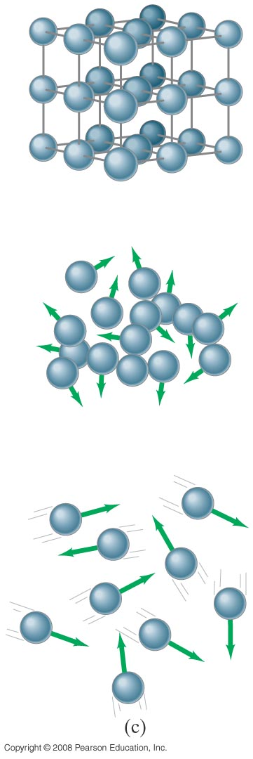
17-1 Atomic Theory of Matter
On a microscopic scale, the arrangements of molecules in solids (a), liquids (b), and gases (c) are quite different.
Forces connecting atoms are different and define the motion.
(a)
(b)
(c)
Notes:
Figure 17-2. Atomic arrangements in (a) a crystalline solid, (b) a liquid, and (c) a gas.

Slide 18
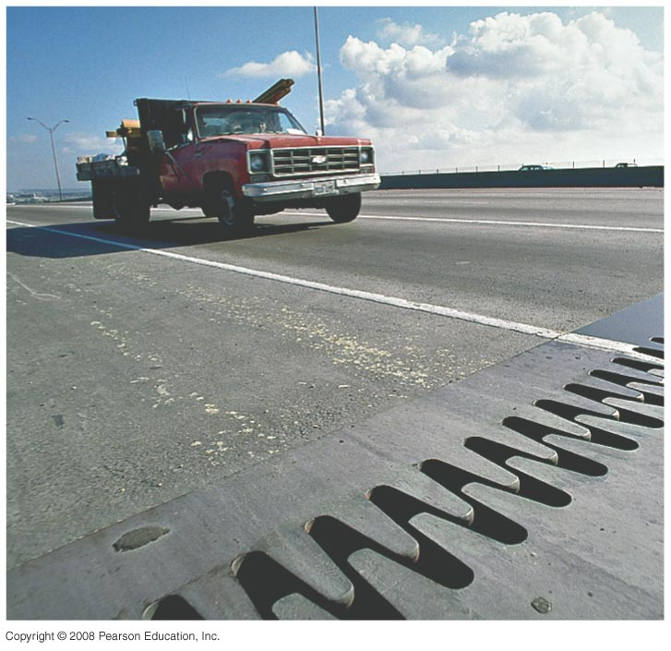
17-2 Temperature and Thermometers
Temperature is a measure of how hot or cold something is.
Most materials expand when heated: An Iron beam is longer when hot than when cold
Concrete roads expand and
contract slightly with temperature
Expansion joint on a bridge
Notes:
Figure 17-3. Expansion joint on a bridge.

Slide 19
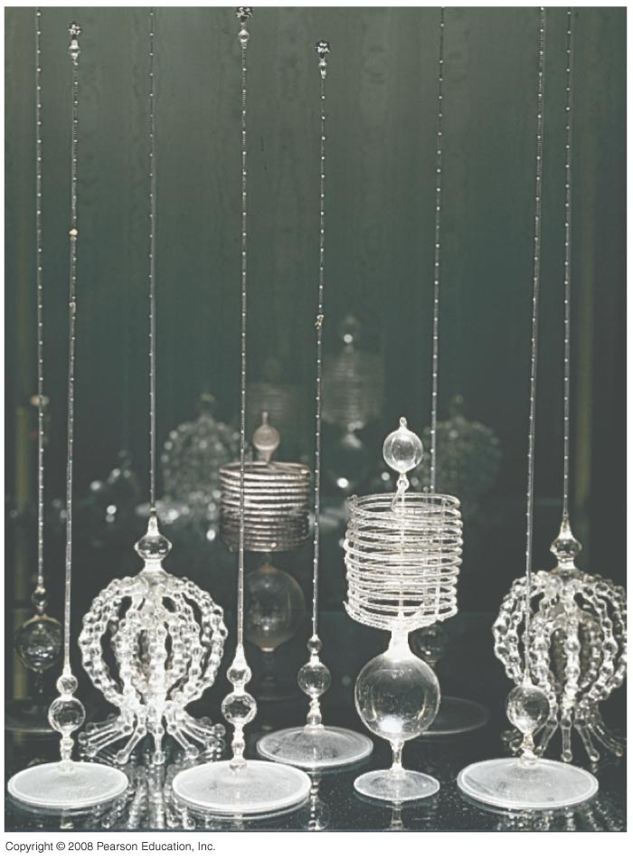
17-2 Temperature and Thermometers
Thermometers are instruments designed to measure temperature. In order to do this, they take advantage of some property of matter that changes with temperature.
Early thermometers:
Built by Accademia del Cimento (1657-1667) in
Florence, Italy
These are mercury thermometers, these are not allowed anymore because of the toxicity of mercury. In the chemistry labs you are using the alcohol thermometers.
Notes:
Figure 17-4. Thermometers built by the Accademia del Cimento (1657–1667) in Florence, Italy, are among the earliest known. These sensitive and exquisite instruments contained alcohol, sometimes colored, like many thermometers today.

Slide 20
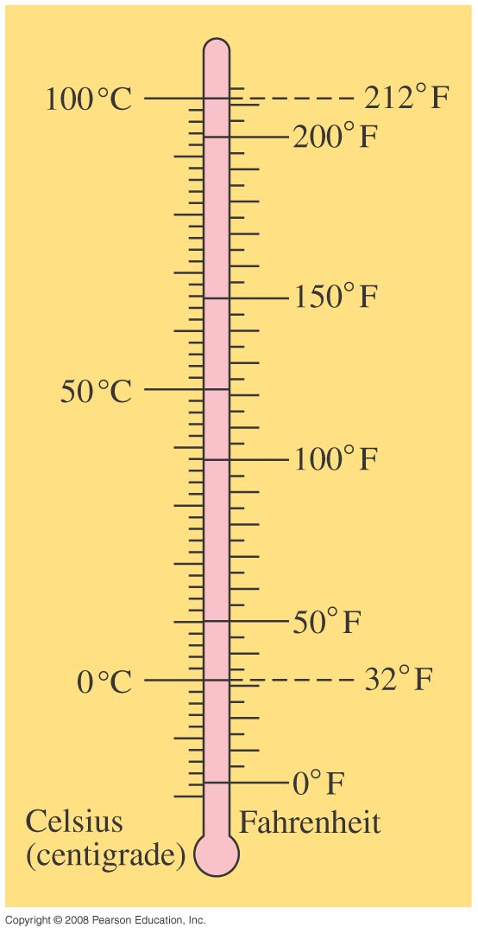
17-2 Temperature and Thermometers
Notes:
Figure 17-7. Celsius and Fahrenheit scales compared.

Slide 21
17-2 Temperature and Thermometers
Example 17-2: Taking your temperature.
Normal body temperature is 98.6°F. What is this on the Celsius scale?
Notes:
Solution: Conversion gives 37.0 °C.

Slide 22
Problem 3
3. (I) (a) “Room temperature” is often taken to be 68°F. What is this on the Celsius scale? (b) The temperature of the filament in a lightbulb is about 1900°C. What is this on the Fahrenheit scale?

Slide 23
17-3 Thermal Equilibrium and The Zeroth Law of Thermodynamics
Two objects placed in thermal contact will eventually come to the same temperature. When they do, we say they are in thermal equilibrium.
The zeroth law of thermodynamics says that if two objects are each in equilibrium with a third object, they are also in thermal equilibrium with each other.

Slide 24
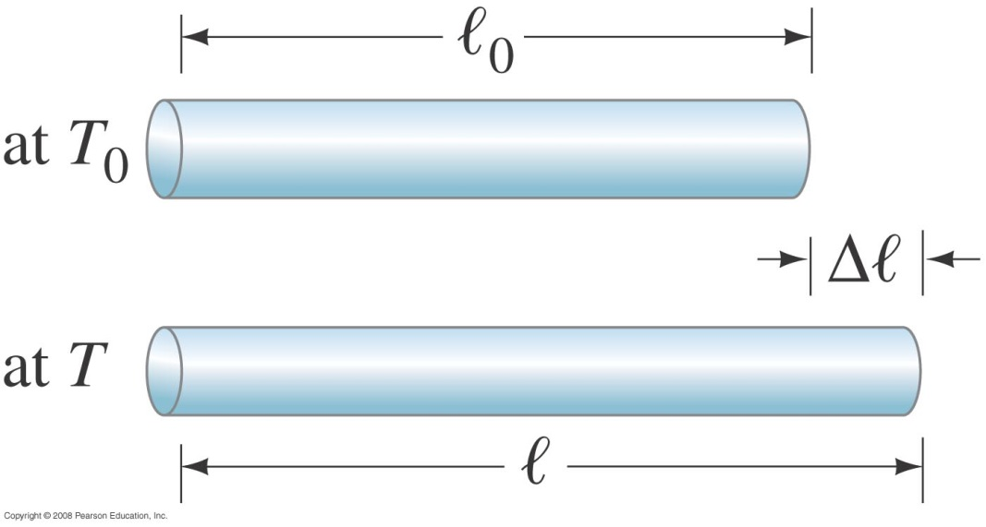
17-4 Thermal Expansion
Linear expansion occurs when an object is heated.
Here, α is the coefficient of linear expansion.
ΔT is the change in Temperature
Notes:
Figure 17-9. A thin rod of length l₀ at temperature T₀ is heated to a new uniform temperature T and acquires length l, where l = l₀ + Δl.

Slide 25
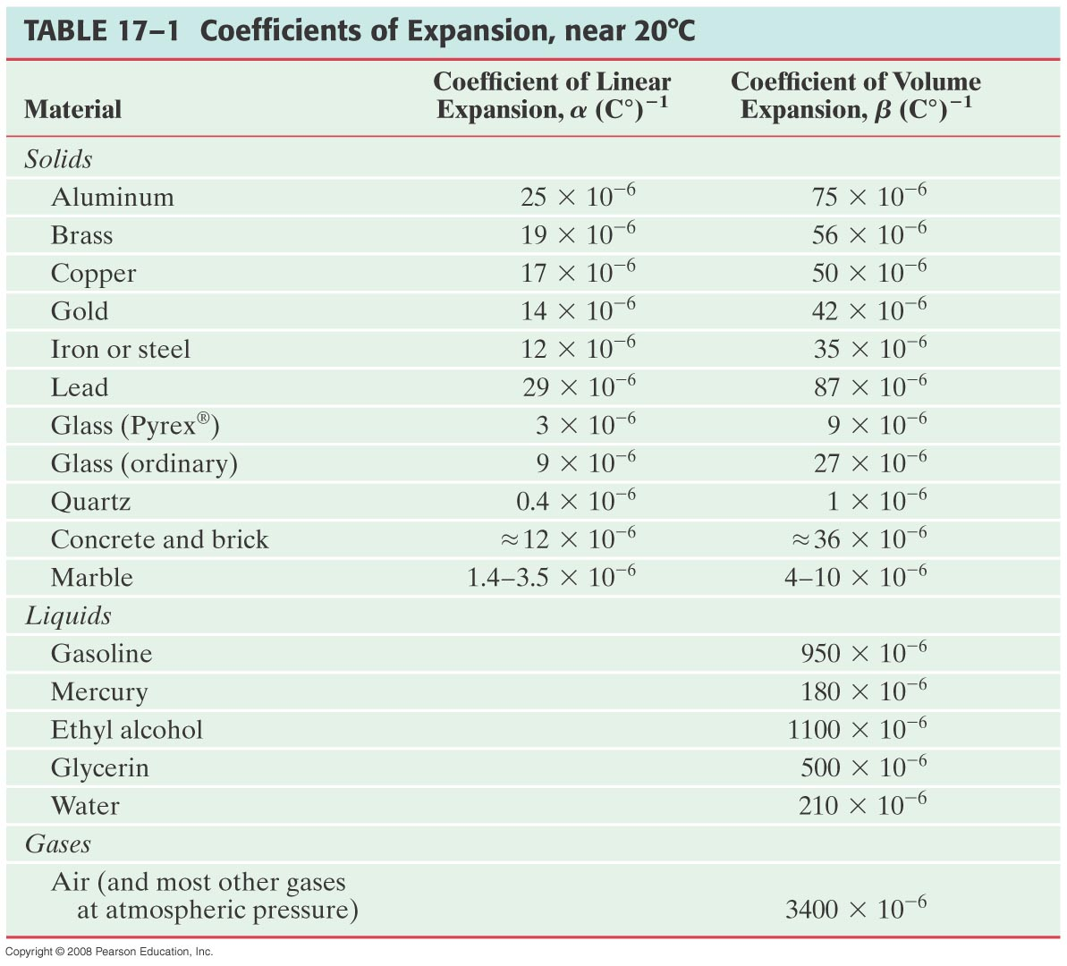
17-4 Thermal Expansion

Slide 26
17-4 Thermal Expansion
Example 17-3: Bridge expansion.
The steel bed of a suspension bridge is 200 m long at 20°C. If the extremes of temperature to which it might be exposed are -30°C to +40°C, how much will it contract and expand?
Notes:
Solution: Substitution gives 4.8 cm expansion and 12 cm contraction.

Slide 27
Problem 10
10. (II) To what temperature would you have to heat a brass rod for it to be 1.0% longer than it is at 25°C?

Slide 28
17-4 Thermal Expansion
Example 17-5: Ring on a rod.
An iron ring is to fit snugly on a cylindrical iron rod. At 20°C, the diameter of the rod is 6.445 cm and the inside diameter of the ring is 6.420 cm. To slip over the rod, the ring must be slightly larger than the rod diameter by about 0.008 cm. To what temperature must the ring be brought if its hole is to be large enough so it will slip over the rod?
Notes:
Solution: The temperature needs to be raised by 430°C, to 450°C.

Slide 29
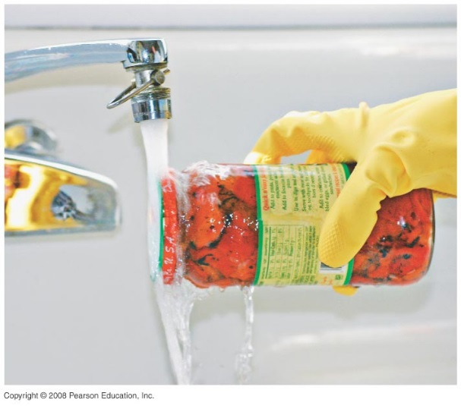
17-4 Thermal Expansion
Conceptual Example 17-6: Opening a tight jar lid.
When the lid of a glass jar is tight, holding the lid under hot water for a short time will often make it easier to open. Why?
Notes:
Solution: The lid will heat before the glass, and expand sooner. Also, metals generally expand more than glass for the same temperature difference.

Slide 30
17-4 Thermal Expansion
Volume expansion is similar, except that it is relevant for liquids and gases as well as solids:
Here, β is the coefficient of volume expansion.
For uniform solids, β ≈ 3α.

Slide 31
17-4 Thermal Expansion
Example 17-7: Gas tank in the Sun.
The 70-liter (L) steel gas tank of a car is filled to the top with gasoline at 20°C. The car sits in the Sun and the tank reaches a temperature of 40°C (104°F). How much gasoline do you expect to overflow from the tank?
Notes:
Solution: Both the tank and the gasoline expand; the amount that spills is the difference. However, the gasoline expands by about 1.3 L, whereas the tank expands by about 0.05 L – the expansion of the tank makes little difference.

Slide 32
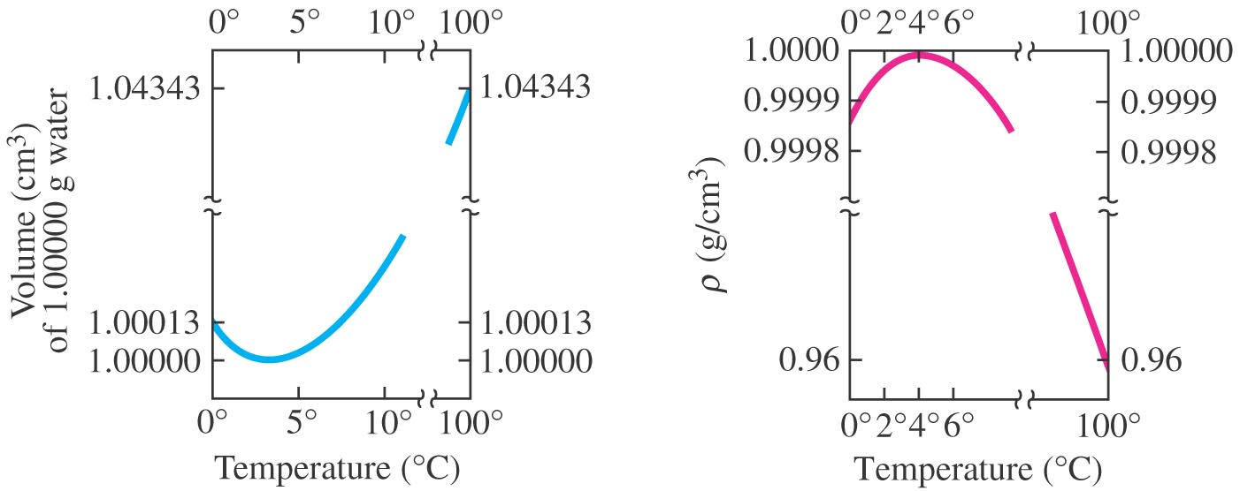
17-4 Thermal Expansion
Water behaves differently from most other solids—its minimum volume occurs when its temperature is 4°C, and has biggest density at 4°C. As it cools further, it expands, as anyone who leaves a bottle in the freezer to cool and then forgets about it can testify.
Notes:
Figure 17-12: Behavior of water as a function of temperature near 4°C. (a) Volume of 1.00000 g of water, as a function of temperature. (b) Density vs. temperature. [Note the break in each axis.]

