Slide 1
Quiz 3

Slide 2
Chapter 4 Problem 6
6. (II) What average force is required to stop a 950-kg car in 8.0 s if the car is traveling at 95 km h?

Slide 3
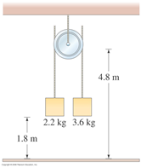
Chapter 4
The two masses shown in Fig below are each initially above the ground, and the massless frictionless pulley is above the ground. What is the acceleration of the system?

Slide 4
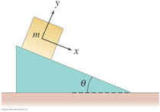
Chapter 4 Problem 48
48. (II) The block shown in Fig. 4–43 has mass m=7.0kg and lies on a fixed smooth frictionless plane tilted at an angle θ=22.0° to the horizontal. (a) Determine the acceleration of the block as it slides down the plane. (b) If the block starts from rest 12.0 m up the plane from its base, what will be the block’s speed when it reaches the bottom of the incline?

