Slide 1
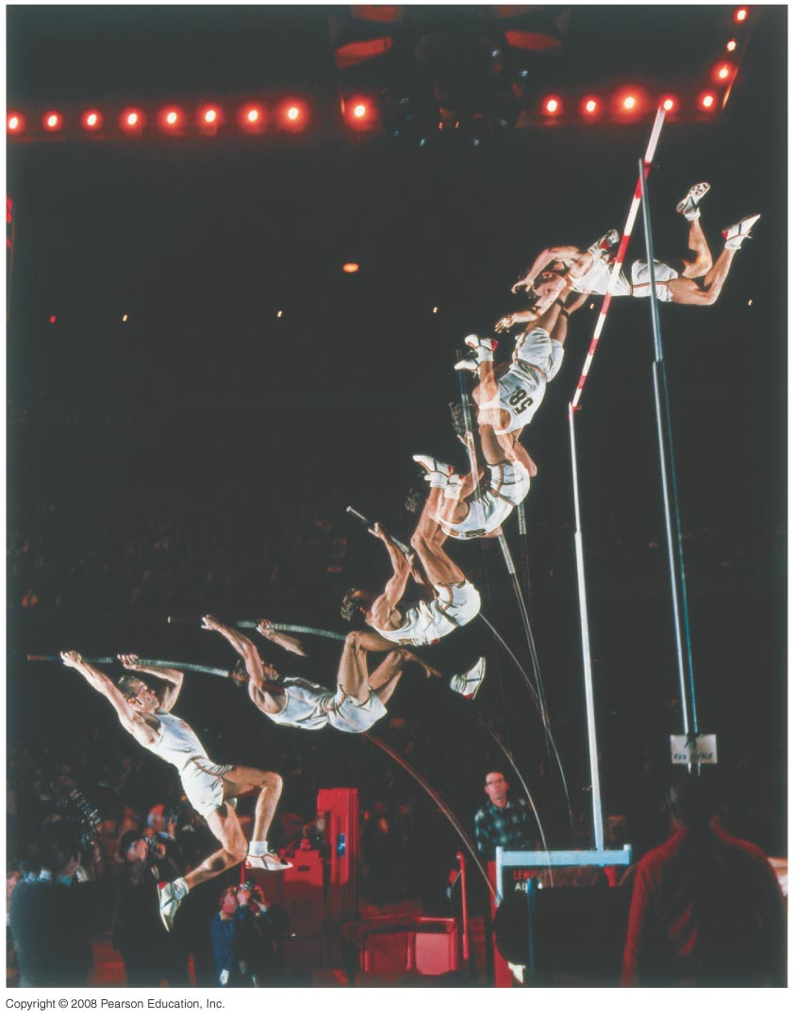
Chapter 8
Conservation of Energy
HW4 due Wednesday, Oct. 29
Chapter 7:Pb. 16, Pb.19, Pb.46
Chapter 8: Pb.20, Pb.23, Pb.33, Pb.68, Pb.71
Notes:
Chapter Opener. Caption: A polevaulter running toward the high bar has kinetic energy. When he plants the pole and puts his weight on it, his kinetic energy gets transformed: first into elastic potential energy of the bent pole and then into gravitational potential energy as his body rises. As he crosses the bar, the pole is straight and has given up all its elastic potential energy to the athlete’s gravitational potential energy. Nearly all his kinetic energy has disappeared, also becoming gravitational potential energy of his body at the great height of the bar (world record over 6 m), which is exactly what he wants. In these, and all other energy transformations that continually take place in the world, the total energy is always conserved. Indeed, the conservation of energy is one of the greatest laws of physics, and finds applications in a wide range of other fields.

Slide 2
8-2 Potential Energy
This potential energy can become kinetic energy if the object is dropped.
Potential energy is a property of a system as a whole, not just of the object (because it depends on external forces).
If U_{grav} = mgy, where do we measure y from?
It turns out not to matter, as long as we are consistent about where we choose y = 0. Only changes in potential energy can be measured.

Slide 3
8-2 Potential Energy
Example 8-3: Potential energy changes for a roller coaster.
A 1000-kg roller-coaster car moves from point 1 to point 2 and then to point 3. (a) What is the gravitational potential energy at points 2 and 3 relative to point 1? That is, take y = 0 at point 1. (b) What is the change in potential energy when the car goes from point 2 to point 3? (c) Repeat parts (a) and (b), but take the reference point (y = 0) to be at point 3.
Notes:
Figure 8-5.
Answer: a. At point 2, U = 9.8 x 10⁴ J; at point 3, U = -1.5 x 10⁵ J.
b. U = -2.5 x 10⁵ J.
c. At point 1, U = 1.5 x 10⁵ J. At point 2, U = 2.5 x 10⁵ J. At point 3, U = 0 (by definition); the change in going from point 2 to point 3 is -2.5 x 10⁵ J.

Slide 4
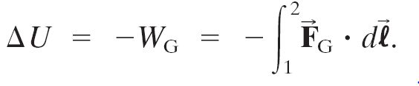
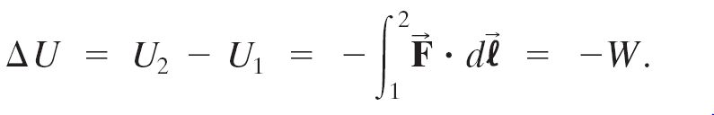
8-2 Potential Energy
General definition of gravitational potential energy:
For any other conservative force:

Slide 5
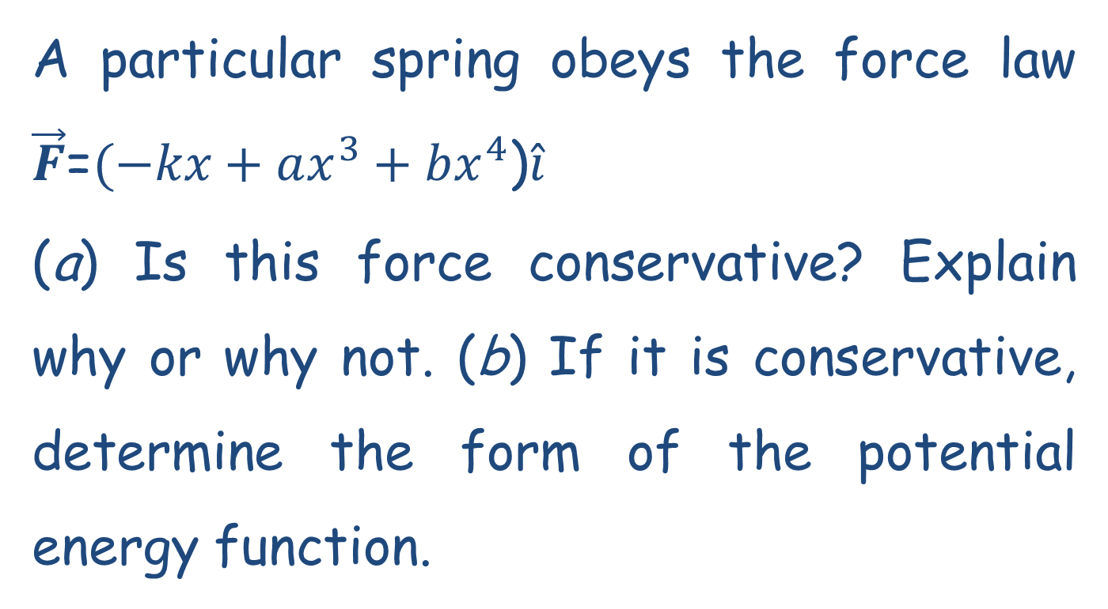
Problem 7

Slide 6
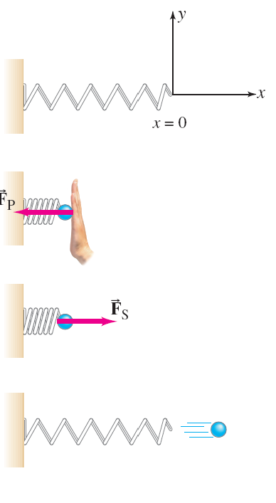

8-2 Potential Energy
A spring has potential energy, called elastic potential energy, when it is compressed. The force required to compress or stretch a spring is:
where k is called the spring constant.
Notes:
Figure 8-6. Caption: A spring (a) can store energy (elastic potential energy) when compressed (b), which can be used to do work when released (c) and (d).

Slide 7

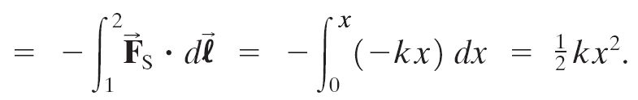

8-2 Potential Energy
Then the elastic potential energy for a spring is:

Slide 8
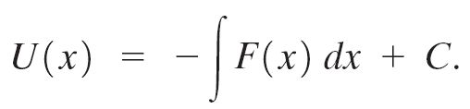
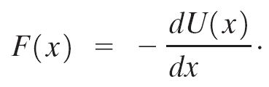
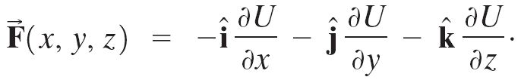
8-2 Potential Energy
In one dimension,
We can invert this equation to find U (x) if we know F (x):
In three dimensions:

Slide 9
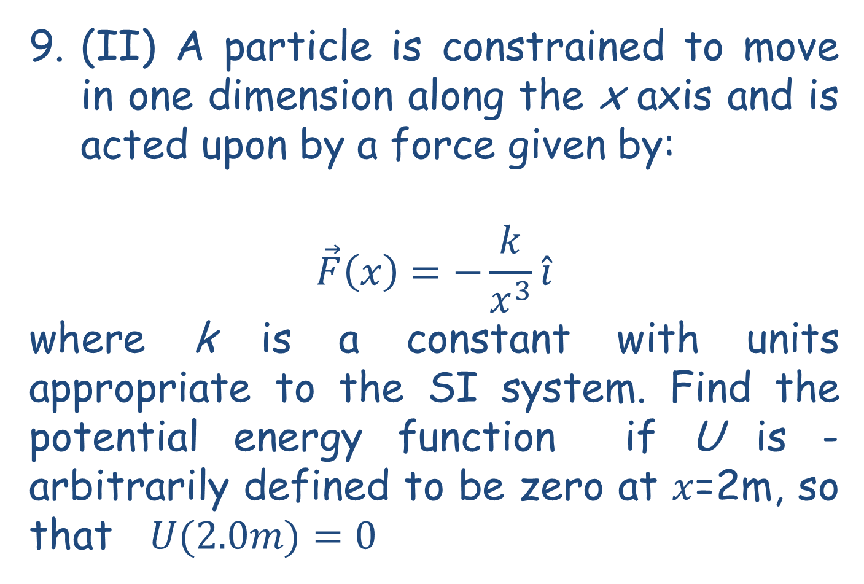
Problem 9

Slide 10

8-3 Mechanical Energy and Its Conservation
If the forces are conservative, the sum of the changes in the kinetic energy and in the potential energy is zero—the kinetic and potential energy changes are equal but opposite in sign.
This allows us to define the total mechanical energy:
And its conservation:
.

Slide 11
8-3 Mechanical Energy and Its Conservation
The principle of conservation of mechanical energy:
If only conservative forces are doing work, the total mechanical energy of a system neither increases nor decreases in any process. It stays constant—it is conserved.

Slide 12

8-4 Problem Solving Using Conservation of Mechanical Energy
In the image on the left, the total mechanical energy at any point is:
Notes:
Figure 8-7. Caption: The rock’s potential energy changes to kinetic energy as it falls. Note bar graphs representing potential energy U and kinetic energy K for the three different positions.

Slide 13
8-4 Problem Solving Using Conservation of Mechanical Energy
Example 8-4: Roller-coaster car speed using energy conservation.
Assuming the height of the hill is 40 m, and the roller-coaster car starts from rest at the top, calculate (a) the speed of the roller-coaster car at the bottom of the hill, and (b) at what height it will have half this speed. Take y = 0 at the bottom of the hill.
Notes:
Figure 8-8. Caption: A roller-coaster car moving without friction illustrates the conservation of mechanical energy.

Slide 14
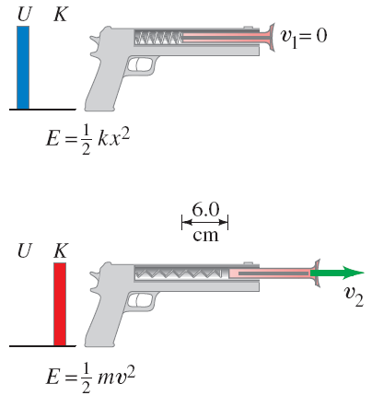

8-4 Problem Solving Using Conservation of Mechanical Energy
For an elastic force, conservation of energy tells us:
Example 8-7: Toy dart gun.
A dart of mass 0.100 kg is pressed against the spring of a toy dart gun. The spring (with spring stiffness constant k = 250 N/m and ignorable mass) is compressed 6.0 cm and released. If the dart detaches from the spring when the spring reaches its natural length (x = 0), what speed does the dart acquire?
Notes:
Figure 8-12. Caption: Example 8-7. (a) A dart is pushed against a spring, compressing it 6.0 cm. The dart is then released, and in (b) it leaves the spring at velocity v₂.
Solution: Use conservation of energy, with the initial energy as elastic potential energy; v = 3.0 m/s.

