Slide 1

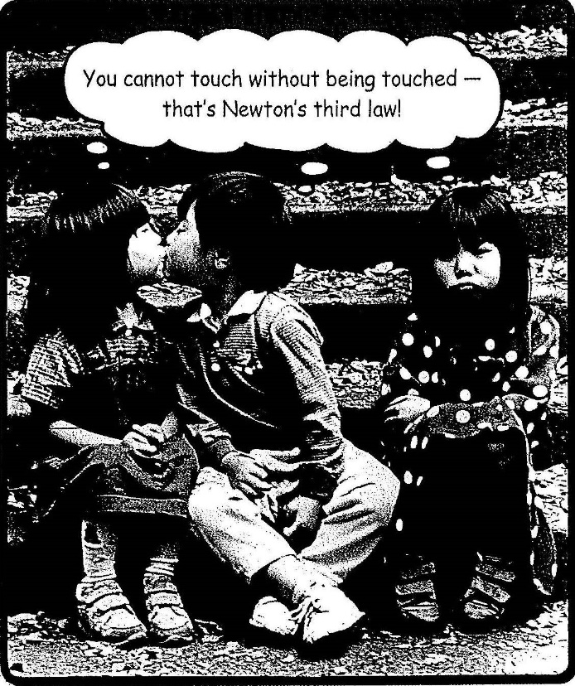
Chapter 4:Dynamics: Newton’s Law of Motion
You cannot touch
without being touched-
That’s Newton’s third law!
Quiz this week.
HW2 :Chapter 2: Pb. 51, Pb.63, Pb.67:Chapter 3: Pb. 3, Pb.5, Pb.10,Pb.38,Pb.46
Due on Monday, Sept. 29

Slide 2
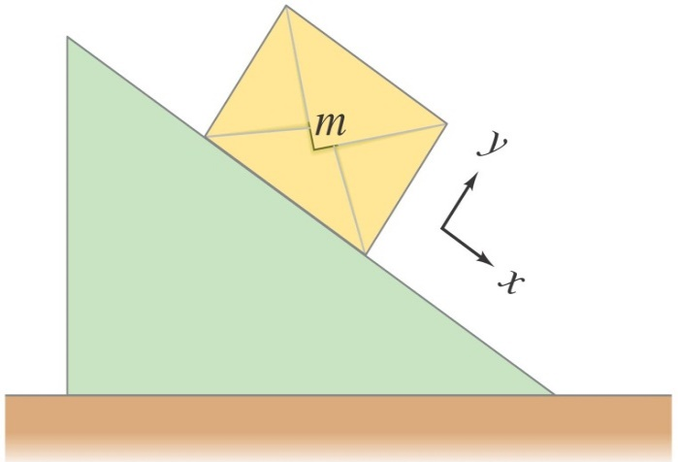
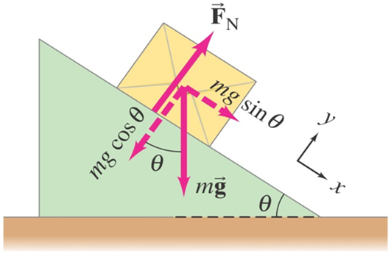
Solving Problems with Newton’s Laws: Free-Body Diagrams
Example 4-16: Box slides down an incline.
A box of mass m is placed on a smooth incline that makes an angle θ with the horizontal. (a) Determine the normal force on the box. (b) Determine the box’s acceleration. (c) Evaluate for a mass m = 10 kg and an incline of θ = 30°.
Notes:
Figure 4-26. Caption: Example 4–16.
(a) Box sliding on inclined plane.
(b) Free-body diagram of box.
Answer: On an incline (or any surface), the normal force is perpendicular to the surface and any frictional forces are parallel to the surface.
(a) The normal force is equal to the component of the weight perpendicular to the incline, or mg cos θ.
(b) The force causing the acceleration is the component of the weight parallel to the incline; therefore the acceleration is g sin θ.
(c) The normal force is 85 N and the acceleration is 4.9 m/s².

Slide 3
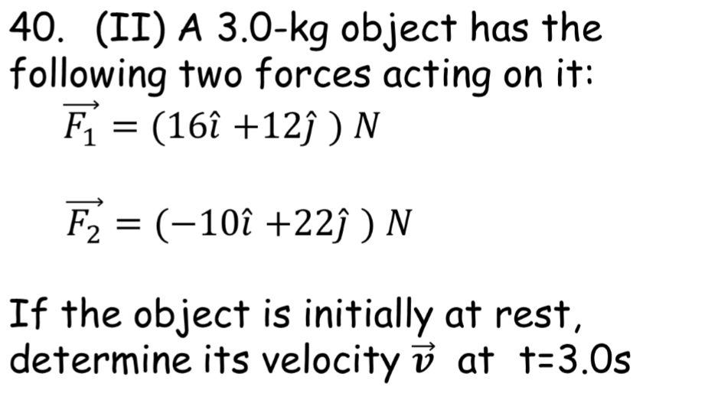
Problem 40

Slide 4
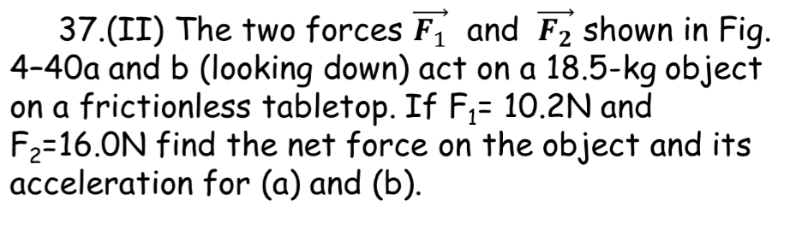
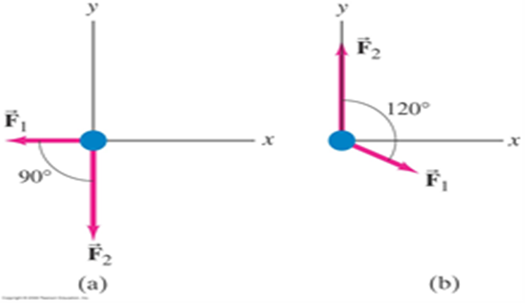
Problem 37

