Slide 1
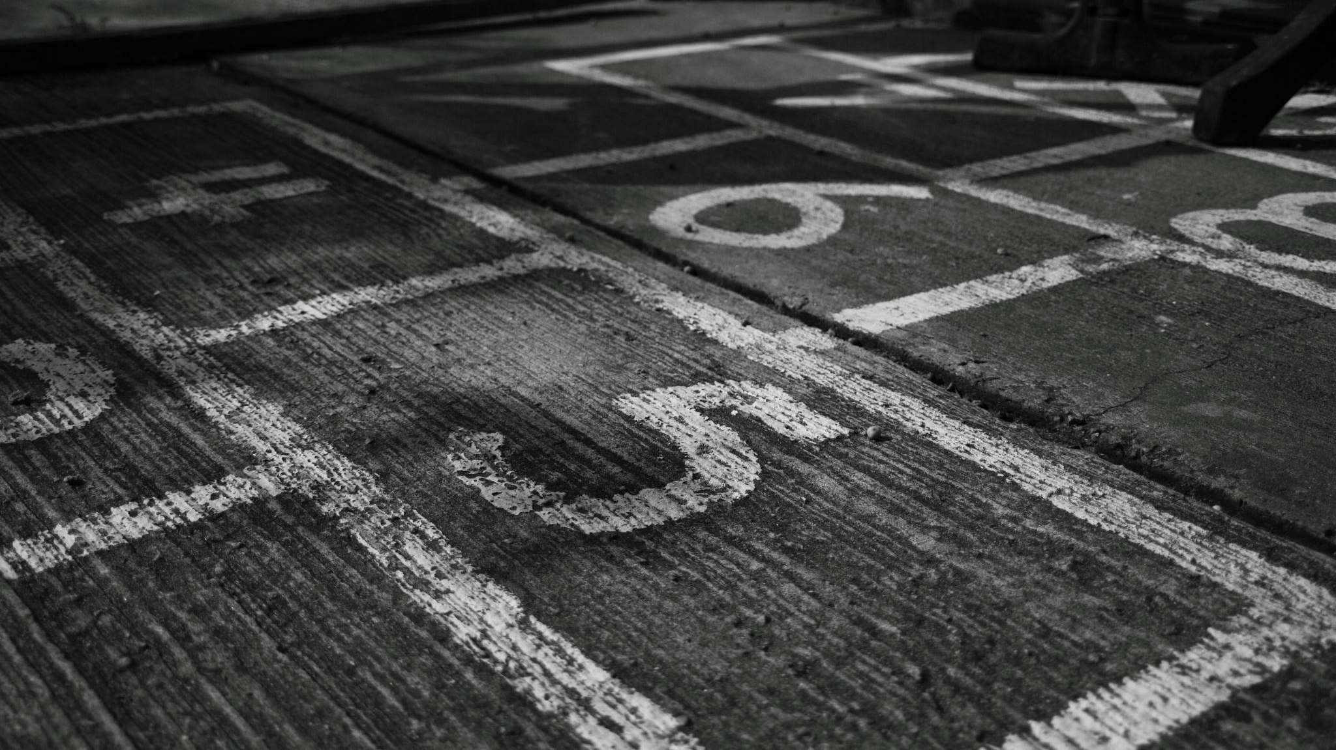
Chapter 8
Rotational Motion of Solid Objects

Slide 2
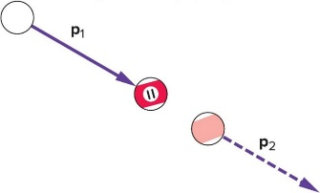
What happens when billiard balls bounce? 1
Simplest case: a head-on collision between the white cue ball and the eleven ball initially at rest.
  If spin is not a factor, the cue ball stops and the eleven ball moves forward with a velocity equal to the initial velocity of the cue ball.
  The eleven ball’s final momentum is equal to the cue ball’s initial momentum.
  Momentum is conserved.
  The eleven ball also has
  a final kinetic energy
  equal to the cue ball’s
  initial kinetic energy.
  Energy is conserved.

Slide 3
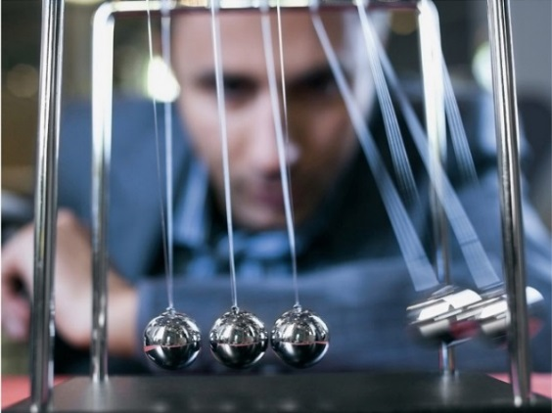
What happens when billiard balls bounce? 2
For equal masses, the only way for momentum and energy to both be conserved is for the cue ball to stop and the eleven ball to move forward with all the velocity.
Another example is the familiar swinging-ball toy with a row of steel balls hanging by threads from a frame.
  If one ball is pulled back and released, the collision with the other balls results in a single ball from the other end flying off with the same velocity as the first ball just before the collision.
  Both momentum and kinetic energy are conserved.
  If two balls on one side are pulled back and released, two balls fly off from the opposite side.

Slide 4
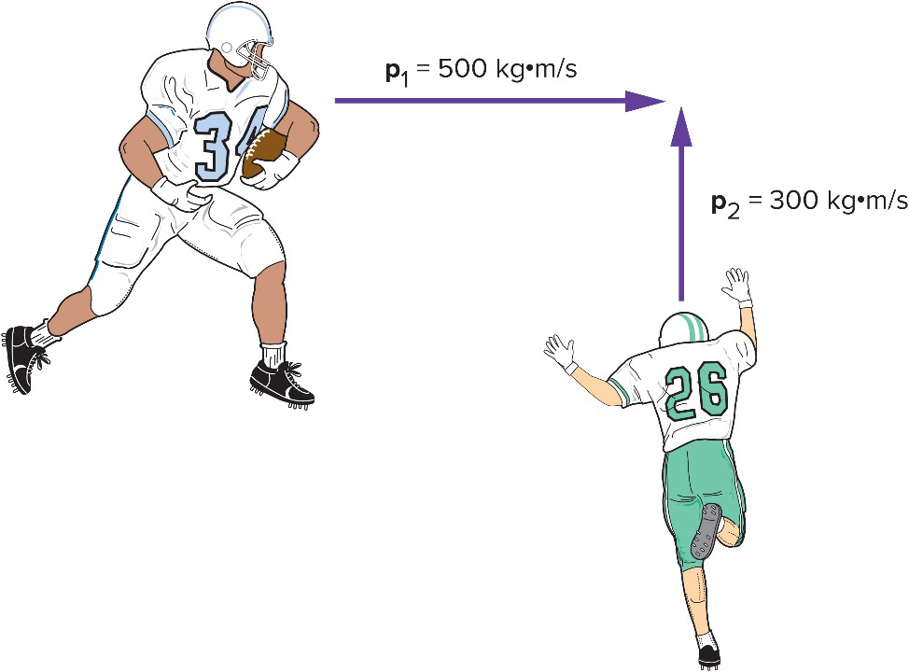
Collisions at an Angle 1
Two football players traveling at right angles to one another collide and stick together.
  What will be their direction of motion after the collision?
Add the individual momentum vectors to get the total momentum of the system before the collision.
The final momentum of the two players stuck together is equal to the total initial momentum.

Slide 5
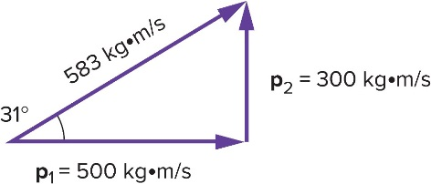
Collisions at an Angle 2
The total momentum of the two football players prior to the collision is the vector sum of their individual momentums.
  The larger initial momentum has a larger effect on the final direction of motion.
Access the text alternative for slide images.

Slide 6
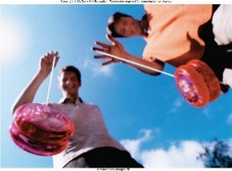
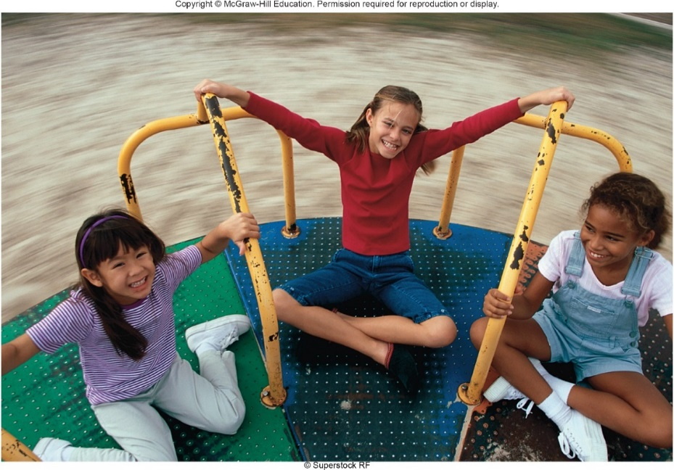
Chapter 8: What Is Rotational Motion?
What does a yo-yo have in common with a merry-go-round?
How can we describe this type of motion?
(1) ©Fuse/Getty Images RFTW; (2)©Superstock RF

Slide 7
Linear Motion vs. Rotational Motion 1
Linear motion involves an object moving from one point to another in a straight line.
Rotational motion involves an object rotating about an axis.
  Examples include a merry-go-round, the rotating earth, a spinning skater, and a turning wheel.
What causes rotational motion?
Does Newton’s second law apply?

Slide 8
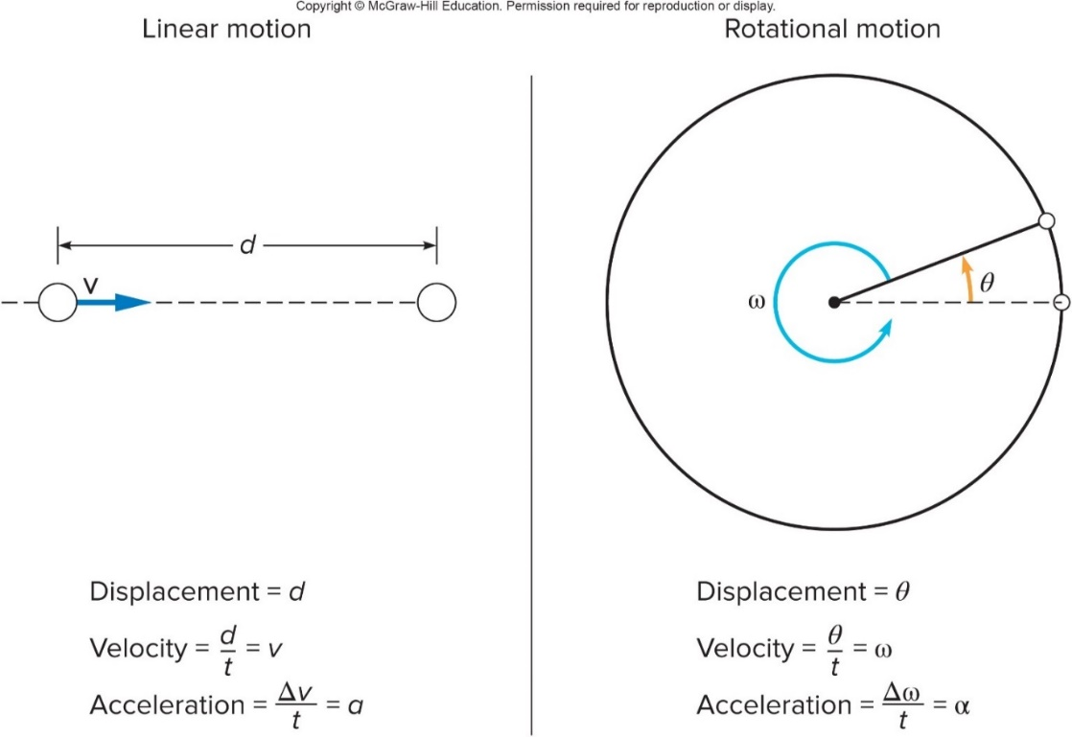
Linear Motion vs. Rotational Motion 2
There is a useful analogy between linear motion and rotational motion.
  Rotational velocity is how fast the object is turning.
    Units: revolutions per minute (rpm); degrees per second
    Analogous to linear velocity

Slide 9
Linear Motion vs. Rotational Motion 3
  Rotational displacement is how far the object rotates (angle).
    Units: fractions of a complete revolution; degrees; radians
    1 complete revolution = 360° = 2π radians
    Analogous to linear displacement: the straight-line distance traveled by an object (including direction of travel)

Slide 10
Linear Motion vs. Rotational Motion 4
  Rotational acceleration is the rate of change of rotational velocity.
    Units: revolutions per second per second
Or radians per second per
second
  Analogous to linear acceleration

Slide 11

Linear Motion vs. Rotational Motion 5
Constant acceleration equations for linear and rotational motion

Slide 12
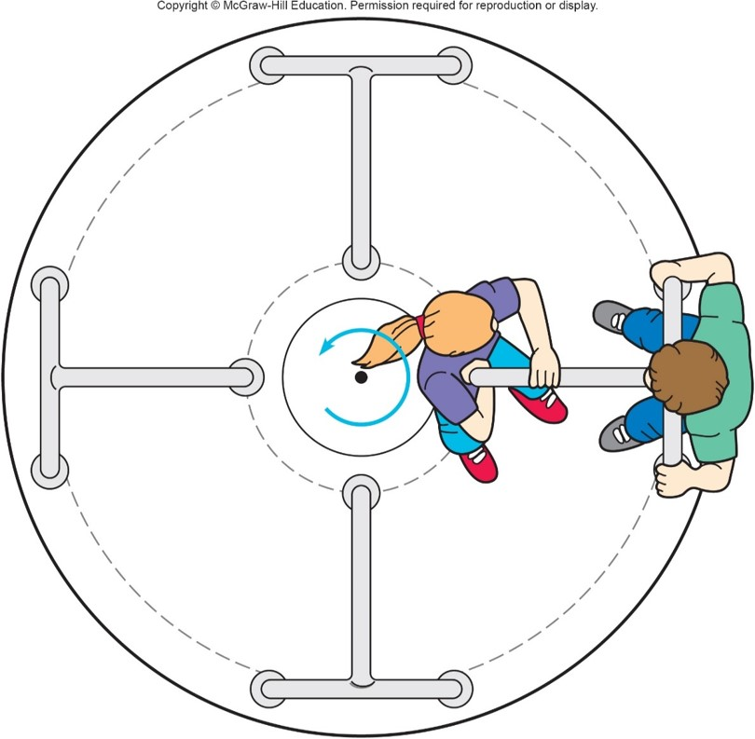
Relationship between linear and rotational velocity
  On a merry-go-round, a rider near the edge travels a greater distance in 1 revolution than one near the center.
  The outside rider is therefore traveling with a greater linear speed.

Slide 13
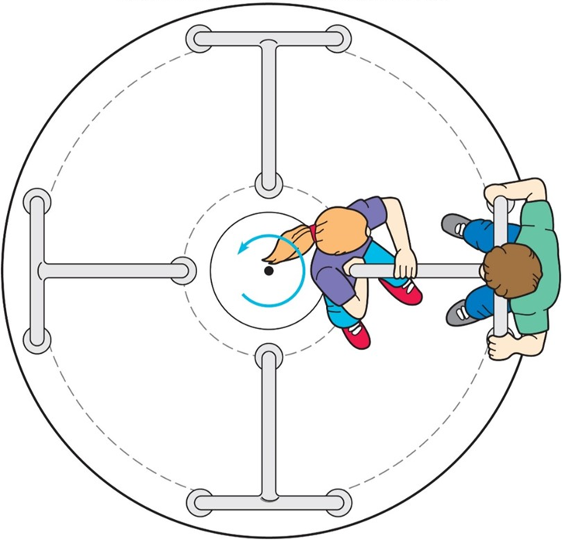
A merry-go-round is accelerated at a constant rate of 0.005 rev/s², starting from rest. What is its rotational velocity at the end of 1 min? 1
a) 0.005 rev/s
b) 0.03 rev/s
c) 0.05 rev/s
d) 0.30 rev/s

Slide 14
A merry-go-round is accelerated at a constant rate of 0.005 rev/s², starting from rest. What is its rotational velocity at the end of 1 min? 2
Define your variables:
What equation will you use?
Remember, half the battle with rotational problems is defining your variables! It’s all Greek!

Slide 15
A merry-go-round is accelerated at a constant rate of 0.005 rev/s², starting from rest. What is its rotational velocity at the end of 1 min? 3
a) 0.005 rev/s
b) 0.03 rev/s
c) 0.05 rev/s
d) 0.30 rev/s
d)

Slide 16
How many revolutions does the merry-go-round make in 1 minute? 1
a) 1.5 rev
b) 3.0 rev
c) 9.0 rev
d) 18.0 rev

Slide 17
How many revolutions does the merry-go-round make in 1 minute? 2
Define your variables:
What equation will you use?

Slide 18
How many revolutions does the merry-go-round make in 1 minute? 3
a) 1.5 rev
b) 3.0 rev
c) 9.0 rev
d) 18.0 rev
c)

Slide 19
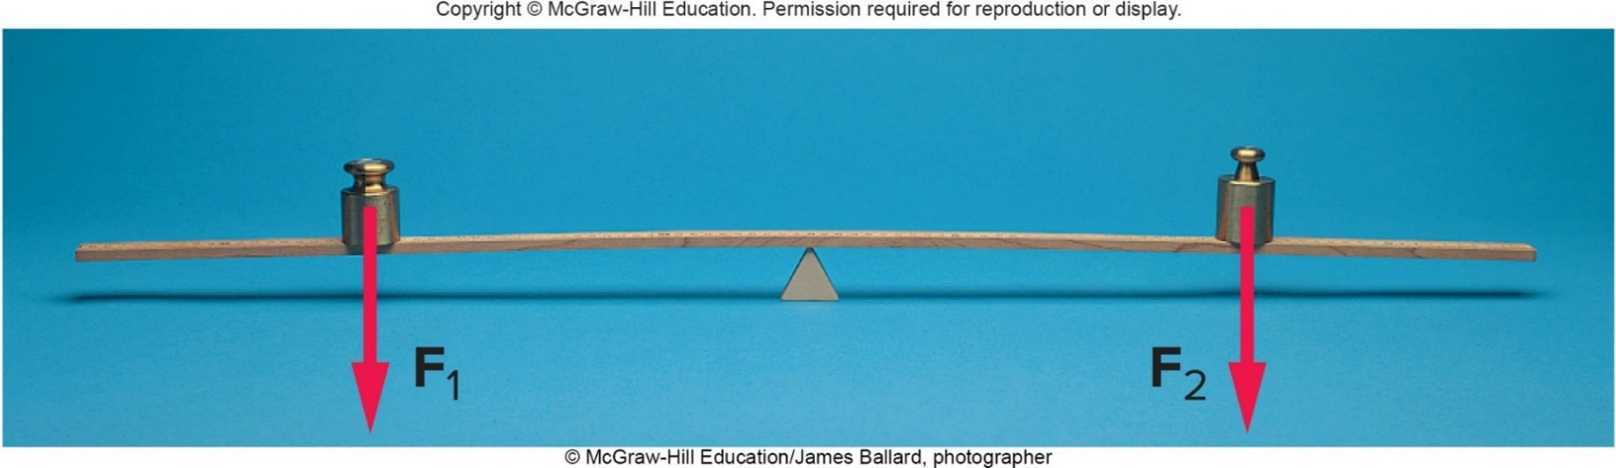
Torque and Balance 1
What causes the merry-go-round to rotate in the first place?
What determines whether an object will rotate?
If an unbalanced force causes linear motion, what causes rotational motion?
©McGraw-Hill Education/James Ballard, photographer

Slide 20
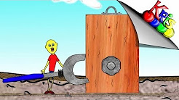
10-4 Torque
https://www.youtube.com/watch?v=Jb65BJCyUCA

Slide 21

Torque and Balance 2
When is a balance balanced?
  Consider a thin but rigid beam supported by a fulcrum or pivot point.
  If equal weights are placed at equal distances from the fulcrum, the beam will not tend to rotate: it will be balanced.
©McGraw-Hill Education/James Ballard, photographer

Slide 22
Torque and Balance 3
  To balance a weight twice as large as a smaller weight, the smaller weight must be placed twice as far from the fulcrum as the larger weight.
  Both the weight and the distance from the fulcrum are important.
  The product of the force and the distance from the fulcrum is called the torque.
  Torque describes the tendency of a weight to produce a rotation.
©McGraw-Hill Education/James Ballard, photographer

Slide 23
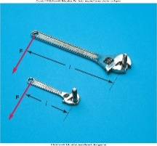
Torque and Balance 4
The distance from the fulcrum to the point of application of the force must be measured in a direction perpendicular to the line of action of the force.
  This distance is called the lever arm or moment arm.
  A longer lever arm produces a greater torque.
  For a force F and a lever arm l, the resulting torque is:
©McGraw-Hill Education/James Ballard, photographer

Slide 24
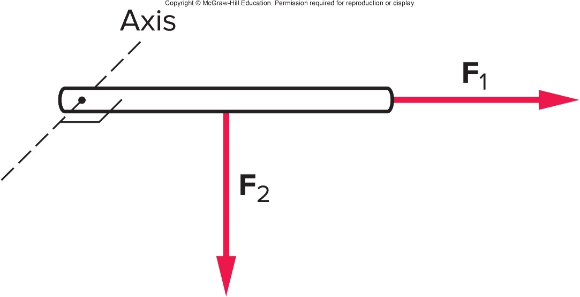
Which of the forces pictured as acting upon the rod will produce a torque about an axis perpendicular to the plane of the diagram at the left end of the rod? 1
a)
b)
c) Both.
d) Neither

Slide 25
Which of the forces pictured as acting upon the rod will produce a torque about an axis perpendicular to the plane of the diagram at the left end of the rod? 2
a)
b)
c) Both
d) Neither
b)
will produce a torque about an axis at the left end
of the rod.
has no lever arm with respect to the
given axis.

Slide 26
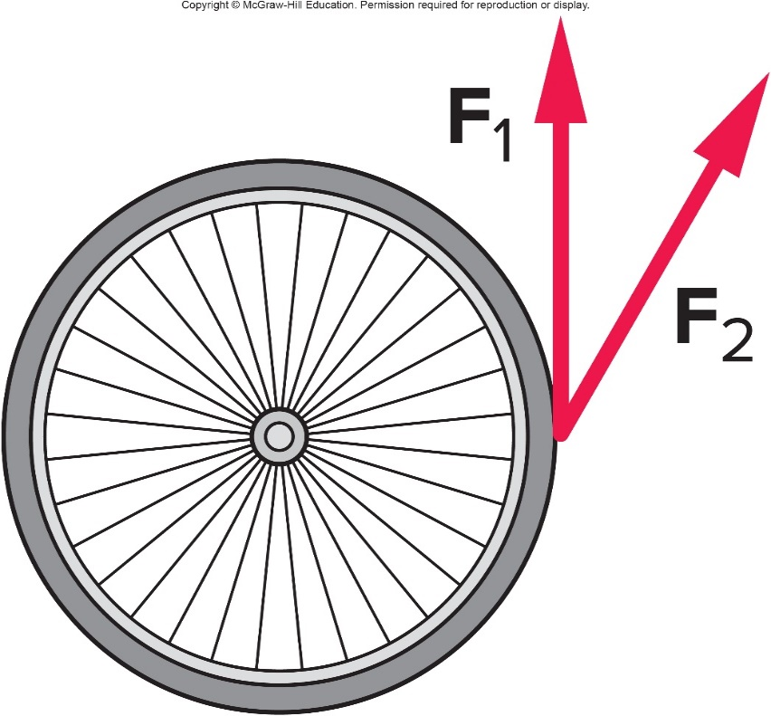
The two forces in the diagram have the same magnitude. Which orientation will produce the greater torque on the wheel? 1
a)
b)
c) Both
d) Neither

Slide 27
The two forces in the diagram have the same magnitude. Which orientation will produce the greater torque on the wheel? 2
a)
b)
c) Both
d) Neither
a)
provides the larger torque,
has a smaller component perpendicular to the radius.

Slide 28
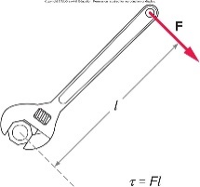
A 50-N force is applied at the end of a wrench handle that is 24 cm long. The force is applied in a direction perpendicular to the handle as shown. What is the torque applied to the nut by the wrench? 1
a) 6 N·m
b) 12 N·m
c) 26 N·m
d) 120 N·m

Slide 29
A 50-N force is applied at the end of a wrench handle that is 24 cm long. The force is applied in a direction perpendicular to the handle as shown. What is the torque applied to the nut by the wrench? 2
a) 6 N·m
b) 12 N·m
c) 26 N·m
d) 120 N·m
b) 50 N × 0.24 m = 12 N·m

Slide 30
What would the torque be if the force were applied half way up the handle instead of at the end? 1
a) 6 N·m
b) 12 N·m
c) 26 N·m
d) 120 N·m

Slide 31
What would the torque be if the force were applied half way up the handle instead of at the end? 2
a) 6 N·m
b) 12 N·m
c) 26 N·m
d) 120 N·m
a) 50 N × 0.12 m = 6 N·m

Slide 32
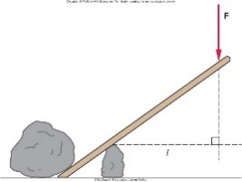
Counterclockwise Rotation
  When the applied force is not perpendicular to the crowbar, for example, the lever arm is found by drawing the perpendicular line from the fulcrum to the line of action of the force.
We call torques that produce counterclockwise rotation positive, and torques that produce clockwise rotation negative.

Slide 33
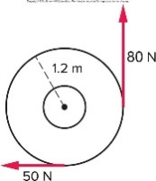
Two forces are applied to a merry-go-round with a radius of 1.2 m as shown. What is the torque about the axle of the merry-go-round due to the 80-N force? 1
a) +9.6 N·m
b) -36 N·m
c) +96 N·m
d) -96 N·m

Slide 34
Two forces are applied to a merry-go-round with a radius of 1.2 m as shown. What is the torque about the axle of the merry-go-round due to the 80-N force? 2
a) +9.6 N·m
b) -36 N·m
c) +96 N·m
d) -96 N·m
c) 1.2 m × 80 N
= +96 N·m
(counterclockwise)

Slide 35
What is the torque about the axle of the merry-go-round due to the 50-N force? 1
a) +60 N·m
b) -60 N·m
c) +120 N·m
d) -120 N·m

Slide 36
What is the torque about the axle of the merry-go-round due to the 50-N force? 2
a) +60 N·m
b) -60 N·m
c) +120 N·m
d) -120 N·m
b) -(1.2 m × 50 N) = -60 N·m
(clockwise)

Slide 37
What is the net torque acting on the merry-go-round? 1
a) +36 N·m
b) -36 N·m
c) +30 N·m
d) -60 N·m
e) +126 N·m

Slide 38
What is the net torque acting on the merry-go-round? 2
a) +36 N·m
b) -36 N·m
c) +30 N·m
d) -60 N·m
e) +126 N·m
a) 96 N·m (counterclockwise) - 60 N·m (clockwise)
= +36 N·m
(counterclockwise)

Slide 39
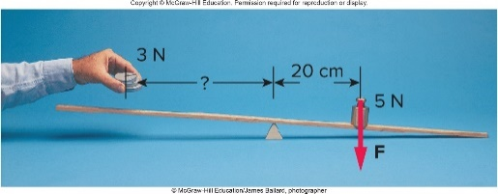
We want to balance a 3-N weight against a 5-N weight on a beam. The 5-N weight is placed 20 cm to the right of a fulcrum. What is the torque produced by the 5-N weight? 1
a) +1 N·m
b) -1 N·m
c) +4 N·m
d) -4 N·m
©McGraw-Hill Education/James Ballard, photographer

Slide 40
We want to balance a 3-N weight against a 5-N weight on a beam. The 5-N weight is placed 20 cm to the right of a fulcrum. What is the torque produced by the 5-N weight? 2
a) +1 N·m
b) -1 N·m
c) +4 N·m
d) -4 N·m
b) F = 5 N
l = 20 cm = 0.2 m
©McGraw-Hill Education/James Ballard, photographer

Slide 41
How far do we have to place the 3-N weight from the fulcrum to balance the system? 1
a) 2 cm
b) 27 cm
c) 33 cm
d) 53 cm
©McGraw-Hill Education/James Ballard, photographer

Slide 42
How far do we have to place the 3-N weight from the fulcrum to balance the system? 2
a) 2 cm
b) 27 cm
c) 33 cm
d) 53 cm
c) F = 3N
©McGraw-Hill Education/James Ballard, photographer

Slide 43
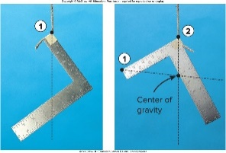
Center of Gravity
  The center of gravity of an object is the point about which the weight of the object itself exerts no torque.
  We can locate the center of gravity by finding the point where it balances on a fulcrum.
For a more complex object, we locate the center of gravity by suspending the object from two different points, drawing a line straight down from the point of suspension in each case, and locating the point of intersection of the two lines.
©McGraw-Hill Education/James Ballard, photographer

Slide 44
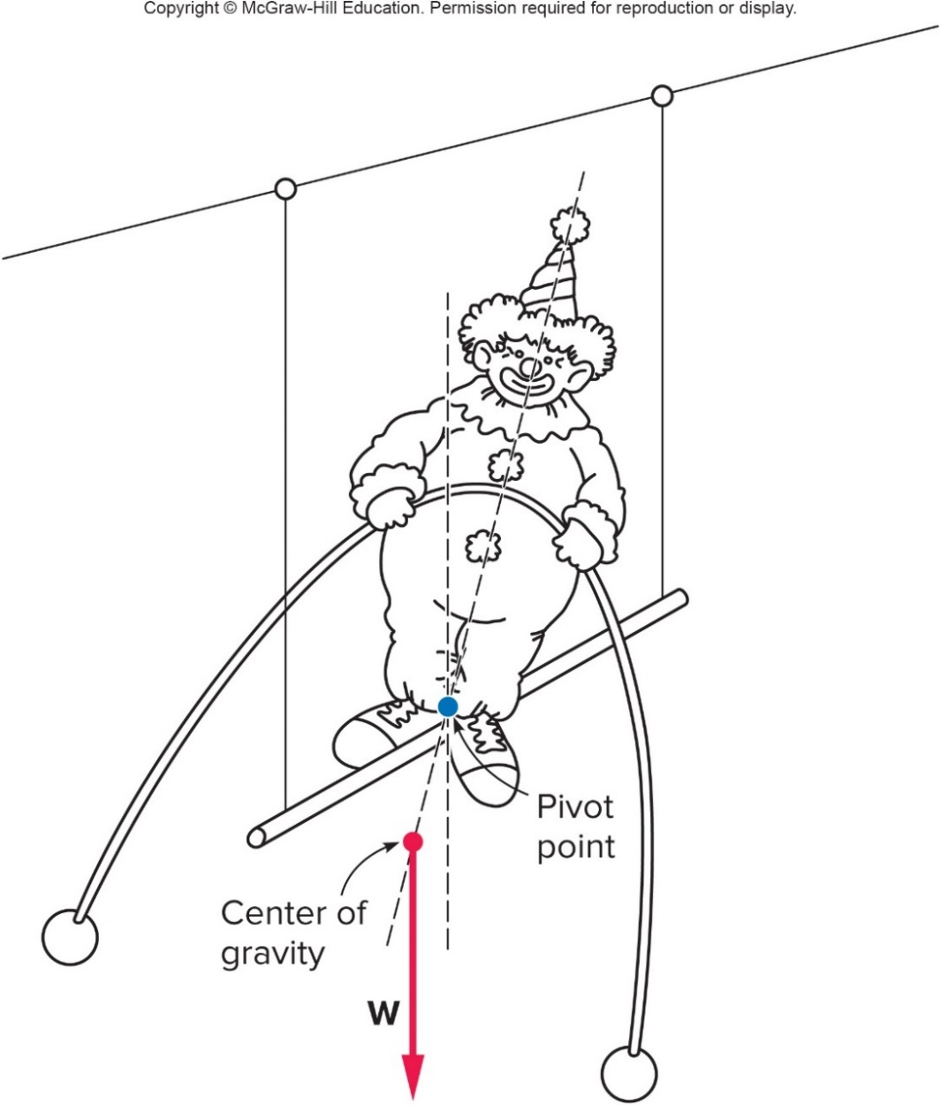
Gravity
  If the center of gravity lies below the pivot point, the object will automatically regain its balance when disturbed.
  The center of gravity returns to the position directly below the pivot point, where the weight of the object produces no torque.

Slide 45
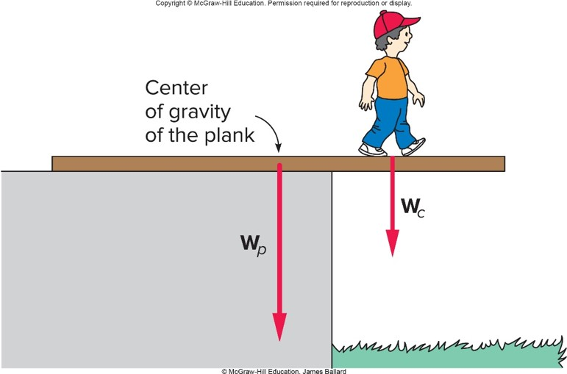
How far can the child walk without tipping the plank?
For a uniform plank, its center of gravity is at its geometric center.
The pivot point will be the edge of the supporting platform.
The plank will not tip as long as the counterclockwise torque from the weight of the plank is larger than the clockwise torque from the weight of the child.
The plank will verge on tipping when the magnitude of the torque of the child equals that of the plank.
©McGraw-Hill Education. James Ballard

Slide 46
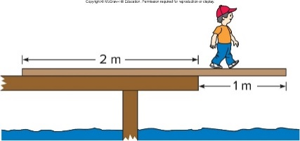
An 80-N plank is placed on a dock as shown. The plank is uniform in density so the center of gravity of the plank is located at the center of the plank. A 160-N boy standing on the plank walks out slowly from the edge of the dock. What is the torque exerted by the weight of the plank about the pivot point at the edge of the dock? 1
a) +80 N·m
b) -80 N·m
c) +160 N·m
d) -160 N·m
e) +40 N·m

Slide 47
An 80-N plank is placed on a dock as shown. The plank is uniform in density so the center of gravity of the plank is located at the center of the plank. A 160-N boy standing on the plank walks out slowly from the edge of the dock. What is the torque exerted by the weight of the plank about the pivot point at the edge of the dock? 2
a) +80 N·m
b) -80 N·m
c) +160 N·m
d) -160 N·m
e) +40 N·m
e) 0.5 m × 80 N = +40 N·m (counterclockwise)

Slide 48

How far from the edge of the dock can the 160-N boy walk until the plank is just on the verge of tipping? 1
a) 0.12 m
b) 0.25 m
c) 0.50 m
d) 1.20 m

Slide 49

How far from the edge of the dock can the 160-N boy walk until the plank is just on the verge of tipping? 2
a) 0.12 m
b) 0.25 m
c) 0.50 m
d) 1.20 m
Set τ from plank equal to τ from boy.
40Nm =
= 160N(l), then solve for l,
b) l= 40 N·m / 160 N = 0.25 m

Slide 50
Rotational Inertia and Newton’s Second Law 1
In linear motion, net force and mass determine the acceleration of an object.
For rotational motion, torque determines the rotational acceleration.
The rotational counterpart to mass is rotational inertia or moment of inertia.
  Just as mass represents the resistance to a change in linear motion, rotational inertia is the resistance of an object to change in its rotational motion.
  Rotational inertia is related to the mass of the object.
  It also depends on how the mass is distributed about the axis of rotation.

Slide 51
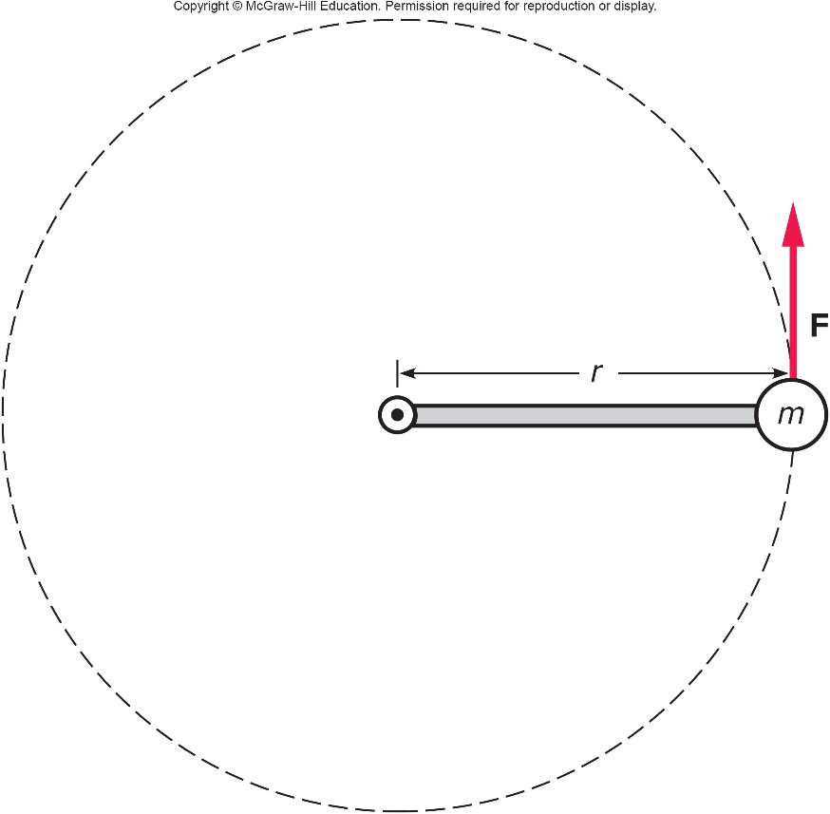
Simplest example: a mass at the end of a light rod 1
A force is applied to the mass in a direction perpendicular to the rod.
The rod and mass will begin to rotate about the fixed axis at the other end of the rod.
The farther the mass is from the axis, the faster it moves for a given rotational velocity.

Slide 52
Simplest example: a mass at the end of a light rod 2
To produce the same rotational acceleration, a mass at the end of the rod must receive a larger linear acceleration than one nearer the axis.
It is harder to get the system rotating when the mass is at the end of the rod than when it is nearer to the axis.

Slide 53
Rotational Inertia and Newton’s Second Law 2
The resistance to a change in rotational motion depends on:
  the mass of the object;
  the square of the distance of the mass from the axis of rotation.
For an object with its mass concentrated at a point:
  Rotational inertia = mass × square of distance from axis
The total rotational inertia of an object like a merry-go-round can be found by adding the contributions of all the different parts of the object.

