Slide 1
Chapter 7: Momentum
No Quiz on Thursday,
Exam 3 on April 22, chapters 7 and 8
Study guide posted
Final Exam on Wednesday, April 30 at 11:30 am

Slide 2
Collisions
How can we describe the change in velocities of colliding football players, or balls colliding with bats?
How does a strong force applied for a very short time affect the motion?
Can we apply Newton’s Laws to collisions?
What exactly is momentum? How is it different from force or energy?
What does “Conservation of Momentum” mean?
Chapter 7 has the answers to these questions.

Slide 3
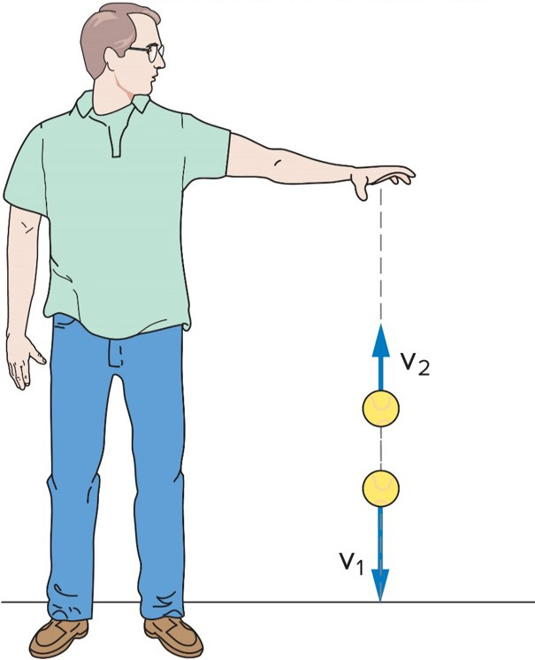
What happens when a ball bounces? 1
When it reaches the floor, its velocity quickly changes direction.
There must be a strong force exerted on the ball by the floor during the short time they are in contact.
This force provides the upward acceleration necessary to change the direction of the ball’s velocity.

Slide 4
What happens when a ball bounces? 2
Forces like this are difficult to analyze:
  Strong forces that act for a very short time.
  Forces that may change rapidly during the collision.
It will help to write Newton’s second law in terms of the total change in velocity over time, instead of acceleration:

Slide 5
Momentum and Impulse 1
Multiply both sides of Newton’s second law by the time interval over which the force acts:
The left side of the equation is impulse, the (average) force acting on an object multiplied by the time interval over which the force acts.
How a force changes the motion of an object depends on both the size of the force and how long the force acts.
The right side of the equation is the change in the momentum of the object.
The momentum of the object is the mass of the object times its velocity.

Slide 6
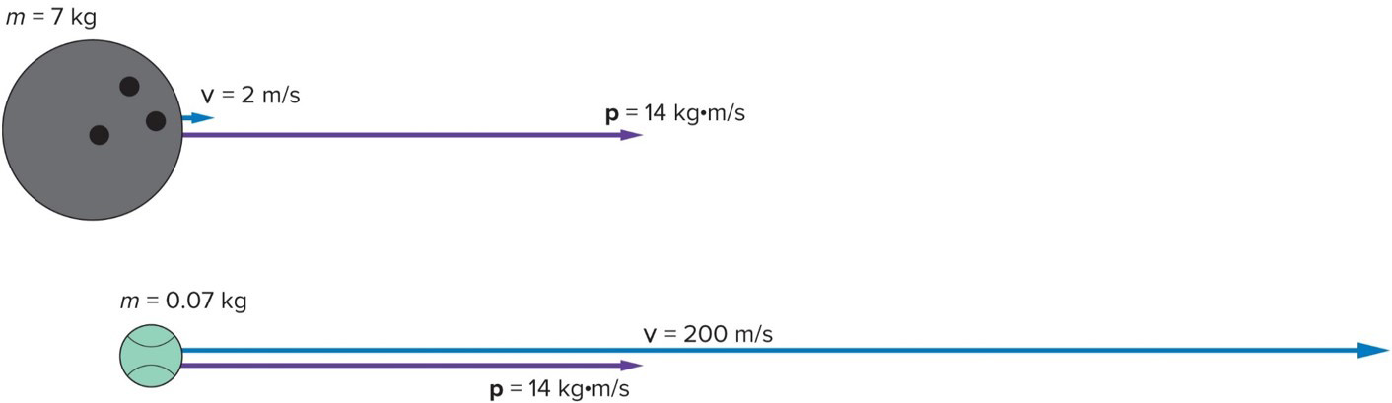
Momentum and Impulse 2
A bowling ball and a tennis ball can have the same momentum, if the tennis ball with its smaller mass has a much larger velocity.

Slide 7
Question 7.1
If the momentum of an object is doubled, its speed must have increased by
4
2
0.5
0.25

Slide 8
Answer 7.1
If the momentum of an object is doubled, its speed must have increased by
2, since p = mv

Slide 9
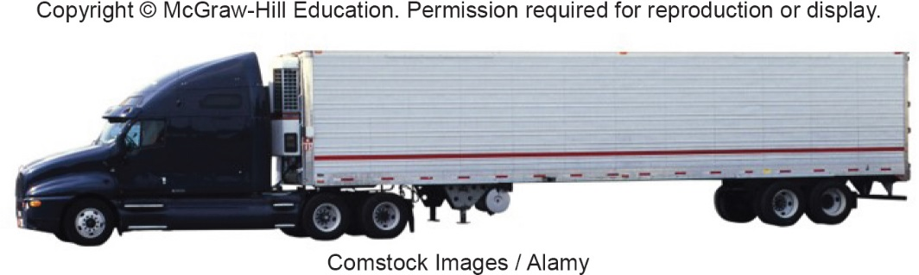
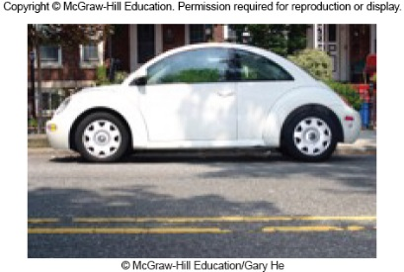
Question 7.2
An 18-wheeler and a Volkswagon Beetle are rolling along with the same momentum. Which one is going faster?
18-wheeler
Volkswagon beetle
same for both
impossible to say
(First) © McGraw-Hill Education/Gary He (Second) Comstocks Images/Alamy

Slide 10
Answer 7.2
An 18-wheeler and a Volkswagon Beetle are rolling along with the same momentum. Which one is going faster?
Volkswagon beetle
Remember m₁v₁ = m₂v₂
(First) Comstocks Images/Alamy (Second) © McGraw-Hill Education/Gary He

Slide 11
Impulse-Momentum Principle 1
The impulse acting on an object produces a change in momentum of the object that is equal in both magnitude and direction to the impulse.

Slide 12
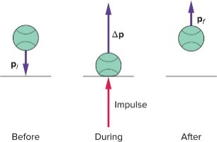
Impulse-Momentum Principle 2
When a ball bounces back with the same speed, the momentum changes from -mv to mv, so the change in momentum is 2mv.

Slide 13
Question 7.3
Maggie drops a stuffed bear over the side of her crib. It hits the floor with speed v and comes to rest. She then drops a rubber ball with the same mass from the same height, and it bounces back upwards with speed v. Compare the change in momentum of the bear and the ball.
∆p_{bear} = ∆p_{ball}
∆p_{bear} = 2 ∆p_{ball}
∆p_{bear} = ½ ∆p_{ball}
∆p_{bear} = - ∆p_{ball}

Slide 14
Answer 7.3
Maggie drops a stuffed bear over the side of her crib. It hits the floor with speed v and comes to rest. She then drops a rubber ball with the same mass from the same height, and it bounces back upwards with speed v. Compare the change in momentum of the bear and the ball.
∆p_{bear} = ½ ∆p_{ball}
p_{final} – p_{initial} = ∆p
0-(-mv) = mv = ∆p_{bear}
mv-(-mv) = 2mv = ∆p_{ball}

Slide 15
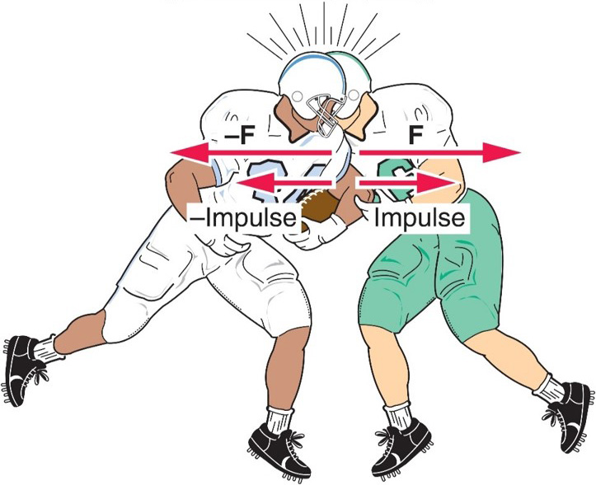
Conservation of Momentum 1
Does Newton’s third law still hold?
  For every action, there is an equal but opposite reaction.
  The defensive back exerts a force on the fullback, and the fullback exerts an equal but opposite force on the defensive back.

Slide 16
Conservation of Momentum 2
  If the net external force acting on a system of objects is zero, the total momentum of the system is conserved. ( No external force is included)

Slide 17
Conservation of Momentum 3
  The changes in momentum for each are equal and opposite.
  The total change of the momentum for the two players is zero.

Slide 18
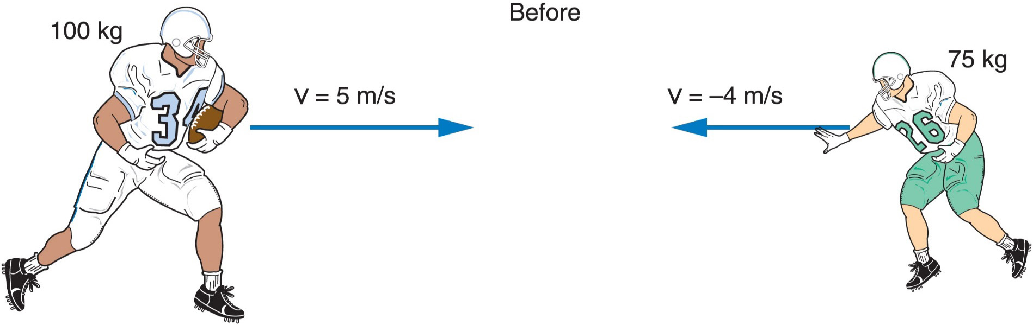
A 100-kg fullback moving straight downfield at 5 m/s collides with a 75-kg defensive back moving in the opposite direction at 4 m/s. The defensive back hangs on to the fullback, and the two players move together after the collision. What is the initial momentum of each player?

Slide 19
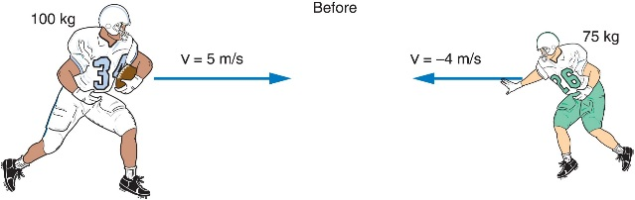
What is the initial momentum of each player? 1
Fullback:
Defensive back:

Slide 20
What is the initial momentum of each player? 2
Fullback:
Defensive back:

Slide 21
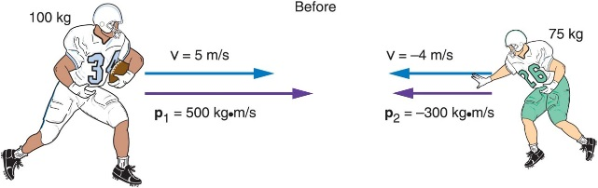
What is the total momentum of the system? 2
Total momentum:
Access the text alternative for slide images.

Slide 22
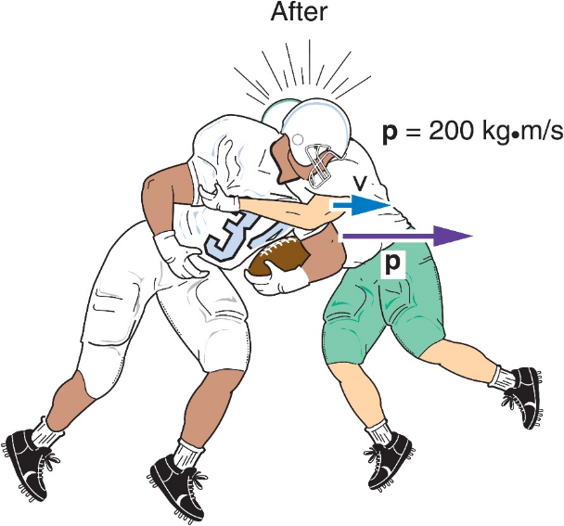
What is the velocity of the two players immediately after the collision? 1
Total mass:
Velocity of both?:

Slide 23
What is the velocity of the two players immediately after the collision? 2
Total mass:
Velocity of both:
This velocity is in the direction of the fullback (the one with larger initial momentum)

Slide 24
Recoil
Why does a shotgun slam against your shoulder when fired, sometimes painfully?
How can a rocket accelerate in empty space when there is nothing there to push against except itself?

Slide 25
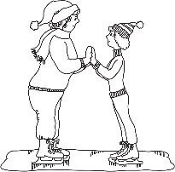
Two skaters of different masses prepare to push off against one another. Which one will gain the larger velocity? 1
The more massive one
The less massive one
They will each have equal but opposite velocities.

Slide 26
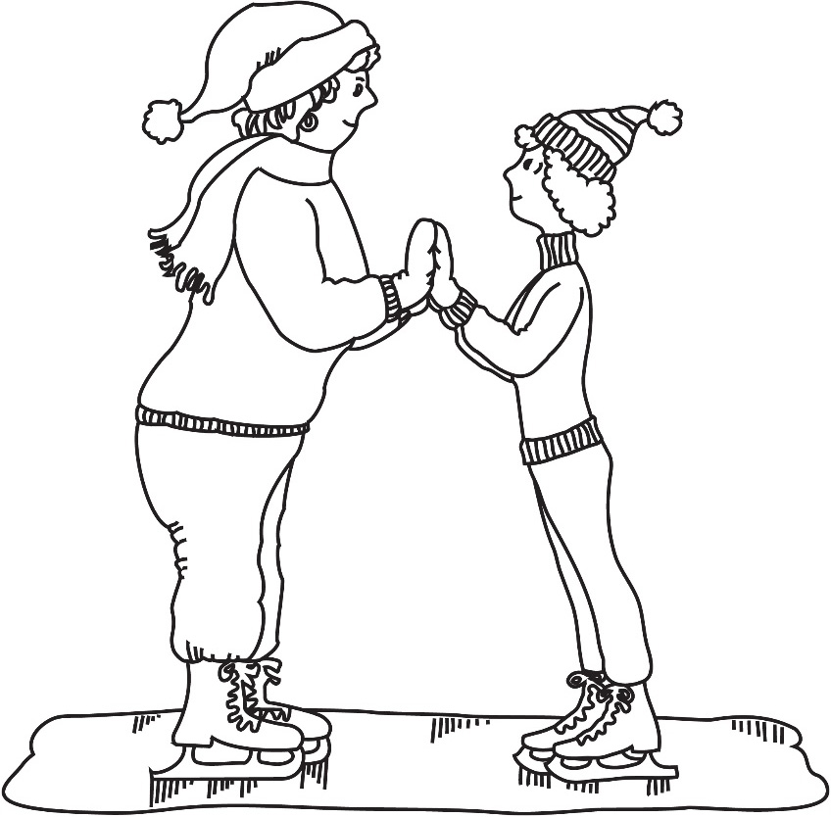
Two skaters of different masses prepare to push off against one another. Which one will gain the larger velocity? 2
The more massive one
The less massive one
They will each have equal but opposite velocities.
The less massive one!
Remember

Slide 27
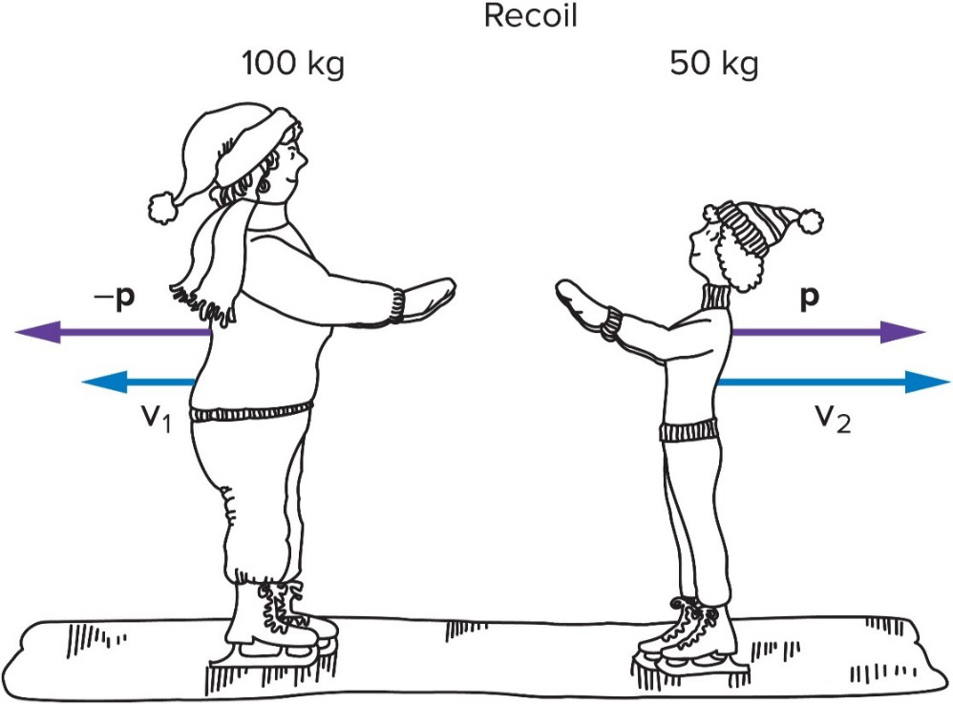
How can the total momentum be zero when at least one of the skaters is moving?
Both must move with momentum values equal in magnitude but opposite in direction:
When added together, the total final momentum of the system is then zero.
Since momentum is mass times velocity p = mv, the skater with the smaller mass must have the larger
velocity:
Access the text alternative for slide images.

Slide 28
Recoil is what happens when a brief force between two objects causes the objects to move in opposite directions.
The lighter object attains the larger velocity to equalize the magnitudes of the momentums of the two objects.
The total momentum of the system is conserved and does not change.
Access the text alternative for slide images.

Slide 29
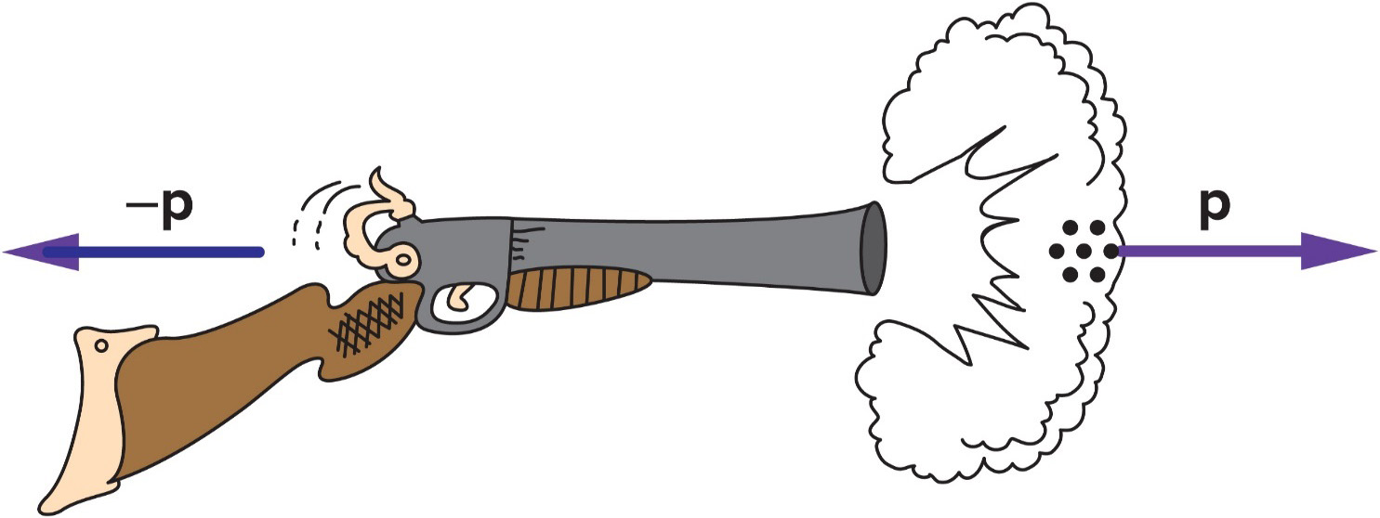
Is momentum conserved when shooting a shotgun? 1
The explosion of the powder causes the shot to move very rapidly forward.
If the gun is free to move, it will recoil backward with a momentum equal in magnitude to the momentum of the shot.

Slide 30
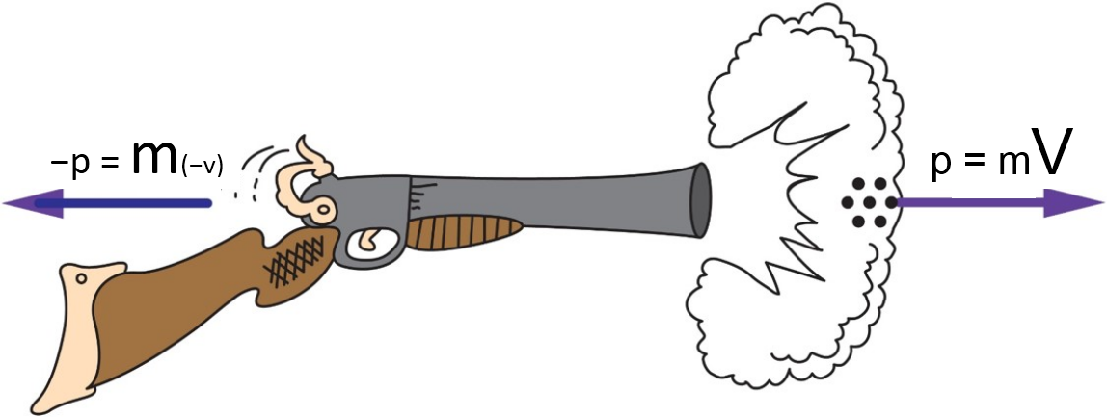
Is momentum conserved when shooting a shotgun? 2
Even though the mass of the shot is small, its momentum is large due to its large velocity.
The shotgun recoils with a momentum equal in magnitude to the momentum of the shot.
The recoil velocity of the shotgun will be smaller than the shot’s velocity because the shotgun has more mass, but it can still be sizeable.

Slide 31
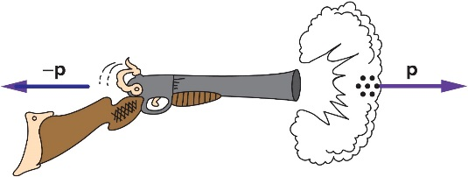
How can you avoid a bruised shoulder? 1
If the shotgun is held firmly against your shoulder, it doesn’t hurt as much.
      WHY?

Slide 32

How can you avoid a bruised shoulder?
If you think of the system as just the shotgun and the pellets, then your shoulder applies a strong external force to the system.
Since conservation of momentum requires the external force to be zero, the momentum of this system is not conserved.

Slide 33
How can you avoid a bruised shoulder? 3
If you think of the system as including yourself with your shoulder against the shotgun, then momentum is conserved because all the forces involved are internal to this system (except possibly friction between your feet and the earth).
With your mass added to the system, the recoil velocity is smaller.

Slide 34
How can you avoid a bruised shoulder? 4
If you think of the system as including yourself and the earth, then momentum is conserved because all the forces involved are internal to this system.
The large mass of the earth means that the change in momentum of the earth would be imperceptible.

Slide 35
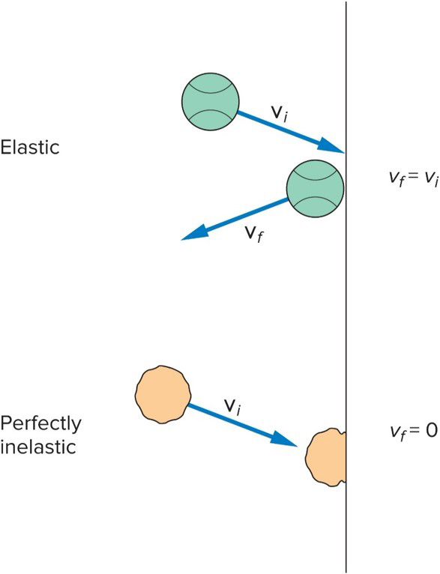
Elastic and Inelastic Collisions 1
Different kinds of collisions produce different results.
  Sometimes the objects stick together.
  Sometimes the objects bounce apart.
What is the difference between these types of collisions?
Is energy conserved as well as momentum?

Slide 36
Elastic and Inelastic Collisions 2
A collision in which the objects stick together after collision is called a perfectly inelastic collision.
  The objects do not bounce at all.
  If we know the total momentum before the collision, we can calculate the final momentum and velocity of the now-joined objects.
For example:
  The football players who stay together after colliding.
  Coupling railroad cars.

Slide 37
Four railroad cars, all with the same mass of 20,000 kg, sit on a track. A fifth car of identical mass approaches them with a velocity of 15 m/s. This car collides and couples with the other four cars. What is the initial momentum of the system? 1
200,000 kg·m/s
300,000 kg·m/s
600,000 kg·m/s
1,200,000 kg·m/s

Slide 38
Four railroad cars, all with the same mass of 20,000 kg, sit on a track. A fifth car of identical mass approaches them with a velocity of 15 m/s. This car collides and couples with the other four cars. What is the initial momentum of the system? 2
200,000 kg·m/s
300,000 kg·m/s
600,000 kg·m/s
1,200,000 kg·m/s
b)

Slide 39
What is the velocity of the five coupled cars after the collision? 1
1 m/s
3 m/s
5 m/s
10 m/s

Slide 40
What is the velocity of the five coupled cars after the collision? 2
1 m/s
3 m/s
5 m/s
10 m/s
b)

Slide 41
Is the kinetic energy after the railroad cars collide equal to the original kinetic energy of car 5? 1
yes
no
It depends.

Slide 42
Is the kinetic energy after the railroad cars collide equal to the original kinetic energy of car 5? 2
yes
no
It depends.
No, in fact it is substantially less than the initial kinetic energy!

Slide 43
Elastic and Inelastic Collisions 3
Energy is not conserved in a perfectly inelastic collision (such as we saw in the railroad car example).
If the objects bounce apart instead of sticking together, the collision is either elastic or partially inelastic.
  An elastic collision is one in which no energy is lost.
  A partially inelastic collision is one in which some energy is lost, but the objects do not stick together.
  The greatest portion of energy is lost in the perfectly inelastic collision, when the objects stick (such as the railroad car example we just did).

Slide 44
Elastic and Inelastic Collisions 4
A ball bouncing off a floor or wall with no decrease in the magnitude of its velocity is an elastic collision.
  The kinetic energy does not decrease.
  No energy has been lost.
A ball sticking to the wall is a perfectly inelastic collision.
  The velocity of the ball after the collision is zero.
  Its kinetic energy is then zero ( it is not moving).
  All of the kinetic energy has been lost.
Most collisions involve some energy loss, even if the objects do not stick, because the collisions are not perfectly elastic.
  Heat is generated, the objects may be deformed, and sound waves are created. So the energy is not actually ‘lost’ it is just transformed into another form (less useful).
  These would be partially inelastic collisions.

Slide 45
Question 7.10
The principle of conservation of momentum
is valid only for perfectly inelastic collisions
is valid only for perfectly elastic collisions
is valid for all collisions
is valid only if the net external force acting on the system is zero
states that it is impossible to change the momentum of an object

Slide 46
Answer 7.10
The principle of conservation of momentum
is valid only if the net external force acting on the system is zero

Slide 47
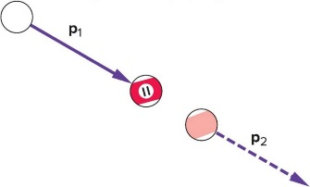
What happens when billiard balls bounce? 1
Simplest case: a head-on collision between the white cue ball and the eleven ball initially at rest.
  If spin is not a factor, the cue ball stops and the eleven ball moves forward with a velocity equal to the initial velocity of the cue ball.
  The eleven ball’s final momentum is equal to the cue ball’s initial momentum.
  Momentum is conserved.
  The eleven ball also has
  a final kinetic energy
  equal to the cue ball’s
  initial kinetic energy.
  Energy is conserved.

Slide 48
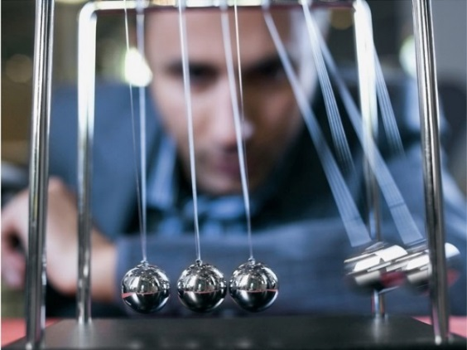
What happens when billiard balls bounce? 2
For equal masses, the only way for momentum and energy to both be conserved is for the cue ball to stop and the eleven ball to move forward with all the velocity.
Another example is the familiar swinging-ball toy with a row of steel balls hanging by threads from a frame.
  If one ball is pulled back and released, the collision with the other balls results in a single ball from the other end flying off with the same velocity as the first ball just before the collision.
  Both momentum and kinetic energy are conserved.
  If two balls on one side are pulled back and released, two balls fly off from the opposite side.

Slide 49
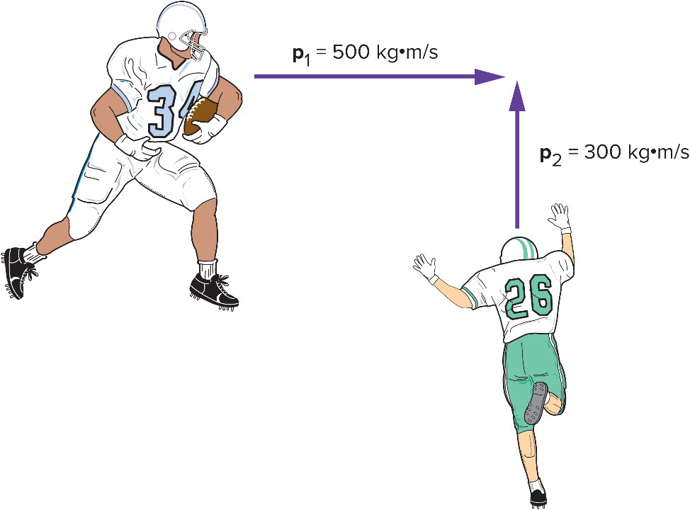
Collisions at an Angle 1
Two football players traveling at right angles to one another collide and stick together.
  What will be their direction of motion after the collision?
Add the individual momentum vectors to get the total momentum of the system before the collision.
The final momentum of the two players stuck together is equal to the total initial momentum.

Slide 50
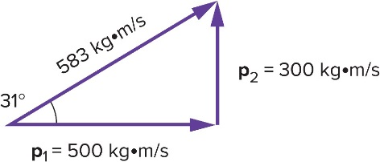
Collisions at an Angle 2
The total momentum of the two football players prior to the collision is the vector sum of their individual momentums.
  The larger initial momentum has a larger effect on the final direction of motion.
Access the text alternative for slide images.

