Slide 1
Chapter 6
Energy and Work
Exam on Thursday, April 10- Bring your calculators
https://www.youtube.com/watch?v=pDK2p1QbPKQ
https://www.youtube.com/watch?v=BSWl_Zj-CZs
https://www.youtube.com/watch?v=eh7uFumf-vc
Copyright 2022 © McGraw Hill LLC. All rights reserved. No reproduction or distribution without the prior written consent of McGraw Hill LLC.

Slide 2
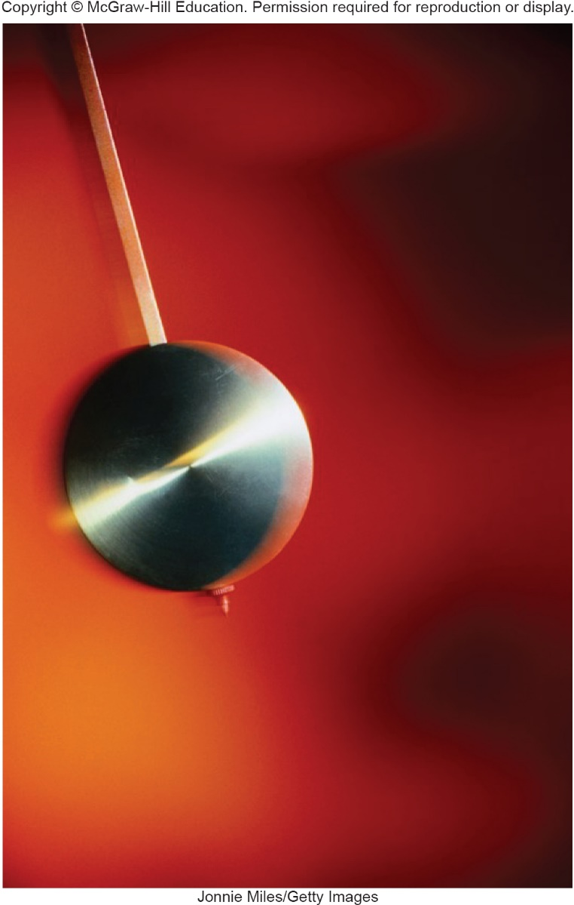
Energy and Oscillations 1
Why does a swinging pendant return to the same point after each swing?
Jonnie Miles/Getty Images

Slide 3
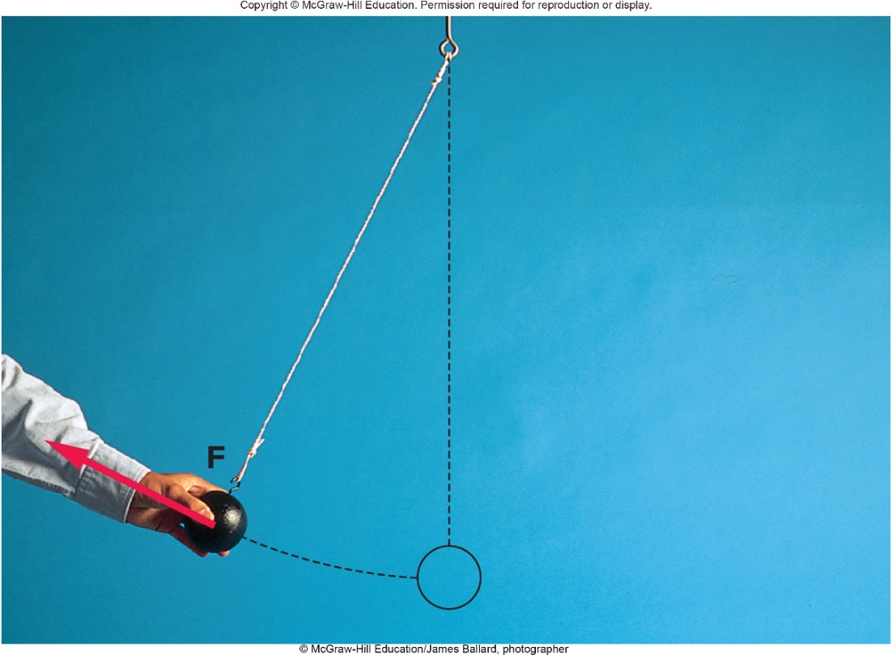
Energy and Oscillations 2
The force does work to move the ball. This increases the ball’s energy, affecting its motion.
©McGraw-Hill Education/James Ballard, photographer

Slide 4
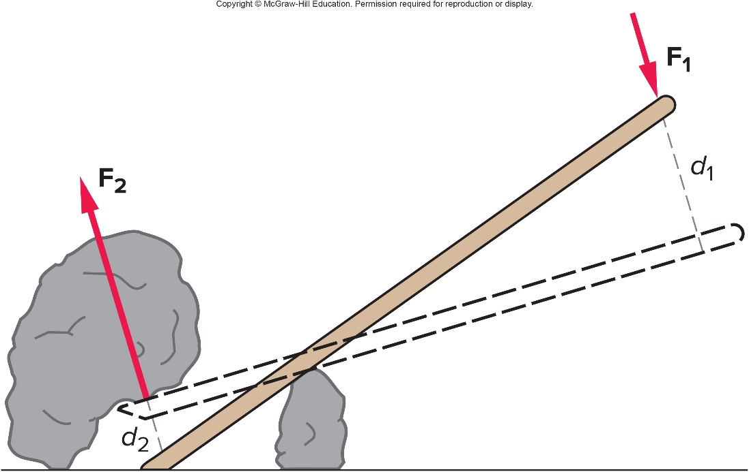
Simple Machines, Work, and Power 1
A simple machine multiplies the effect of an applied force.
  For example, a lever :
A small force applied to one end delivers a large force to the rock.
The small force acting through a large distance moves the rock a small distance.

Slide 5
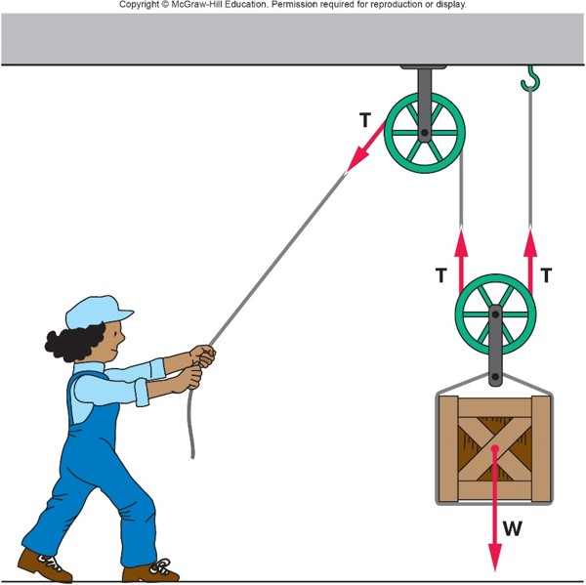
Simple Machines, Work, and Power 2
A simple machine multiplies the effect of an applied force.
  For example, a pulley :
A small tension applied to one end delivers twice as much tension to lift the box.
The small tension acting through a large distance moves the box a small distance.

Slide 6
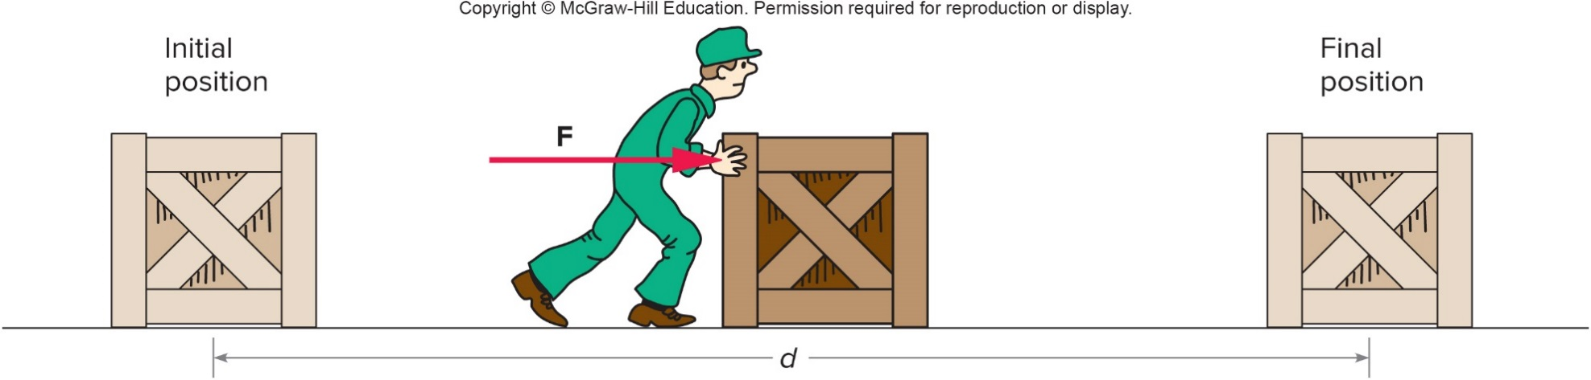
Work
Work is equal to the force applied times the distance moved.
  Work = Force × Distance:
  W = F d
  Work output = Work input
  units: 1 Joule (J) = 1 Nm

Slide 7
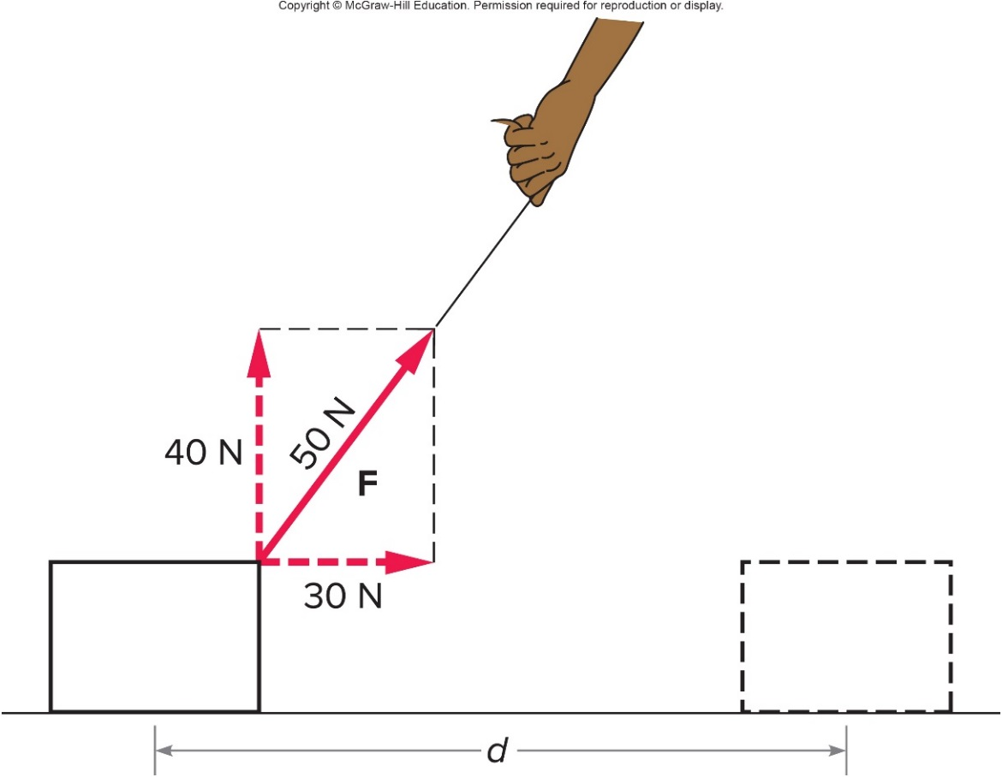
Forces
Only forces parallel to the motion do work.
In this case, with the block sliding horizontally, only the 30N part of the diagonal force does work.
Access the text alternative for slide images.

Slide 8
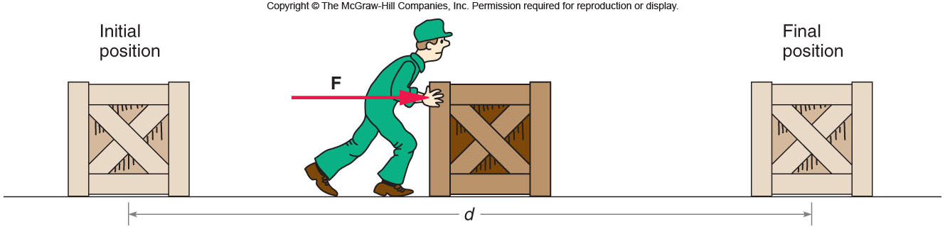
Question 6.1
A crate is being pushed with a constant horizontal force, F. Four forces can be identified: 1) F, 2) the gravitational force, 3) the normal force, and 4) the frictional force. Which forces do NO work on the crate?
1 & 4
2 & 3
2 & 3 & 4
1 & 2 & 3

Slide 9
Answer 6.1
A crate is being pushed with a constant horizontal force, F. Four forces can be identified: 1) F, 2) the gravitational force, 3) the normal force, and 4) the frictional force. Which forces do NO work on the crate?
2 & 3, since they are perpendicular to the motion

Slide 10
Power
Power is the rate of doing work
  Power = Work divided by Time:
  P = W / t
  units: 1 watt (W) = 1 J / s

Slide 11
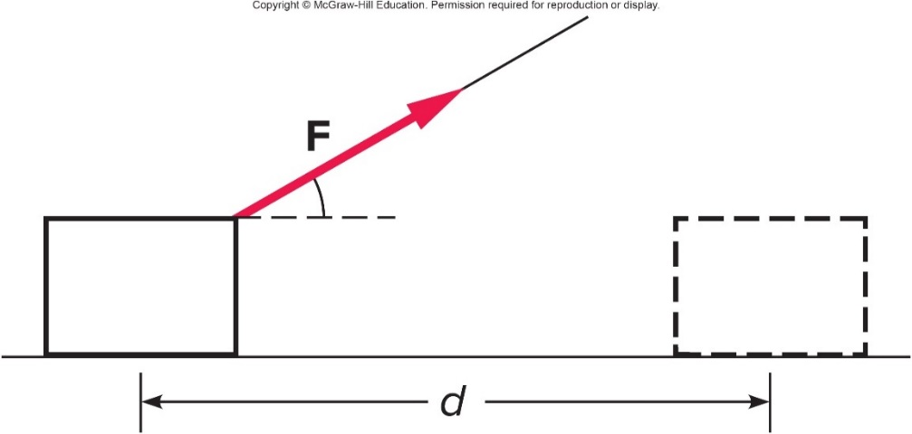
A string is used to pull a wooden block across the floor without accelerating the block. The string makes an angle to the horizontal. Does the force applied via the string do work on the block? 1
a) Yes, the force F does work.
b) No, the force F does no work.
c) Only part of the force F does work.
d) You can’t tell from this diagram.

Slide 12
A string is used to pull a wooden block across the floor without accelerating the block. The string makes an angle to the horizontal. Does the force applied via the string do work on the block? 2
a) Yes, the force F does work.
b) No, the force F does no work.
c) Only part of the force F does work.
d) You can’t tell from this diagram.
c) Only the part of the force that is parallel to the distance moved does work on the block. This is the horizontal part of the force F.

Slide 13
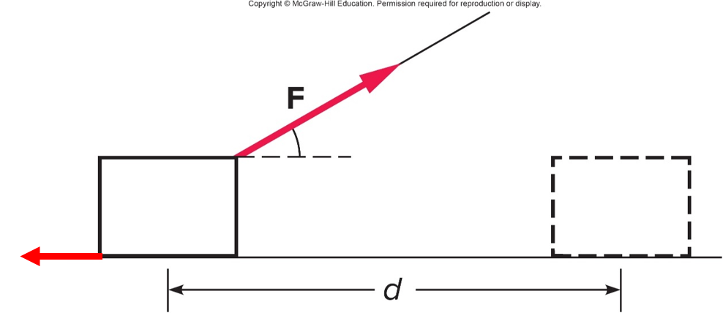
If there is a frictional force opposing the motion of the block, does this frictional force do work on the block? 1
a) Yes, the frictional force does work.
b) No, the frictional force does no work.
c) Only part of the frictional force does work.
d) You can’t tell from this diagram.

Slide 14
If there is a frictional force opposing the motion of the block, does this frictional force do work on the block? 2
a) Yes, the frictional force does work.
b) No, the frictional force does no work.
c) Only part of the frictional force does work.
d) You can’t tell from this diagram.
a) Yes. Since the frictional force is antiparallel to the distance moved, it does negative work on the block.

Slide 15
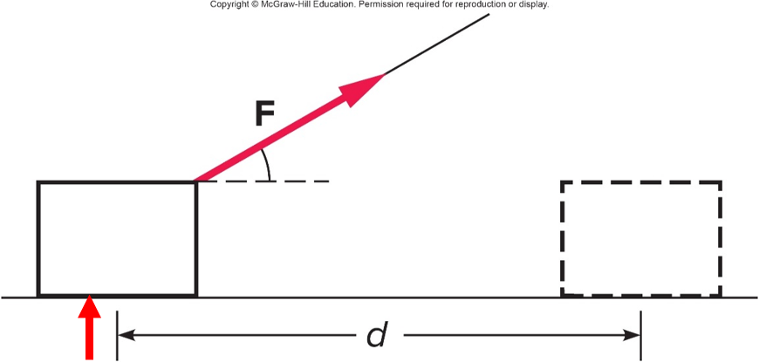
Does the normal force of the floor pushing upward on the block do any work? 1
a) Yes, the normal force does work.
b) No, the normal force does no work.
c) Only part of the normal force does work.
d) You can’t tell from this diagram.

Slide 16
Does the normal force of the floor pushing upward on the block do any work? 2
a) Yes, the normal force does work.
b) No, the normal force does no work.
c) Only part of the normal force does work.
d) You can’t tell from this diagram.
b) No. Since the normal force is perpendicular to the distance moved, it does no work on the block.

Slide 17
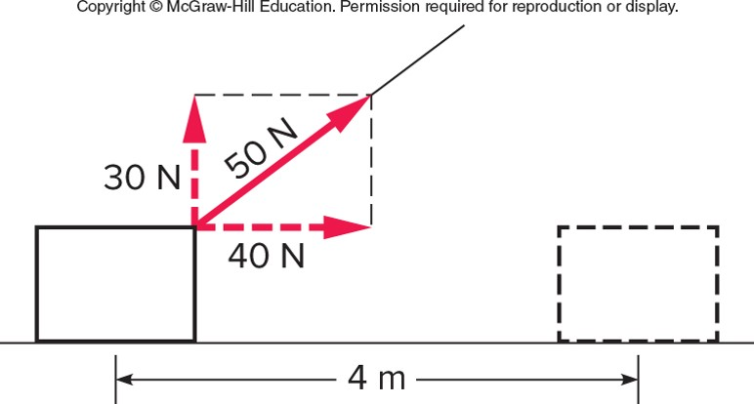
A force of 50 N is used to drag a crate 4 m across a floor. The force is directed at an angle upward from the crate as shown. What is the work done by the horizontal component of the force? 1
a) 120 J
b) 160 J
c) 200 J
d) 280 J
e) 0 J

Slide 18
A force of 50 N is used to drag a crate 4 m across a floor. The force is directed at an angle upward from the crate as shown. What is the work done by the horizontal component of the force? 2
a) 120 J
b) 160 J
c) 200 J
d) 280 J
e) 0 J
b) The horizontal component of force is 40 N and is in the direction of motion. W = F · d = (40 N) · (4 m) = 160 J.

Slide 19
What is the work done by the vertical component of the force? 1
a) 120 J
b) 160 J
c) 200 J
d) 280 J
e) 0 J

Slide 20
What is the work done by the vertical component of the force? 2
a) 120 J
b) 160 J
c) 200 J
d) 280 J
e) 0 J
e) The vertical component of force is 30 N but isn’t in the direction of motion: W = F · d = (30 N) · (0 m) = 0 J.

Slide 21
What is the total work done by the 50-N force? 1
a) 120 J
b) 160 J
c) 200 J
d) 280 J
e) 0 J

Slide 22
What is the total work done by the 50-N force? 2
a) 120 J
b) 160 J
c) 200 J
d) 280 J
e) 0 J
b) Only the component of force in the direction of motion does work: W = F · d = (40 N) · (4 m) = 160 J.

Slide 23
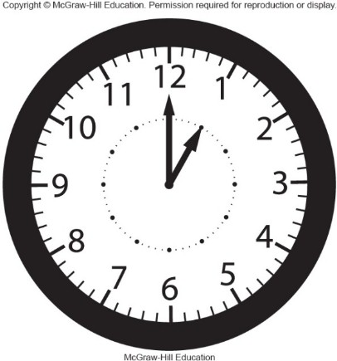
Question 6.2
If an equivalent amount of work is done in a shorter period of time
more power is required
the same amount of power is required
less power is required
McGraw-Hill Education

Slide 24
Answer 6.2
If an equivalent amount of work is done in a shorter period of time
more power is required, power is work per unit time

Slide 25
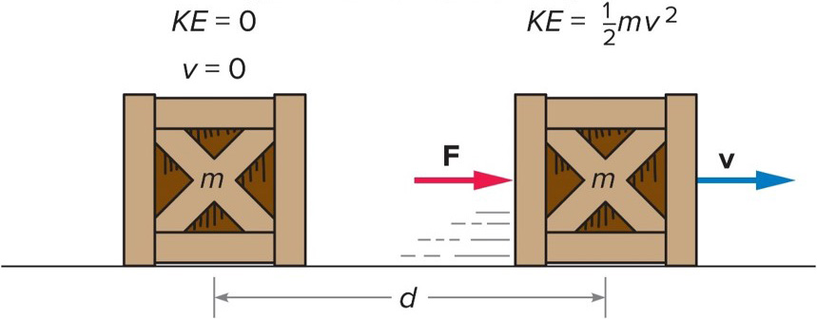
Kinetic Energy 1
Kinetic energy is the energy associated with an object’s motion.
  Doing work on an object increases its kinetic energy.
Work done = change in kinetic energy
Access the text alternative for slide images.

Slide 26
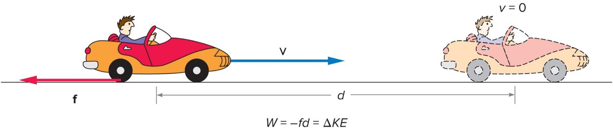
Kinetic Energy 2
Negative work is the work done by a force acting in a direction opposite to the object’s motion.
  For example, a car skidding to a stop
  What force is acting to slow the car?

Slide 27
Question 6.3
If objects A and B have the same mass, but object B has 9X the kinetic energy of object A, what is true of their speeds?
v_{B} = 9v_{A}
v_{B} = 3v_{A}
9v_{B} = v_{A}
3v_{B} = v_{A}

Slide 28
Answer 6.3
If objects A and B have the same mass, but object B has 9X the kinetic energy of object A, what is true of their speeds?
v_{B} = 3v_{A}
Since KE is proportional to the velocity squared, if the velocity has tripled, the KE will increase by a factor of 3² or 9.

Slide 29
Question 6.4
Compare the kinetic energy of two balls:
ball 1: mass m thrown with speed 2v
ball 2: mass 2m thrown with speed v
KE₁ = 4KE₂
KE₁ = KE₂
2KE₁ = KE₂
KE₁ = 2KE₂

Slide 30
Answer 6.4
Compare the kinetic energy of two balls:
ball 1: mass m thrown with speed 2v
ball 2: mass 2m thrown with speed v
KE₁ = 2KE₂
KE₁ = ½ m(2v)² = ½ mv²(4)
KE₂ = ½ 2m(v)² = ½ mv²(2)

Slide 31
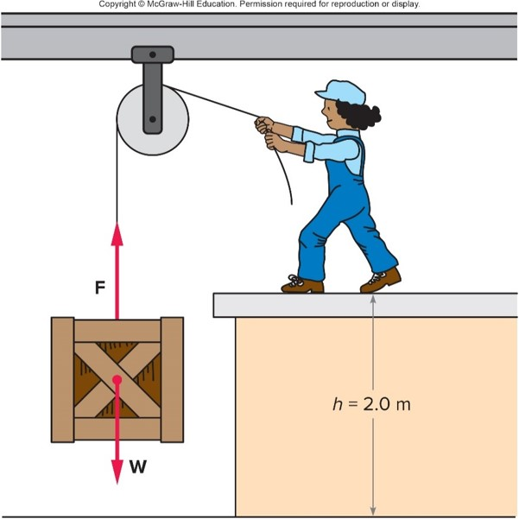
Potential Energy 1
If work is done but no kinetic energy is gained, we say that the potential energy has increased.
  For example, if a force is applied to lift a crate, the gravitational potential energy of the crate has increased.
  The work done is equal to the force (mg) times the distance lifted (height).
  The gravitational potential energy equals mgh.
PE_{g}=mgh

Slide 32
Question 6.6
A truck, initially at rest, rolls down a frictionless hill and attains a speed of 20 m/s at the bottom. To achieve a speed of 40 m/s at the bottom, how many times higher must the hill be?
half the height
the same height
12 times the height
twice the height
four times the height

Slide 33
Answer 6.6
A truck, initially at rest, rolls down a frictionless hill and attains a speed of 20 m/s at the bottom. To achieve a speed of 40 m/s at the bottom, how many times higher must the hill be?
four times the height
If the speed has doubled, then the kinetic energy is 4X as much. Therefore the initial potential energy must be 4X as much.

Slide 34
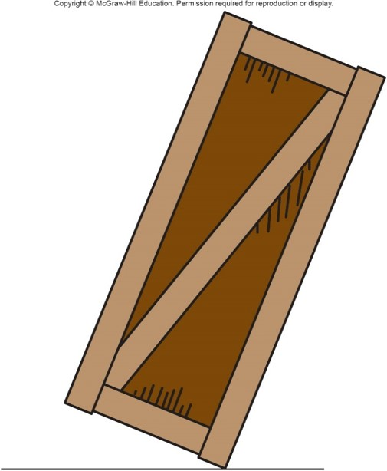
Work is done on a large crate to tilt the crate so that it is balanced on one edge, rather than sitting squarely on the floor as it was at first. Has the potential energy of the crate increased? 1
a) Yes
b) No

Slide 35
Work is done on a large crate to tilt the crate so that it is balanced on one edge, rather than sitting squarely on the floor as it was at first. Has the potential energy of the crate increased? 2
a) Yes
b) No
a) Yes. The center of the crate has been lifted slightly. If it is released it will fall back and convert the potential energy into kinetic energy.

Slide 36
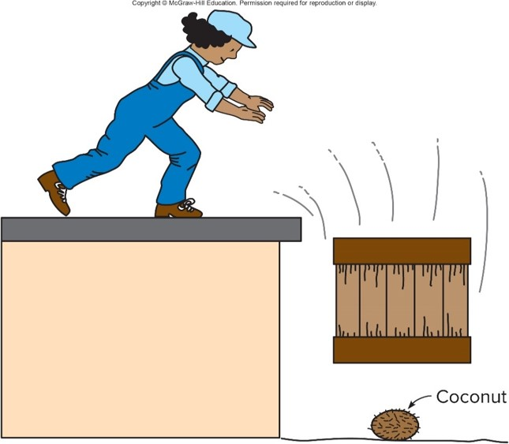
Potential Energy 2
The term potential energy implies storing energy to use later for other purposes.
  For example, the gravitational potential energy of the crate can be converted to kinetic energy and used for other purposes.

Slide 37
Problem
A monkey carries a coconut of mass 2.0 kg to a height of 10 m. Calculate the potential energy of the coconut and the work done by the monkey in getting the coconut to that height.

Slide 38
Problem solution
P=mgh
=(2.0kg)(9.8m/s²)(10m)= 196J

Slide 39
Question 6.7
Potential energy is energy that an object possesses because of its
position
motion
temperature
conductivity

Slide 40
Answer 6.7
Potential energy is energy that an object possesses because of its
position

Slide 41
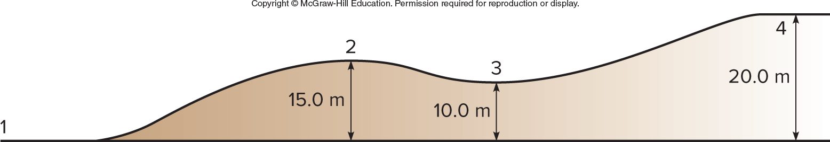
Question 6.8
A cart starts with velocity v and rolls up the frictionless path shown. At what point is the potential energy greatest?
1
2
3
4

Slide 42
Answer 6.8
A cart starts with velocity v and rolls up the frictionless path shown. At what point is the potential energy greatest?
4, since the potential energy depends on the position. Highest position—most potential energy.

Slide 43
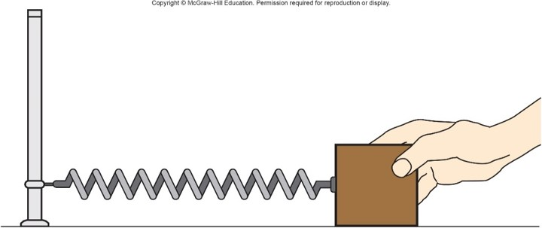
Potential Energy 3
An elastic force is a force that results from stretching or compressing an object.
Elastic potential energy is the energy gained when work is done to stretch a spring.
  The spring constant, k, is a number describing the stiffness of the spring.

Slide 44
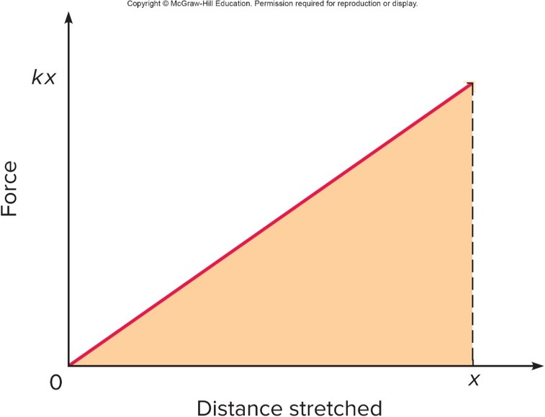
Potential Energy 4
The increase in elastic potential energy is equal to the work done by the average force needed to stretch the spring.

Slide 45
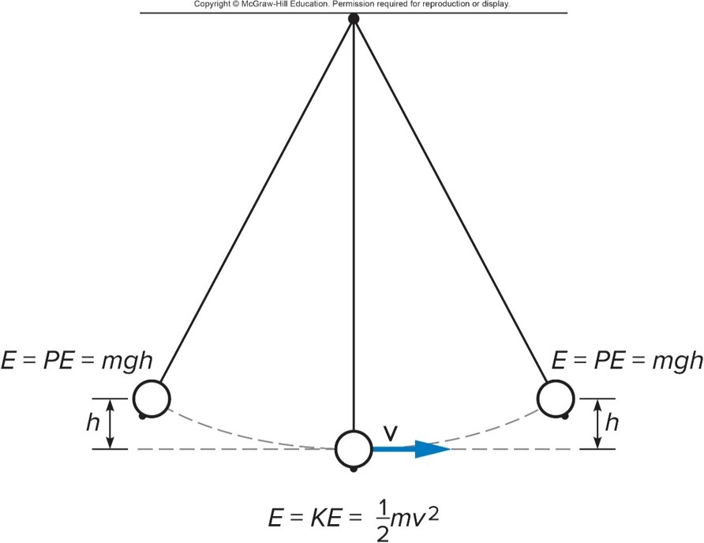
Conservative Forces
Conservative forces are forces for which the energy can be completely recovered.
  Gravity and elastic forces are conservative.
  Friction is not conservative.

Slide 46
Conservation of Energy
Conservation of energy means the total energy (the kinetic plus potential energies) of a system remain constant.
  Energy is conserved if there are no non-conservative forces doing work on the system.

Slide 47
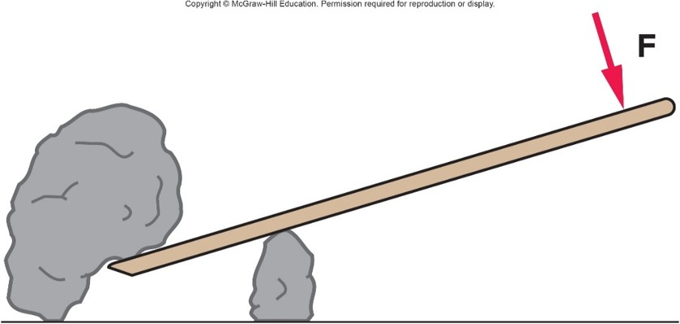
A lever is used to lift a rock. Will the work done by the person on the lever be greater than, less than, or equal to the work done by the lever on the rock? 1
a) Greater than
b) Less than
c) Equal to
d) Unable to tell
e) from this diagram

Slide 48
A lever is used to lift a rock. Will the work done by the person on the lever be greater than, less than, or equal to the work done by the lever on the rock? 2
a) Greater than
b) Less than
c) Equal to
d) Unable to tell
e) from this diagram
c) Equal to. The work done by the person can never be less than the work done by the lever on the rock. If there are no dissipative forces they will be equal. This is a consequence of the conservation of energy.

Slide 49
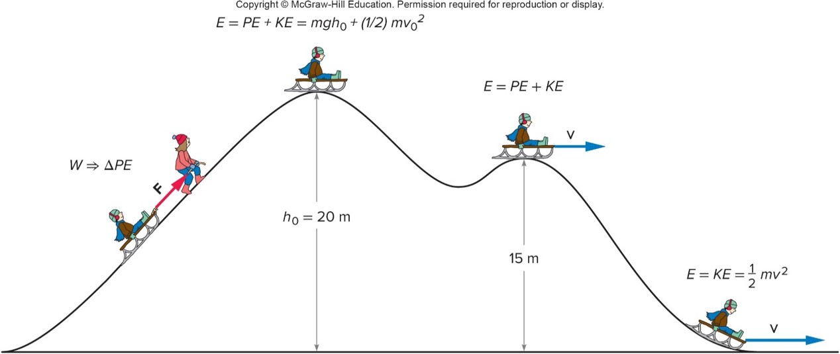
Potential Energy and Kinetic Energy
  Work done in pulling a sled up a hill produces an increase in potential energy of the sled and rider.
  This initial energy is converted to kinetic energy as they slide down the hill.

Slide 50
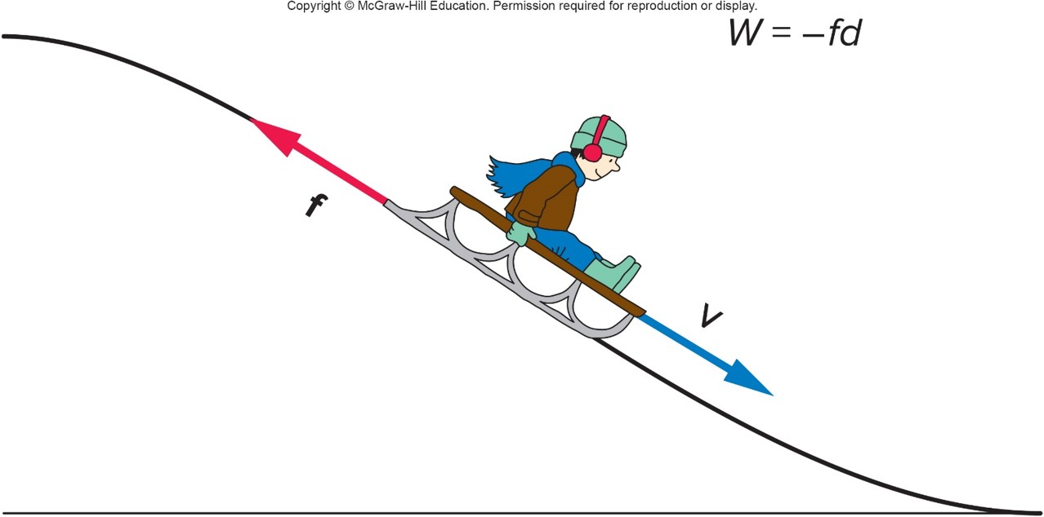
Frictional Forces
  Any work done by frictional forces is negative.
  That work removes mechanical energy from the system.

Slide 51
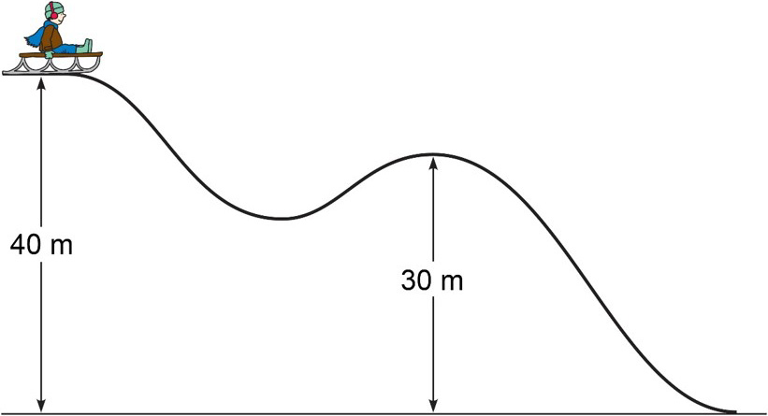
A sled and rider with a total mass of 50 kg are perched at the top of the hill shown. Suppose that 2000 J of work is done against friction as the sled travels from the top (at 40 m) to the second hump (at 30 m). Will the sled make it to the top of the second hump if no kinetic energy is given to the sled at the start of its motion? 1
a) yes
b) no
c) It depends.

Slide 52
A sled and rider with a total mass of 50 kg are perched at the top of the hill shown. Suppose that 2000 J of work is done against friction as the sled travels from the top (at 40 m) to the second hump (at 30 m). Will the sled make it to the top of the second hump if no kinetic energy is given to the sled at the start of its motion? 2
a) yes
b) no
c) It depends.
a) Yes. The difference between the potential energy at the first point and the second point, plus loss to friction is less than the potential energy at the start of the motion. The sled will still have kinetic energy at the top of the second hump.

Slide 53
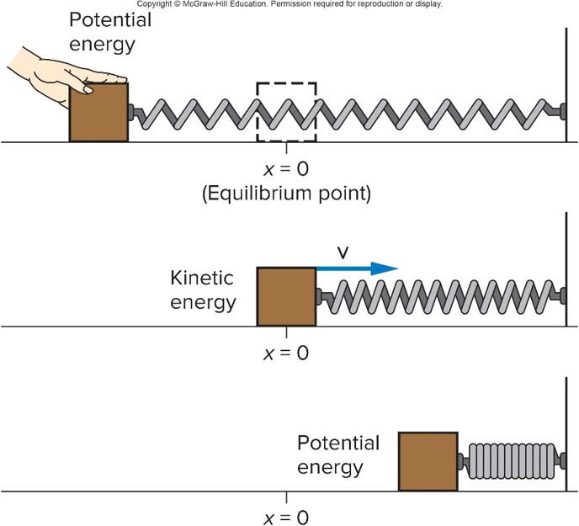
Springs and Simple Harmonic Motion 1
Simple harmonic motion occurs when the energy of a system repeatedly changes from potential energy to kinetic energy and back again.
Energy added by doing work to stretch the spring is transformed back and forth between potential energy and kinetic energy.

Slide 54
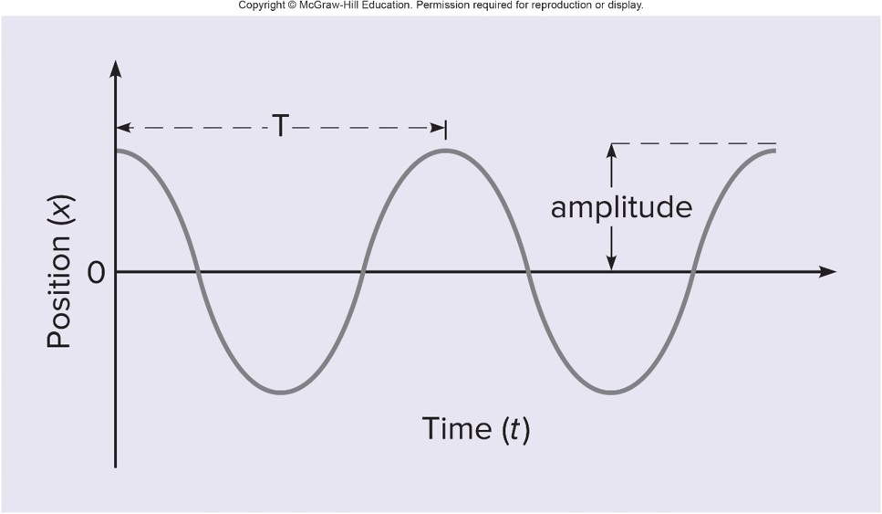
The horizontal position x of the mass on the spring is plotted against time as the mass moves back and forth.
  The period T is the time taken for one complete cycle.
  The frequency f is the number of cycles per unit time.
  The amplitude is the maximum distance from equilibrium.

Slide 55
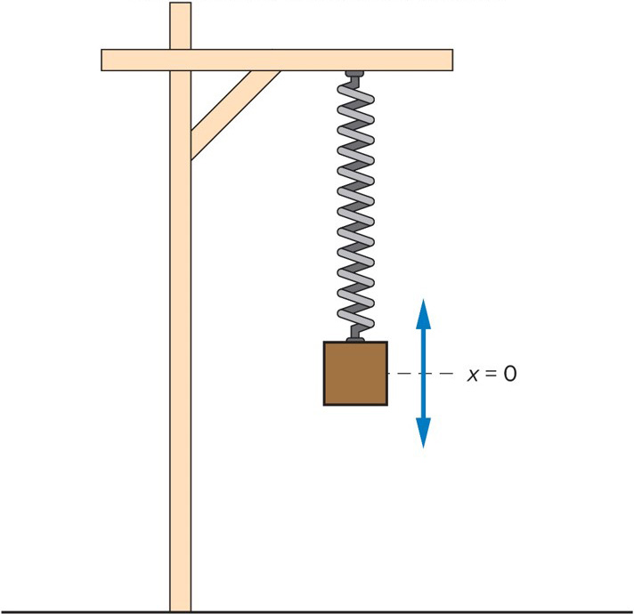
Forces and Simple Harmonic Motion
A restoring force is a force that exerts a push or a pull back towards equilibrium.
A restoring force that increases in direct proportion to the distance from equilibrium results in simple harmonic motion.

Slide 56
Springs and Simple Harmonic Motion 2
In simple harmonic motion the acceleration is NOT constant.
The velocity is maximum as it goes through the equilibrium position.
The velocity is zero at the extremes of the motion.

Slide 57
Springs and Simple Harmonic Motion 3
For a spring the elastic potential energy is
The spring constant, k, is a measure of how stiff a spring is.
The variable x represents the distance from equilibrium.

