Slide 1
Chapter 2-Class 2
Describing Motion
Exam 1 study guide problems posted
The Physics of Everyday Phenomena
Copyright 2022 © McGraw Hill LLC. All rights reserved. No reproduction or distribution without the prior written consent of McGraw Hill LLC.

Slide 2
Videos to watch
https://www.youtube.com/watch?v=rZo8-ihCA9E
This first video is about velocity, speed and acceleration
https://www.youtube.com/watch?v=4J-mUek-zGw
This one is about the Position vs. Time Graph

Slide 3
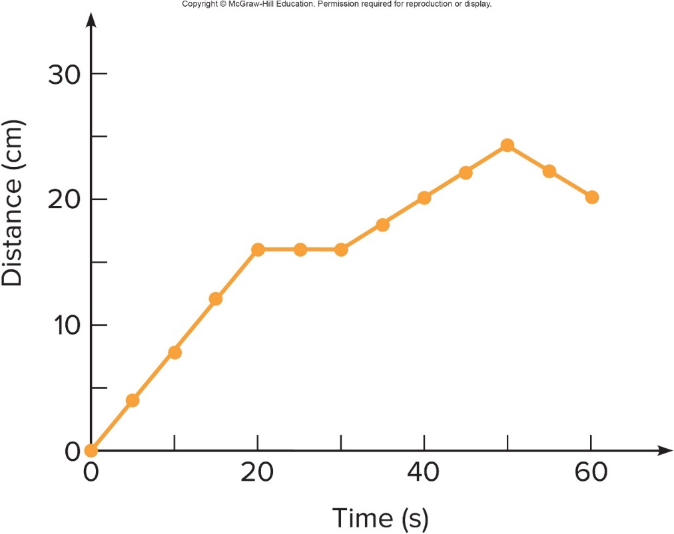
To graph the data in the table, let the horizontal axis represent time, and the vertical axis represent distance.
Each interval on an axis represents a fixed quantity of distance or time.
The first data point is at 0 seconds and 0 cm.
The second data point is at 5 seconds and 4.1 cm. Etc.

Slide 4
The graph displays information in a more useful manner than a simple table. It is much easier to determine the answers to the following questions with a graph.
When is the car moving the fastest?
When is it moving the slowest?
When is the car not moving at all?
At what time does the car start moving in the opposite direction?

Slide 5
The slope on the distance-versus-time graph represents the velocity.
Slope is change in vertical quantity divided by change in horizontal quantity.
“rise over run”
steepest “slope” is between 0 s and 20 s, this is where it is moving the fastest.
slope is zero (flat) between 20 s and 30 s, here it is not moving. Notice that here the value of the distance doesn’t change.

Slide 6

The slope on the distance-versus-time graph represents the velocity.
At what time does the car start moving in the opposite direction?

Slide 7

The slope on the distance-versus-time graph represents the velocity. 3
At what time does the car start moving in the opposite direction?
The slope is negative between 50 s and 60 s. This would imply the velocity is negative, it has thus changed direction. Note that the value for the distance has decreased.

Slide 8
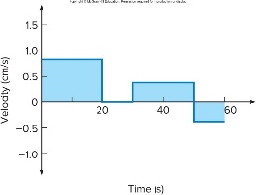

To summarize the car’s velocity information, let the horizontal axis represent time, and the vertical axis represent velocity.
The velocity is constant wherever the slope of the distance-vs-time graph is constant.
The velocity changes only when the distance graph’s slope changes.

Slide 9
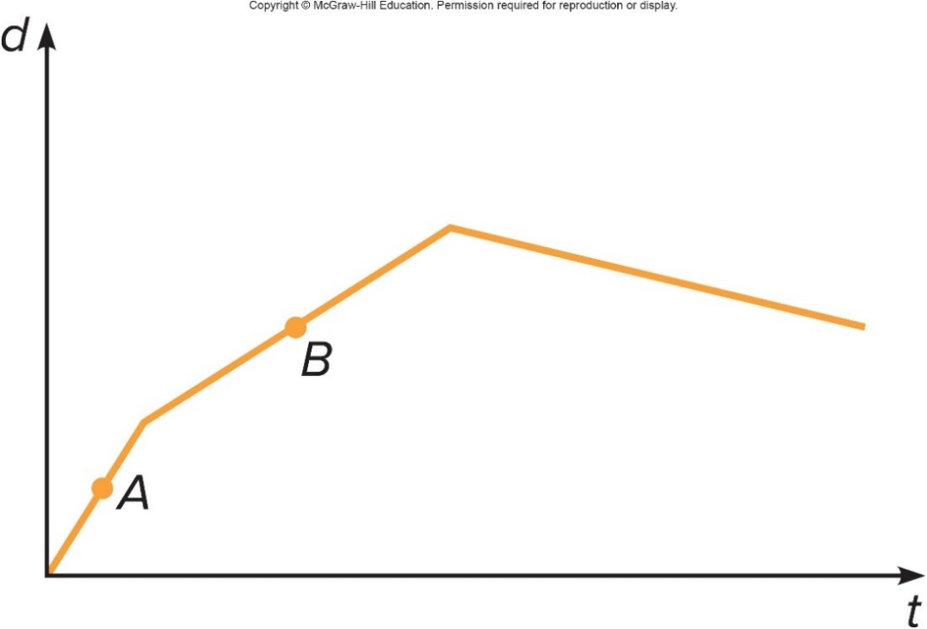
The graph shows the position of a car with respect to time. Does the car ever go backward (assume no u-turn)? 1
a) Yes, during the first segment (labeled A).
b) Yes, during the second segment (labeled B).
c) Yes, during the third segment (not labeled).
d) No, never.

Slide 10

The graph shows the position of a car with respect to time. Does the car ever go backward (assume no u-turn)? 2
c) Yes. The distance traveled is decreasing during the third segment, so at this time the car is moving backward (in reverse).

Slide 11
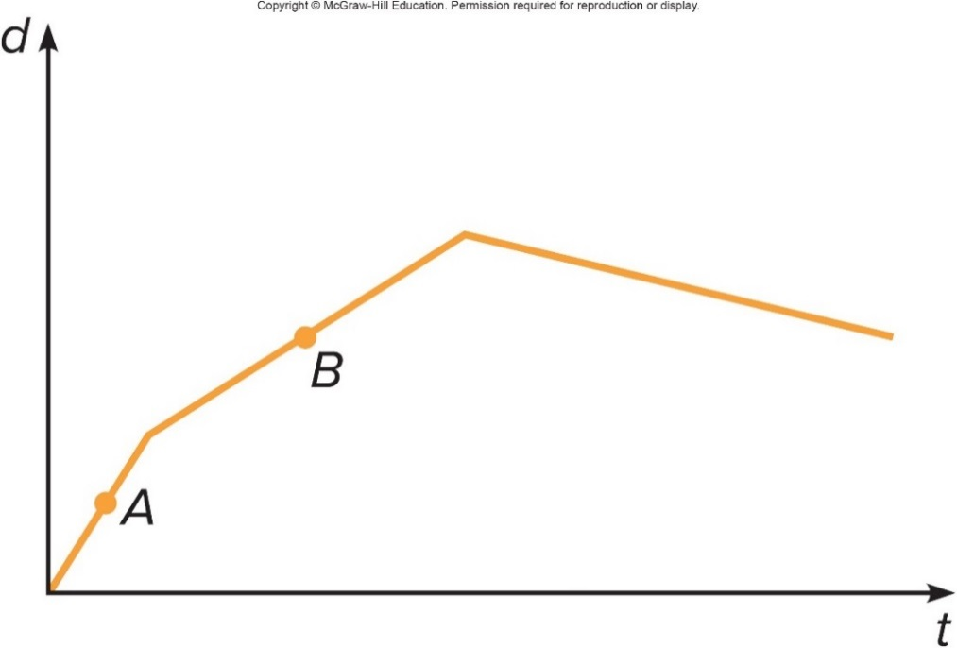
Is the instantaneous velocity at point A greater or less than that at point B? 1
a) Greater than
b) Less than
c) The same as
d) Unable to tell from this graph

Slide 12
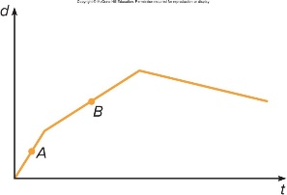
Is the instantaneous velocity at point A greater or less than that at point B? 2
a) Greater than
b) Less than
c) The same as
d) Unable to tell from this graph
a) The instantaneous velocities can be compared by looking at their slopes. The steeper slope indicates the greater instantaneous velocity, so the velocity at A is greater.

Slide 13
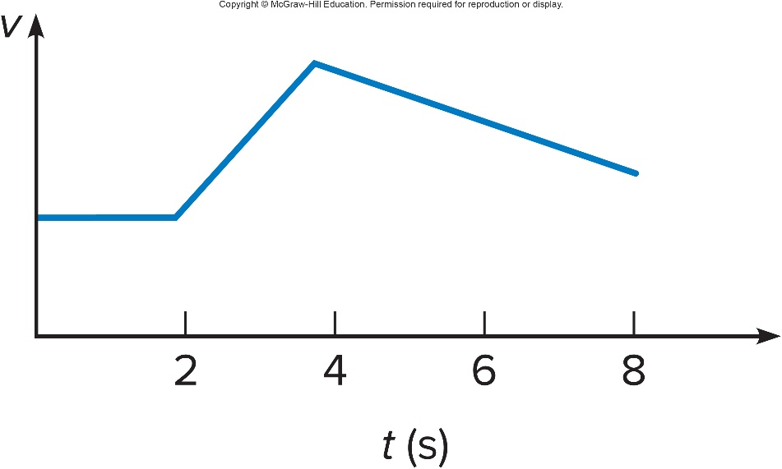
In the graph shown, is the velocity constant for any time interval? 1
a) Yes, between 0 s and 2 s.
b) Yes, between 2 s and 4 s.
c) Yes, between 4 s and 8 s.
d) Yes, between 0 s and 8 s.
e) No, never.
The slope at any point on the velocity-versus-time graph represents the acceleration

Slide 14
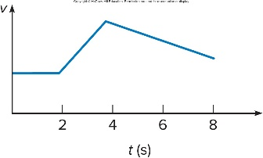
In the graph shown, is the velocity constant for any time interval? 2
a) Yes, between 0 s and 2 s.
b) Yes, between 2 s and 4 s.
c) Yes, between 4 s and 8 s.
d) Yes, between 0 s and 8 s.
e) No, never.
a) The velocity is constant between 0 s and 2 s. The velocity is not changing during this interval, and the graph is flat, it has a slope of zero. Note that this is a graph of velocity, not of distance.

Slide 15

In the graph shown, during which time interval is the acceleration greatest? 1
a) Between 0 s and 2 s.
b) Between 2 s and 4 s.
c) Between 4 s and 8 s.
d) The acceleration does not change.

Slide 16
In the graph shown, during which time interval is the acceleration greatest? 2
b) The graph is steepest and has the greatest slope between 2 s and 4 s, the velocity is changing fastest during this interval making the acceleration the greatest.

Slide 17
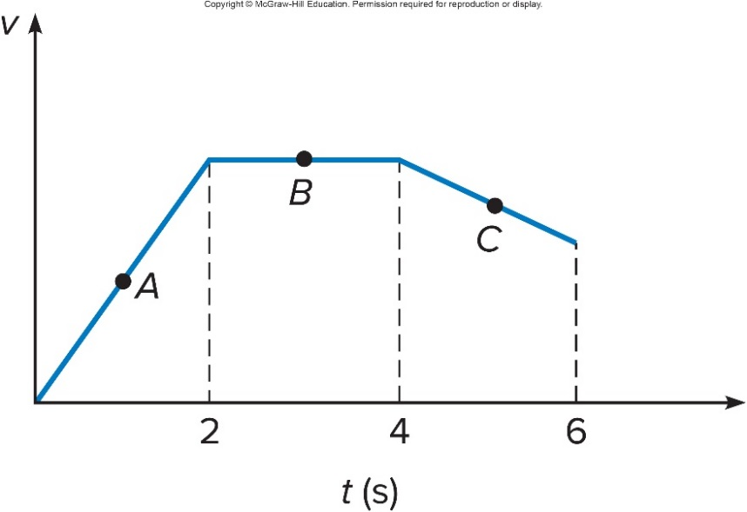
At which point is the magnitude of the acceleration the greatest? 1
a) Point A
b) Point B
c) Point C
d) The acceleration does not change.

Slide 18

At which point is the magnitude of the acceleration the greatest?
a) Point A
b) Point B
c) Point C
d) The acceleration does not change.
a) The magnitude of the acceleration is greatest when the velocity is changing the fastest. This is where the graph of velocity versus time is steepest (has the greatest slope), so point A.

Slide 19

During which time interval is the distance traveled by the car the greatest? 1
a) Between 0 s and 2 s.
b) Between 2 s and 4 s.
c) Between 4 s and 6 s.
d) It is the same for all time intervals.

Slide 20
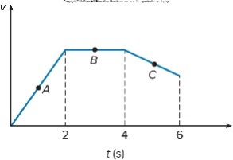
During which time interval is the distance traveled by the car the greatest? 2
a) Between 0 s and 2 s.
b) Between 2 s and 4 s.
c) Between 4 s and 6 s.
d) It is the same for all time intervals.
b) The distance traveled is greatest when the area under the velocity curve is greatest. This occurs between 2 s and 4 s.

Slide 21
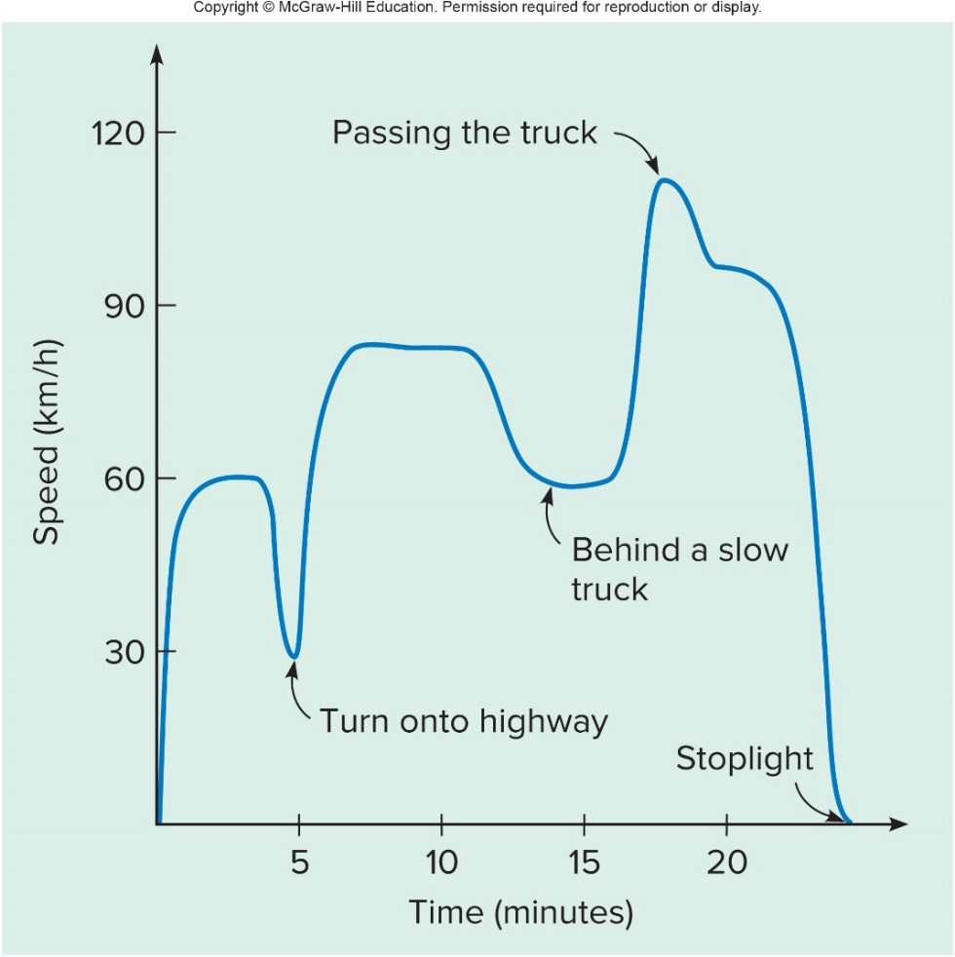
The graph of the speed of a car traveling on a local highway illustrates the relationship between acceleration and velocity.
A steep slope indicates a rapid change in velocity (or speed), and thus a large acceleration.
A horizontal line has zero slope and represents zero acceleration, so the object is moving with constant velocity.

Slide 22
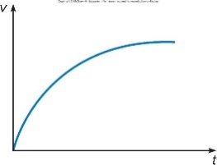
The velocity graph of an object is shown. Is the acceleration of the object constant? 1
a) Yes.
b) No.
c) It is impossible to determine from this graph.

Slide 23
The velocity graph of an object is shown. Is the acceleration of the object constant? 2
a) Yes.
b) No.
c) It is impossible to determine from this graph.
b) No, the acceleration is NOT constant. The slope of the velocity curve gradually decreases with time, so the acceleration is decreasing. Initially the velocity is changing quite rapidly, but as time goes on the velocity reaches a maximum value and then remains constant.

Slide 24
Uniform Acceleration
Uniform Acceleration is the simplest form of acceleration.
  It occurs whenever there is a constant force acting on an object.
  Most of the examples we consider will involve constant acceleration.
    A falling rock or other falling object.
    A car accelerating at a constant rate.
  The acceleration does not change as the motion proceeds.

Slide 25
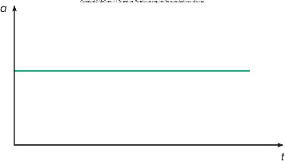
The acceleration graph for uniform acceleration is a horizontal line. The acceleration does not change with time.
For example, a car moving along a straight road and speeding up at a constant rate would have a constant acceleration.
Notice that, even though the acceleration is not changing, the speed is changing. It is just changing at a constant rate.

Slide 26
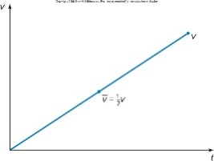
The velocity graph for uniform acceleration is a straight line with a constant slope. The slope of the velocity graph is equal to the acceleration.
For this example, the car starts out with zero initial velocity.
The velocity then increases at a steady rate.

Slide 27
Problem 3
Starting from rest and moving in a straight line, a runner achieves a speed of 7.0 m /s in a time of 4.5 seconds. Determine the average acceleration of the runner.

Slide 28
Problem 4
The velocity of a car decreases from 25 m/ s to 12 m / s in a time of 4.2 seconds. What is the average acceleration of the car?

Slide 29
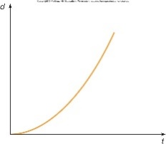
The distance graph for uniform acceleration has a constantly increasing slope, due to a constantly increasing velocity. The distance covered grows more and more rapidly with time.
The distance at any instant is velocity times the time at that instant.
The total distance covered is average velocity times the total elapsed time.

Slide 30
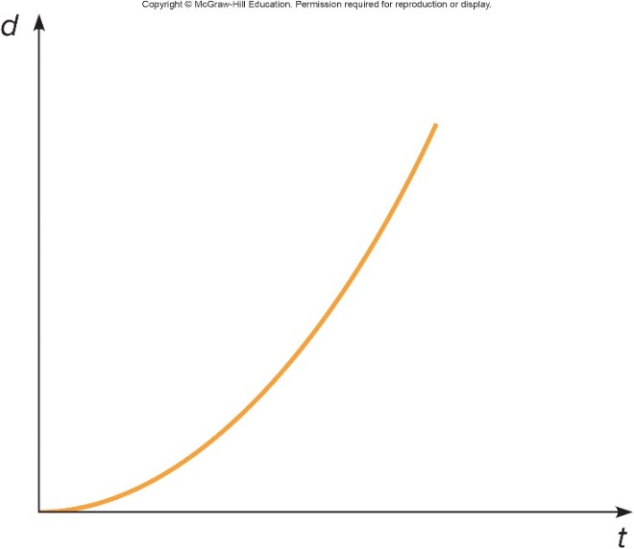
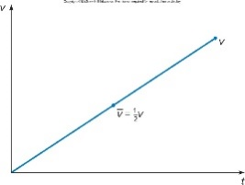
The distance traveled is equal to the area under the velocity graph, for example, the triangular area under the blue curve below.
If the car starts out with zero initial velocity, the final velocity is at and the average velocity is 1/2(at).

Slide 31
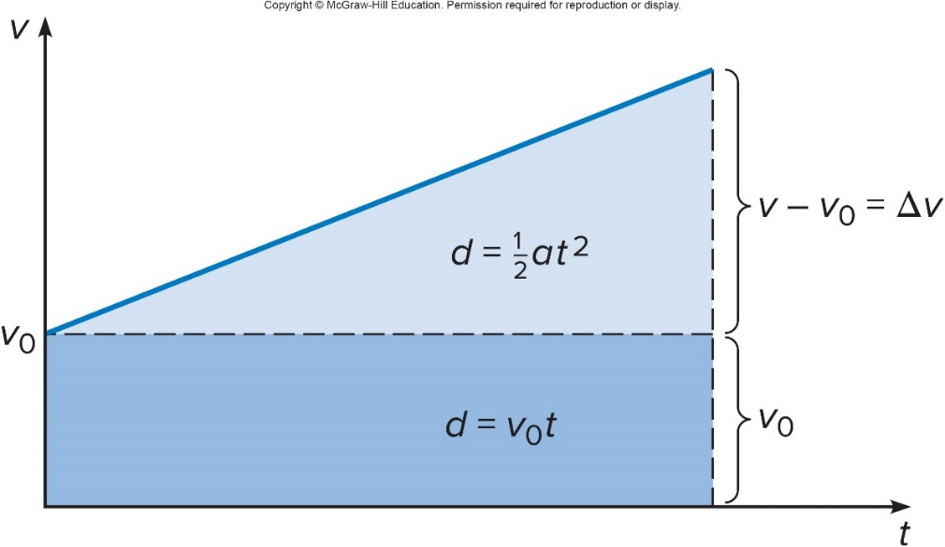
For a non-zero initial velocity, the total distance covered is the area of the triangle plus the area of the rectangle as shown below.
The first term is the area of the rectangle, representing the distance the object would travel if it moved with constant velocity
for a time t.
The second term is the area of the triangle, representing the additional distance traveled due to the acceleration.

Slide 32
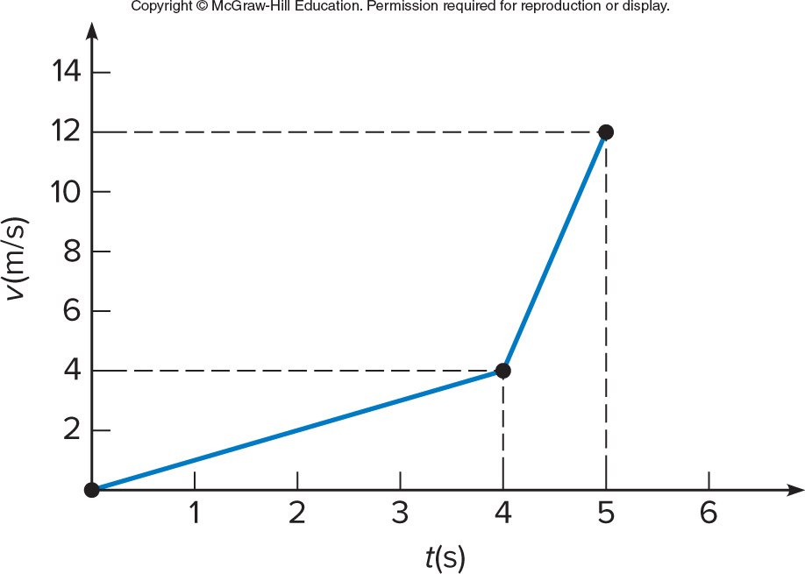
The velocity of a car increases with time as shown. What is the average acceleration between 4 s and 5 s? 1
a)
b)
c)
d)
e)

Slide 33
The velocity of a car increases with time as shown. What is the average acceleration between 4 s and 5 s? 2
a)
b)
c)
d)
e)
c)

Slide 34
Graphs are helpful in describing motion
As you can see, you can retrieve a lot of information from a simple graph.
Learning to interpret the different graphs is time well spent. Be sure to notice the axes labels! For example, a negative slope on a distance graph means an object is moving in the opposite direction. Yet a negative slope on a velocity graph (when the speed is positive) means the speed is decreasing.

